Slide 1

©JudithHadfield2026
©TheWOWShow2026
Notes:
References: The WOW Show
An Online Television Show on Careers - The WOW Show
The WOW Show – YouTube
Film link – www.youtube.com/watch?v=QuC-E0GBbbk

Slide 2
Careers Learning Objectives
Recognise the breadth of the modern labour market, including emerging and lesser‑known roles (Gatsby Benchmark 2).
Identify personal strengths, interests and values and link them to possible career pathways.
Understand different routes into work, including apprenticeships, technical education, university and workplace training (Gatsby Benchmark 7).
Develop essential employability skills, including communication, teamwork, problem‑solving and adaptability.
Use reliable careers information sources, including The WOW Show website and YouTube channel, to explore future options (Gatsby Benchmark 1).
Use the lesson as a slideshow to order animations correctly. Thank you
©JudithHadfield2026
©TheWOWShow2026
Notes:
References: The WOW Show
An Online Television Show on Careers - The WOW Show
Film link – www.youtube.com/watch?v=QuC-E0GBbbk
Career Development Institute
Film link - Give us a minute - YouTube

Slide 3

1
Starter – Future Snapshots
Starter quiz (5 mins)
Write down your first thoughts on the following questions.
In pairs or as a group discuss your answers.
Don’t worry if you have some blanks, not everyone knows what career they would like to do when they leave school.
Write down one career that you are interested in.
Write down one career you have heard of but don’t understand
Write down one career that you don’t think will exist in 20 years
©JudithHadfield2026
©TheWOWShow2026
©TheWOWShow2026
Notes:
References: The WOW Show
An Online Television Show on Careers - The WOW Show
The WOW Show - YouTube
Film link – www.youtube.com/watch?v=QuC-E0GBbbk

Slide 4
2
Watch The WOW Show film
Take time to watch The WOW Show film, ‘Give us a minute’, highlighting the variety of careers out there.
Click here for the film.
Give us a minute - YouTube
©VotesforSchools2020
©TheWOWShow2026
Notes:
References: The WOW Show
An Online Television Show on Careers - The WOW Show
The WOW Show - YouTube
Film link – www.youtube.com/watch?v=QuC-E0GBbbk

Slide 5

3
Guided Discussion
Over the next few slides, discuss as a pair or in a group, the following questions.
Construction and apprenticeships
What skills did the apprentice carpenter or crane driver mention?
How do these roles challenge stereotypes?
©JudithHadfield2026
©TheWOWShow2026
Notes:
References: The WOW Show
An Online Television Show on Careers - The WOW Show
The WOW Show - YouTube
Film link - Give us a minute - YouTube

Slide 6

3
Guided Discussion
Hospitality and global opportunities
What surprised you about the training at Wivenhoe House Hotel or The Edge Hotel School?
How could hospitality lead to travel?
©JudithHadfield2026
©TheWOWShow2026
Notes:
References: The WOW Show
An Online Television Show on Careers - The WOW Show
The WOW Show - YouTube
Film link - Give us a minute - YouTube

Slide 7

3
Guided Discussion
Creative Industries
How did the fashion photography student create her own opportunities?
What technical roles exist behind theatre, film and music production?
©JudithHadfield2026
©TheWOWShow2026
Notes:
References: The WOW Show
An Online Television Show on Careers - The WOW Show
The WOW Show - YouTube
Film link - Give us a minute - YouTube

Slide 8
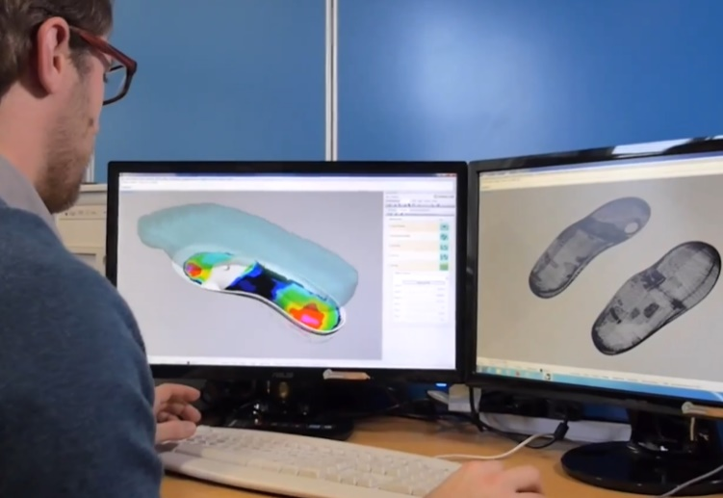
3
Guided Discussion
Health and Science roles
What did you learn about podiatry or working as a dietician that you didn’t know before?
©JudithHadfield2026
©TheWOWShow2026
Notes:
References: The WOW Show
An Online Television Show on Careers - The WOW Show
The WOW Show - YouTube
Film link - Give us a minute - YouTube

Slide 9
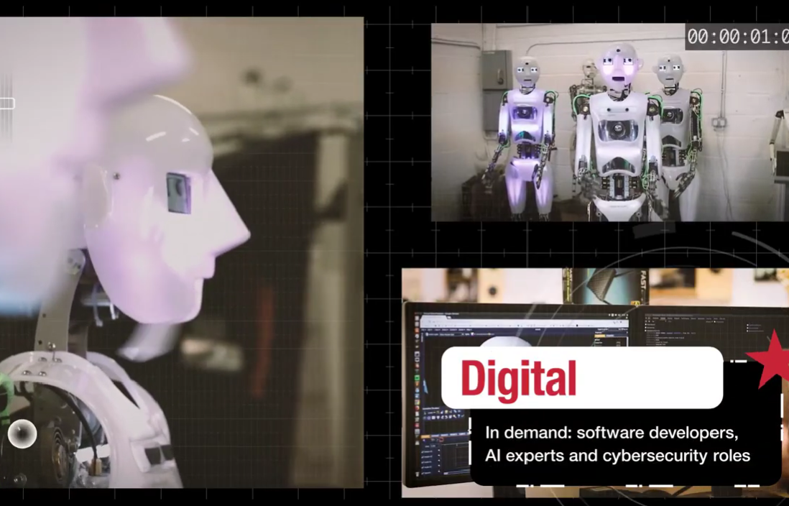
3
Guided Discussion
Technology and Robotics
How is technology shaping careers in design, music and construction?
©JudithHadfield2026
©TheWOWShow2026
Notes:
References: The WOW Show
An Online Television Show on Careers - The WOW Show
The WOW Show - YouTube
Film link - Give us a minute - YouTube

Slide 10

3
Guided Discussion
Armed forces
What range of roles exist in the Navy beyond the ones you expected?
©JudithHadfield2026
©TheWOWShow2026
Notes:
References: The WOW Show
An Online Television Show on Careers - The WOW Show
The WOW Show - YouTube
Film link - Give us a minute - YouTube

Slide 11

3
Guided Discussion
Soft skills
Which soft skills were mentioned?
Why do you think employers value them as much as qualifications?
©JudithHadfield2026
©TheWOWShow2026
Notes:
References: The WOW Show
An Online Television Show on Careers - The WOW Show
The WOW Show - YouTube
Film link - Give us a minute - YouTube

Slide 12

4a
Classroom idea – Career Clusters Carousel
Go to one of the stations and complete the following activities
List the careers from that sector shown in the film
Add two more careers that belong in that sector
Identify and record one key skill needed in that sector
©JudithHadfield2026
©TheWOWShow2026
Notes:
References: The WOW Show
An Online Television Show on Careers - The WOW Show
The WOW Show - YouTube
Film link - Give us a minute - YouTube

Slide 13

4b
Classroom idea – Skill spotting Challenge
Work in pairs or small groups for the following:
Pick one career from the film
Identify the technical and soft skills shown and needed
Map the skills to your own strengths
©JudithHadfield2026
©TheWOWShow2026
Notes:
References: The WOW Show
An Online Television Show on Careers - The WOW Show
The WOW Show - YouTube
Film link - Give us a minute - YouTube

Slide 14

4c
Classroom idea – Research using The WOW Show
Use The WOW Show YouTube channel and website to research the following:
One career of interest not shown in the film
Note what that career involves
Identify the training route
Find one surprising fact
©JudithHadfield2026
©TheWOWShow2026
Notes:
References: The WOW Show
An Online Television Show on Careers - The WOW Show
The WOW Show - YouTube
Film link - Give us a minute - YouTube

Slide 15
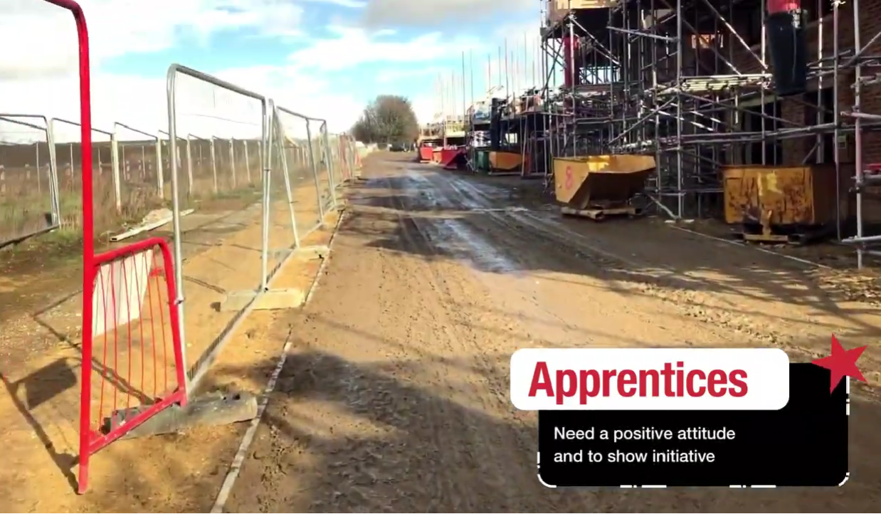
4d
Classroom idea – Routes into… Pathway Maps
Choose one career from the film and create a pathway map showing the following:
GCSE subjects that help
Post 16 options (A level, T level, apprenticeships, etc)
Training and qualifications
Where could the career lead in 5-10 years?
©JudithHadfield2026
©TheWOWShow2026
Notes:
References: The WOW Show
An Online Television Show on Careers - The WOW Show
The WOW Show - YouTube
Film link - Give us a minute - YouTube

Slide 16
5
Refection and Plenary
Complete one of the following:
One career I’d like to explore further is …
One skill I want to develop is …
One thing that surprised me in the film was …
©JudithHadfield2026
©TheWOWShow2026
Notes:
References: The WOW Show
An Online Television Show on Careers - The WOW Show
The WOW Show - YouTube
Film link - Give us a minute - YouTube

Slide 17
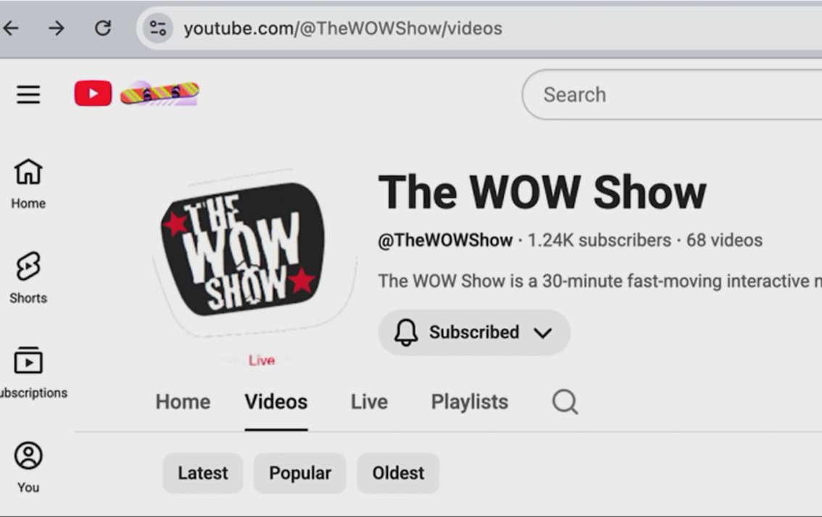
6
Optional Homework – choose any of the following:
Extra ideas for homework
Explore The WOW Show website or YouTube channel and write a short profile of a career that interests you.
Interview a family member about their career path and compare it to what is currently available.
Create a mini advertising poster about one career from the film, including skills, training, salary and future opportunities.
©JudithHadfield2026
©TheWOWShow2026
Notes:
References: The WOW Show
An Online Television Show on Careers - The WOW Show
The WOW Show - YouTube
Film link - Give us a minute - YouTube

Slide 18
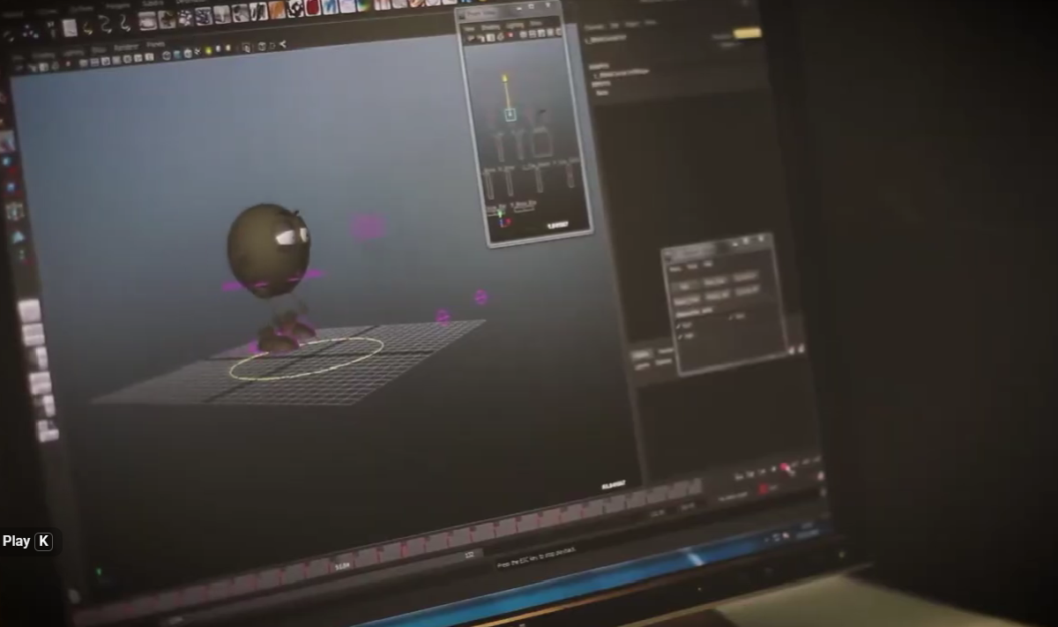
7
Extension Lesson – Future Skills and You
Explore how automation, AI and robotics (as shown in the film) are changing work.
Try predicting which careers might grow, change or completely disappear.
Link your own strengths and how you can gain experience and build skills for the career of your choice.
©JudithHadfield2026
©TheWOWShow2026
Notes:
References: The WOW Show
An Online Television Show on Careers - The WOW Show
The WOW Show - YouTube
Film link - Give us a minute - YouTube

Slide 19

8
Further help and information:
Useful links:
Construction Training Courses & Qualifications (Construction Tickets) – CITB Hospitality The Edge Hotel School - Wivenhoe House Hotel Health https://www.healthcareers.nhs.uk Navy Royal Navy Jobs | Royal Navy UCAS website https://www.ucas.com/careers-advice National Careers Week 2026 Countdown - NCW 2026 Virtual Careers Fair | Apprenticeship advice Find an apprenticeship - GOV.UK Apprenticeships The City and Guilds qualifications and apprenticeships: https://www.cityandguilds.com/apprenticeships Apprenticeship advice: https://www.gov.uk/topic/further-education-skills/apprenticeships | BBC Bitesize is also a good source of information: https://www.bbc.co.uk/bitesize/careers The National Careers Service: https://nationalcareers.service.gov.uk/ The WOW Show An Online Television Show on Careers - The WOW Show The WOW Show – YouTube The film link Give us a minute - YouTube
©JudithHadfield2026
©VotesforSchools2020
©TheWOWShow2026
Notes:
References: The WOW Show
An Online Television Show on Careers - The WOW Show
The WOW Show - YouTube

