Slide 1


Making a Difference – A Health Careers Special
Lesson 3
In association with

Slide 2
Learning objectives for today
To learn about different types of work, including employment, self-employment and voluntary work; that everyone has a ‘career’; their pathway through education and work.
To work as a team, setting goals, working together, negotiation, managing setback and conflict.
To understand more about cancer and cancer prevention, including healthy lifestyles; acknowledge that childhood cancers are rarely caused by lifestyle choices.
Keywords
Pressure – Pressure is defined as force per unit area. It is usually more convenient to use pressure rather than force to describe the influences upon fluid behaviour. The standard unit for pressure is the Pascal, which is a Newton per square metre.
Radiation – The emission of energy as electromagnetic waves or as moving subatomic particles, especially high-energy particles which cause ionization.
STEM – Science, Technology, Engineering and Maths.
Biomechanics – The study of the mechanical laws relating to the movement or structure of living organisms.
©VotesForSchools2019

Slide 3


1
What skills did all of the Allied Health careers need?
Reflect and share (2 mins)
When you last accessed healthcare, what was most important to you?
Careers in health need more than qualifications. They need all sorts of people skills, too!
Pair discussion (1 min)
Based on the video, can you think of what these people skills are?
Rapport:
A close and harmonious relationship in which the people or groups concerned understand each other's feelings or ideas and communicate well.
Rapport
Teamwork
Communication
Compassion
©VotesForSchools2019

Slide 4
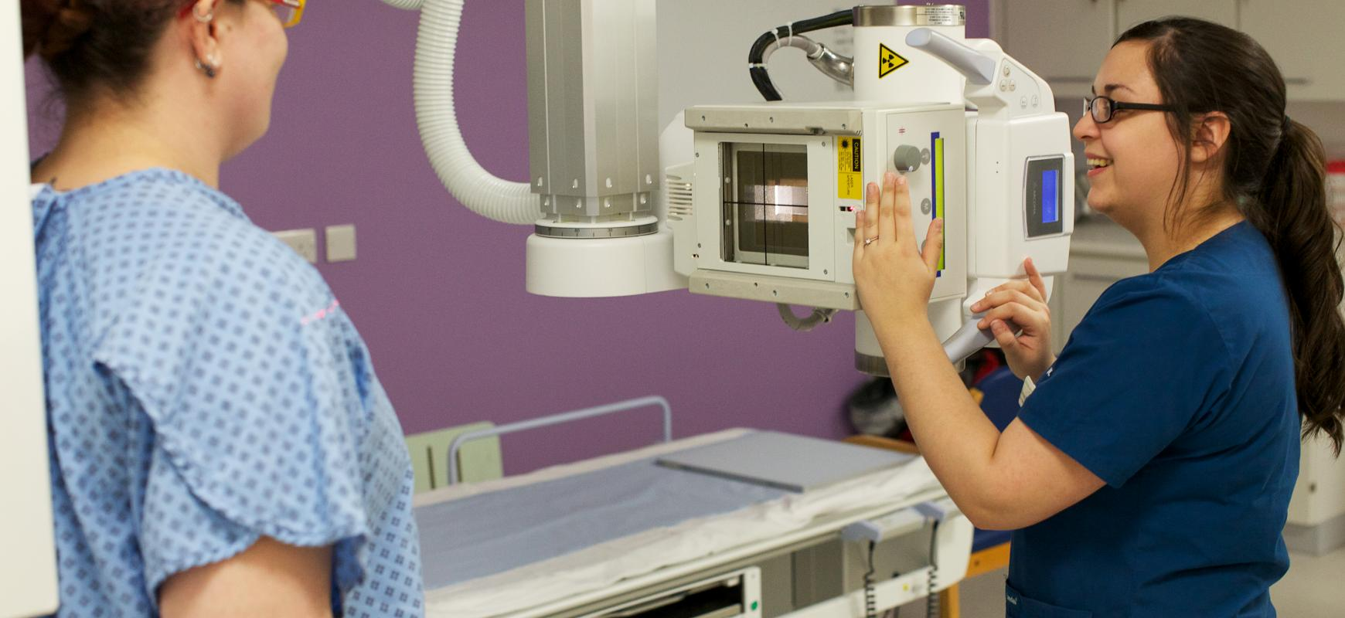
2
What about a career as a radiographer?
0:00-
2:16
Recall (2 mins)
Click the image to watch a video. What were the two ways radiation was used?
Extension:
In your Science lesson you could find out the effects of radiation on healthy cells in the body.
Radiation Therapy (Radiotherapy):
This is a cancer treatment that uses high doses of radiation to kill cancer cells and shrink tumours.
https://www.youtube.com/watch?v=9JxrqT6_5ew
©VotesForSchools2019
Notes:
Images: https://www.healthiernorthwestlondon.nhs.uk/bettercare/ourstaff/radiographycareers
You tube: https://www.youtube.com/watch?v=9JxrqT6_5ew

Slide 5
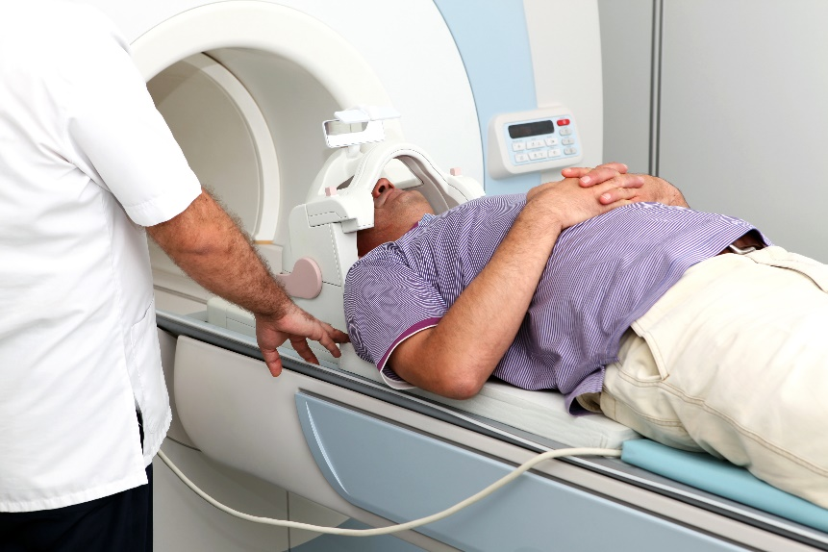
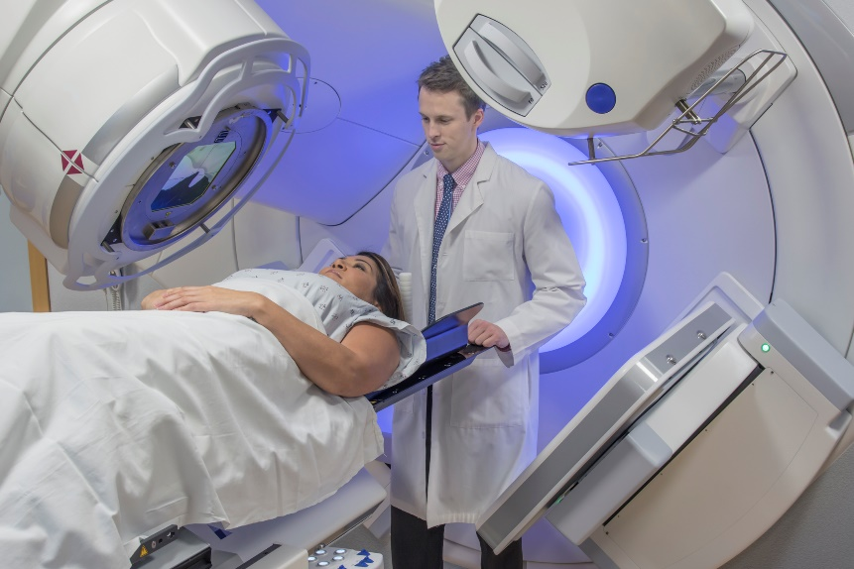
3
How is radiation used for diagnosis and treatment?
Discuss (2 mins)
Can you remember how the radiation was used to treat cancer?
Fun Fact:
Because radiation was found to exist in hot spring waters which were known for their ‘healing powers’, it was marketed as a wonder cure for all sorts of illnesses in Victorian times.
High energy radiation:
This affects the cancer cells to the point that they cannot repair themselves from the damage.
©VotesForSchools2019

Slide 6
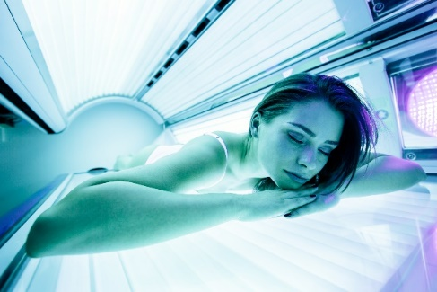
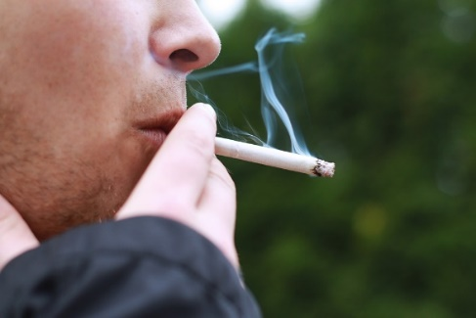
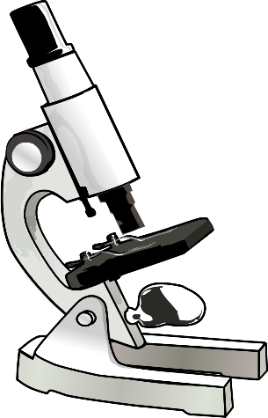
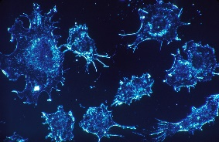
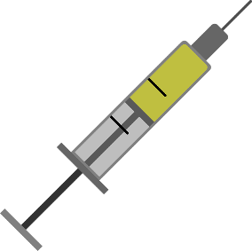
4
What increases the risk factors for cancer?
Discuss (2 mins)
What do you know about cancer? Can you list the things that can cause it? Click for some ideas.
Tanning Booth
Smoking
Cancer cells under a microscope.
Sun’s Rays
Viruses
If you are worried about cancer, or have any questions about the causes, symptoms and treatments,
click here.
Age
Genetics
Human papillomavirus (HPV) vaccine:
Currently, the national NHS HPV vaccination programme uses a vaccine called Gardasil. Gardasil protects against 4 types of HPV: 6, 11, 16 and 18. Between them, types 16 and 18 are the cause of most cervical cancers in the UK.
©VotesForSchools2019
Notes:
Images:
1- https://commons.wikimedia.org/wiki/File:Dr_Kern_tanning_bed.JPG
2- https://pixabay.com/photos/smoking-smoke-cigarette-man-1026556/
3- https://pixabay.com/photos/cancer-cells-cel
4- http://www.publicdomainfiles.com/show_file.php?id=13528377018448ls-scan-541954/
5- https://pixabay.com/illustrations/vaccine-injection-vaccination-2826912/

Slide 7
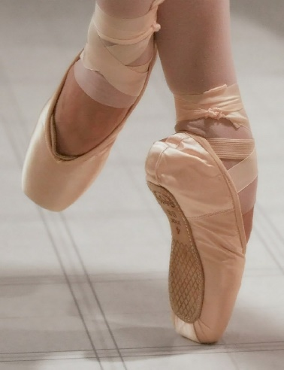
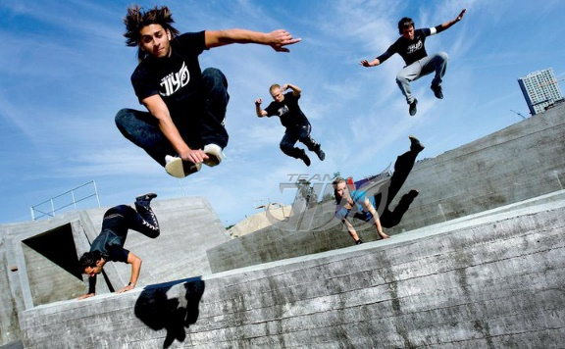
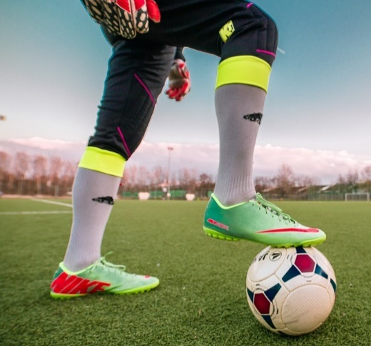
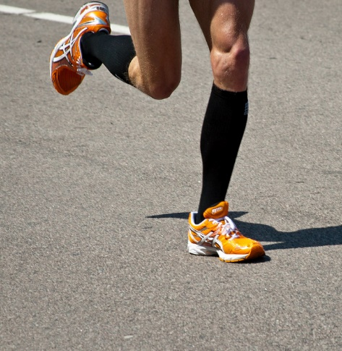
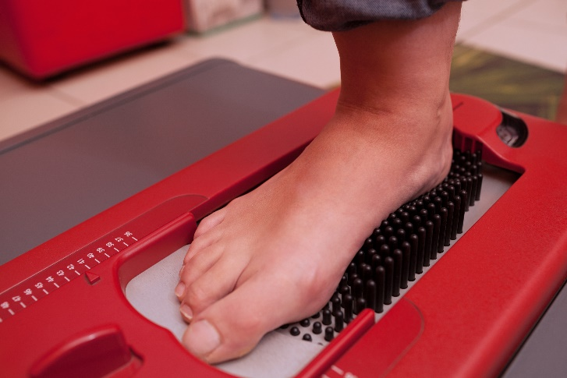
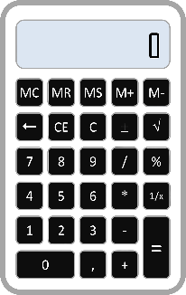
5
Did you realise how important podiatry is in sport?
Discuss (2 mins)
Did you realise how important it is to care for your feet?
What about the pressure that we put on them every day?
Extension:
Use the formula to the right to measure the pressure you put through your feet every day.
Pressure:
The scientific definition of pressure is force per unit area: P = F/A.
https://www.youtube.com/watch?v=T8Hi2sHtJbI&t
Notes:
Wow Show clip: https://www.youtube.com/watch?v=T8Hi2sHtJbI&t Teacher notes: 2:04 minutes clip
Images:
1- https://www.needpix.com/photo/274370/ballet-ballerina-pointe-shoes-ballet-dancers-balance-shoe-dance-toe-woman
2- https://pixabay.com/photos/football-sport-footballers-1274662/
3- https://www.goodfreephotos.com/vector-images/calculator-vector-art.png.php
4- iStock
5- https://commons.wikimedia.org/wiki/File:Team_JiYo_-_pioneerne_indenfor_parkour_i_danmark.jpg

Slide 8
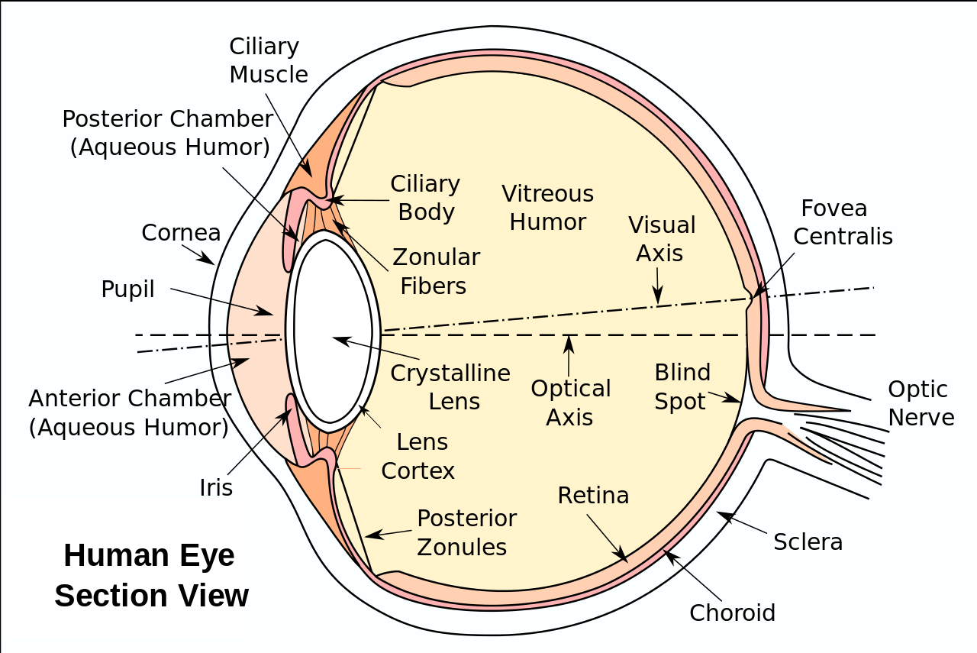
6
Would you like to be an orthoptist?
Reflection (2 mins)
Your eyes need to work and move together to see depth. Try looking at a magic 3D image , then when you see the picture cover one eye? What happens ?
Orthoptists are also specialists in children's vision
They help vision development by prescribing glasses and patching. A patch is put over the eye with the better vision to stop the brain from favouring that eye and to allow the vision from the poorly seeing eye to develop equally.
FUN FACTS
Each eye has 6 muscles that move the eyes up, down, inwards, outwards and in a rotary action.
These muscles are controlled by cranial nerves.
If these nerves are damaged, it will stop the muscle from working in its pair. This will cause a misalignment of the eyes and the patient experiences double vision.
Notes:
Images:
1- https://en.wikipedia.org/wiki/File:Eyesection.svg

Slide 9
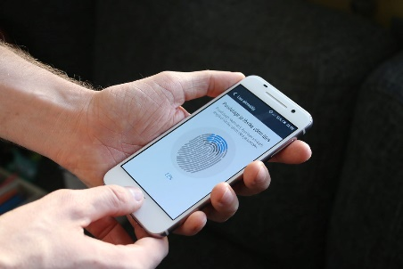
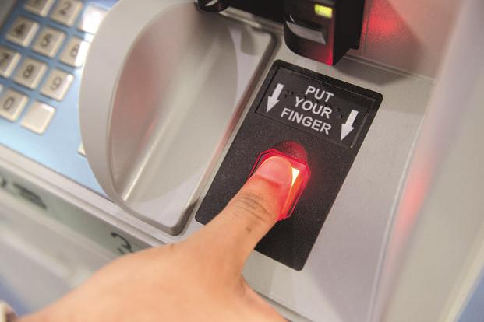
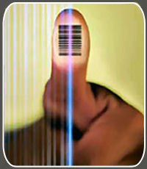
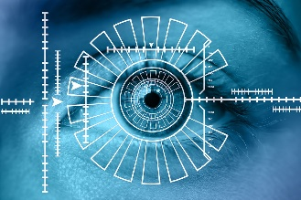
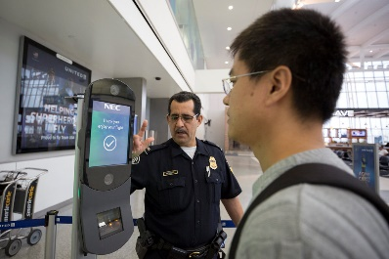


7
Have you ever experienced biometric authentications?
Discuss (2 mins)
Do you think biometric authentication will help prevent crime? Click to see the areas it could help with.
ICT access
Phone access
Bank details
Crime prevention
Security
Fingerprints
Solving crimes
Biometrics authentication:
This is a security process that relies on the unique biological characteristics of an individual to verify that they are who they say they are.
Passports
Notes:
Images:
1- http://www.publicdomainfiles.com/show_file.php?id=13533879019572
2- https://commons.wikimedia.org/wiki/File:British_biometric_passport.jpg
3- https://www.flickr.com/photos/andrikoolme/23075504614
4-https://commons.wikimedia.org/wiki/File:Finger_Print_Login_latest_banking_security_application.png
5- https://pixabay.com/illustrations/eye-iris-biometrics-2771174/
6- https://www.flickr.com/photos/cbpphotos/26902931678
7- https://www.techjuice.pk/bank-biometric-verification-last-date/

Slide 10
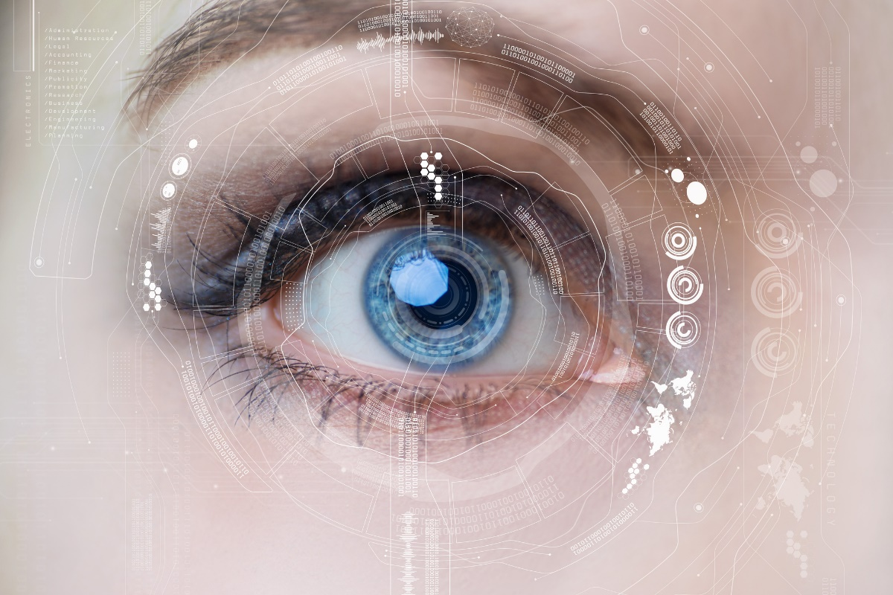
8
Would you trust eye recognition for your personal information?
Fun Fact:
Iris patterns are so distinctive that the probability of two people possessing identical patterns equates to 1 in 10 to the 78th power, meaning your eyes are truly your own, and most likely unique in the entire history of humankind.
Video (2 mins)
Click the eye to watch a video.
0:00-
1:52
Pair discussion
(3-5 mins)
Would you want your eye to be used to access your phone or bank account?
https://safeshare.tv/x/13zFQh7BPG4
Notes:
Alternative video link:
1- https://www.youtube.com/watch?v=13zFQh7BPG4

Slide 11
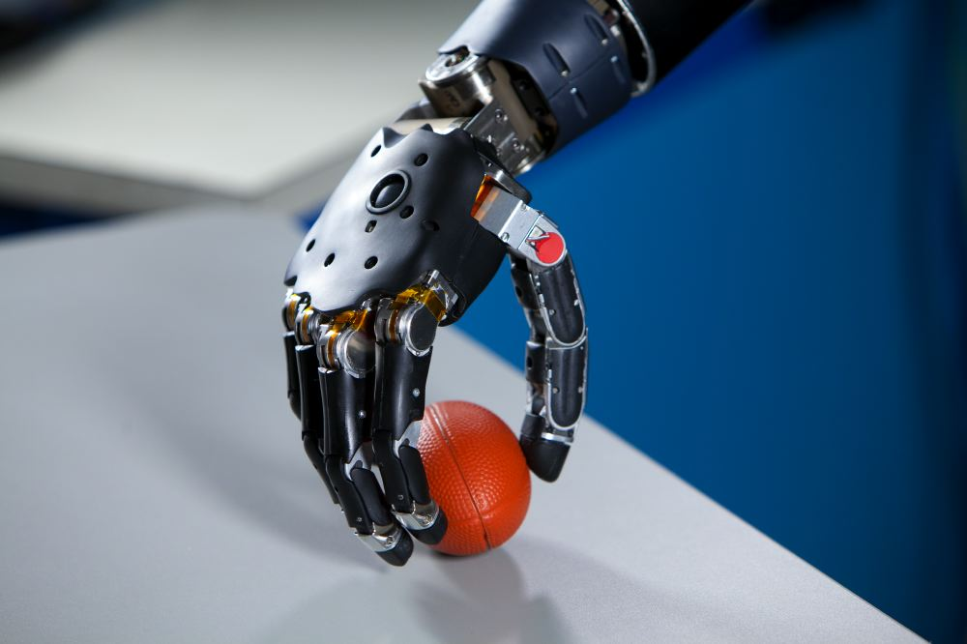
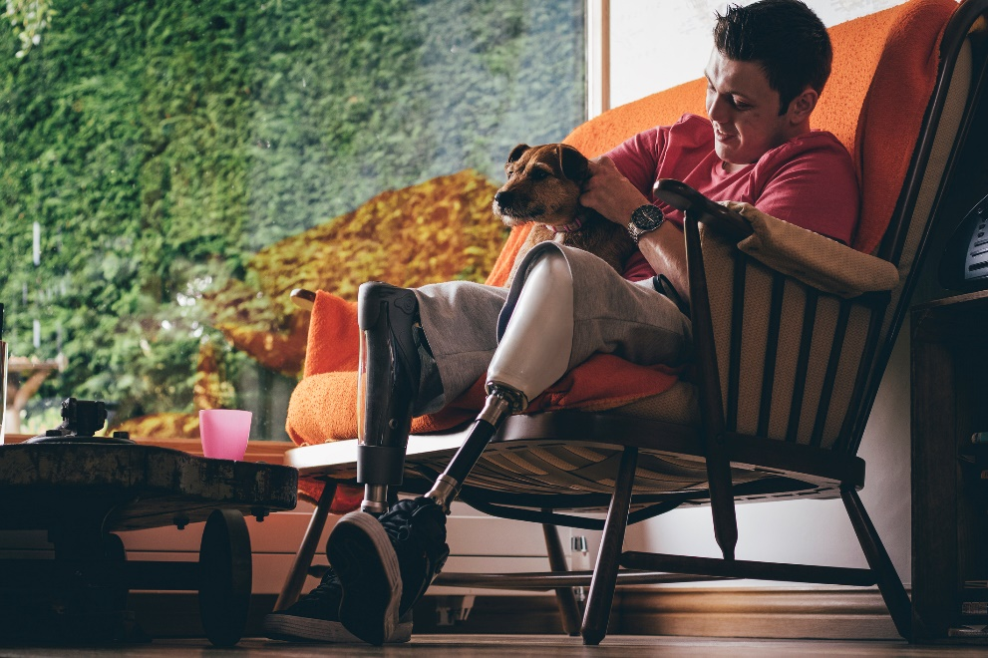
9
How can biomechanics change people’s lives ?
Pair discussion (1 min)
How do prosthetics change people’s everyday lives?
Fun Fact:
Both prosthetists and orthotists use state-of-the-art digital imaging techniques, CAD (computer-aided design) and CAM (computer-aided modelling). In either role, you'll work alongside doctors, nurses, podiatrists, physiotherapists, occupational therapists and technicians.
https://www.youtube.com/watch?v=4s3FF1H9K2o&list=PLffqqalyShWASq-4snzSwTltfOdhvGNlG&index=16&t=0s
©VotesForSchools2019
Notes:
WOW Show clip: https://www.youtube.com/watch?v=4s3FF1H9K2o&list=PLffqqalyShWASq-4snzSwTltfOdhvGNlG&index=16&t=0s
Teacher notes 2:18 minutes
Images:
1- https://pixabay.com/photos/prosthetic-foot-special-model-rehab-2291027/
2- https://www.flickr.com/photos/soldiersmediacenter/4176034443
3- https://commons.wikimedia.org/wiki/File:Brain-Controlled_Prosthetic_Arm_2.jpg
4- https://www.med.navy.mil/sites/nhrc/Features%20Images/Forms/DispForm.aspx?ID=27
5-iStock

Slide 12






10
Which qualifications do you need for a health career?
In the film, there were 14 Allied Health Professions featured. However, there are many more roles in health all with different qualifications required.
Or, you could do a Foundation Degree in Healthcare Practice. This qualification is designed to promote the development of healthcare career pathways, and to prepare healthcare assistant and healthcare support workers for the role of assistant/associate practitioner.
What about an apprenticeship in the healthcare sector?
There are a huge number of apprenticeships designed for clinical and non-clinical roles in the health sector. Apprenticeships enable young people and adult learners to earn while they learn, gaining job-specific skills, a qualification and improved prospects for the future.
For most clinical careers, such as Allied Health Professions nursing or medicine entry is through a degree approved by the Health and Care Professions Council, Nursing and Midwifery Council, General Medical Council or another regulatory body.
©VotesForSchools2019

Slide 13
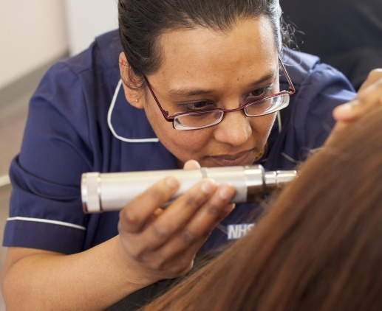
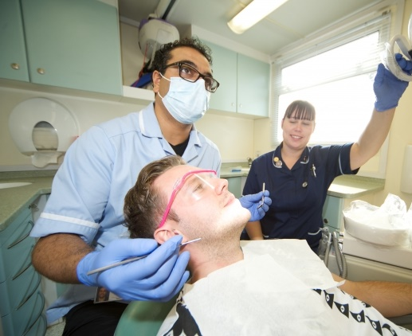
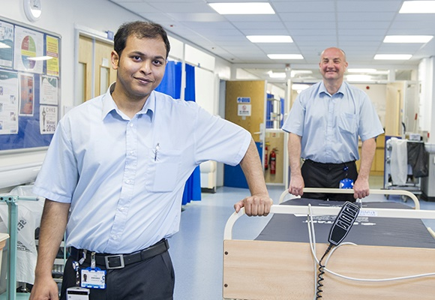
11
Career paths
If any of the 14 AHP roles have excited you and you wish to know more, click the pictures below for more details.
Foundation degree routes
Degree route to AHP
Apprenticeships & Traineeships
©VotesForSchools2019
Notes:
Images:
https://www.healthcareers.nhs.uk/explore-roles/wider-healthcare-team/roles-wider-healthcare-team/clinical-support-staff/assistant-practitioner
https://www.healthcareers.nhs.uk/career-planning/study-and-training/considering-or-university
https://www.healthcareers.nhs.uk/career-planning/study-and-training/apprenticeships-traineeships-and-cadet-schemes
Websites: https://www.healthcareers.nhs.uk/explore-roles/allied-health-professionals
For pathway progression use the link below:
https://www.rsaacademies.org.uk/projects/the-wow-show-health-careers-special-making-a-difference-teacher-resources/

Slide 14
12
Setting goals for your future
Specific:
Specific means that you have to say what you want to do very clearly.
Measurable:
Measurable targets tell you exactly what you need to do to succeed.
Achievable:
An achievable target has to be something you can do.
Relevant:
What I’m going to do needs to help me to achieve what I want.
Timed:
If I don’t know how much time I have, I don’t know when to take action.
©VotesForSchools2019

Slide 15
Making a Difference – A Health Careers Special
Lesson 3
In association with

