Slide 1


Making a Difference – A Health Careers Special
Lesson 2
In association with
©VotesForSchools2019
Notes:
For pathway progression use the link below:
https://www.rsaacademies.org.uk/projects/the-wow-show-health-careers-special-making-a-difference-teacher-resources/

Slide 2

Learning objectives for today
To understand what constitutes a balanced diet, including the risks of overeating and dieting.
To learn about eating disorders and how to get help, where to go for support.
To explore the characteristics of emotional and mental health and the causes, symptoms and treatments of some mental and emotional health disorders (including stress, anxiety and depression).
Keywords
Anorexia – An emotional disorder characterised by an obsessive desire to lose weight by refusing to eat.
Body dysmorphic disorder – A psychological disorder in which a person becomes obsessed with imaginary defects in their appearance.
Confidentiality – The state of keeping or being kept secret or private.
©VotesForSchools2019

Slide 3

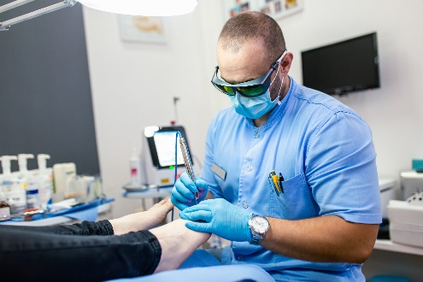

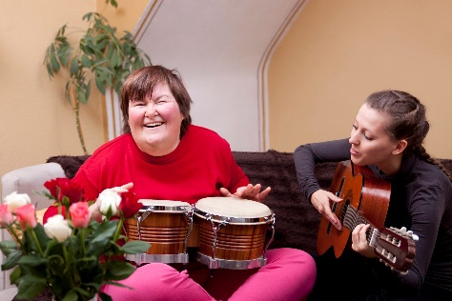
1
What did you think of the careers?
Pair discussion (2 mins)
Which careers did you find interesting in the WOW Show film?
Would you consider one of the roles in future?
Orthoptist?
Podiatrist?
Note! The roles are varied and have different entry requirements and skills.
Reflect and share (1 min)
Were you surprised by any of the roles and what they involved?
Radiographer?
Music Therapist?
©VotesForSchools2019
©VotesForSchools2019

Slide 4
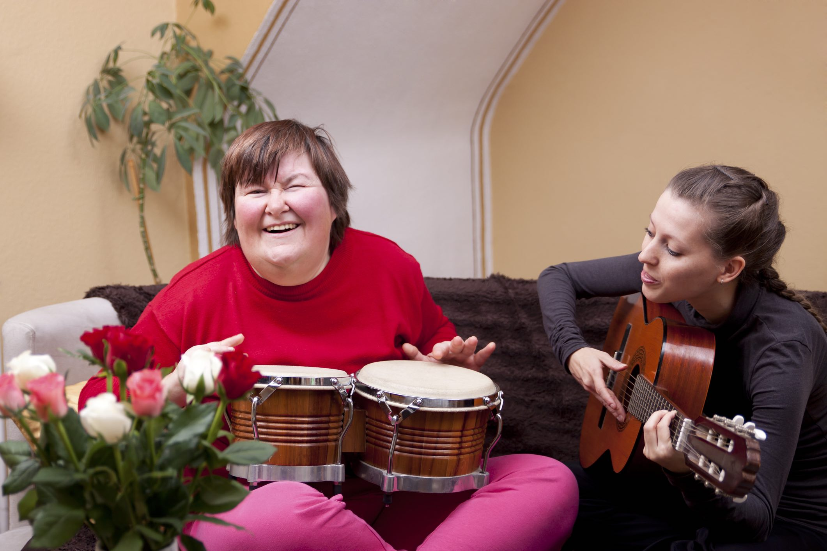
2
What about a career as a music therapist?
Watch the video
(3 minutes)
Can music change the way you feel? How?
0:00-
0:55
Discuss (2 mins)
How important is physical activity in physiotherapy?
Music Therapist:
A therapist who helps people deal with their feelings through music.
Extension:
Think about the types of music you use to lift your mood when things aren’t going how you would like them to. Do they have anything in common?
https://safeshare.tv/x/6ggb_-kLppc
©VotesForSchools2019
Notes:
Video link: https://safeshare.tv/x/6ggb_-kLppc
You tube: https://www.youtube.com/channel/UCXDSgY0E_aACHXcSqX14YNg (teacher’s notes start video at 4:10 end at 5:05)

Slide 5
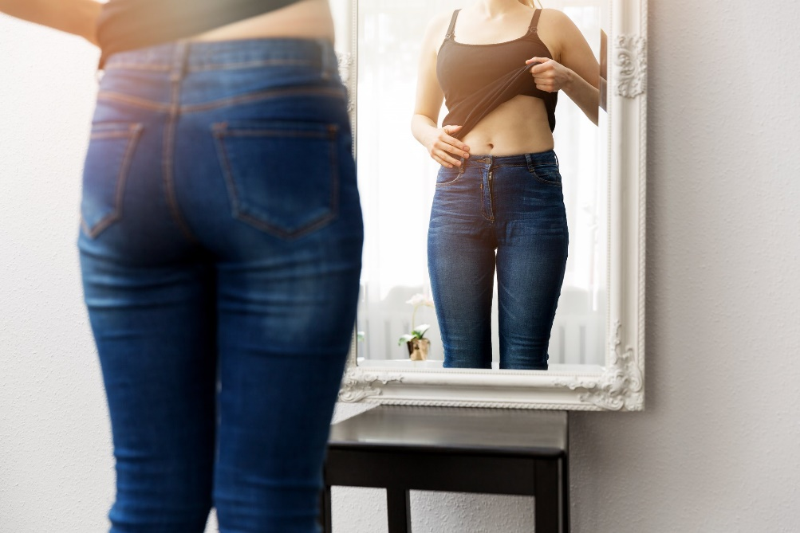
3
How do you think the dietitian helped her clients?
Discuss (2 mins)
What do you already know about anorexia and body dysmorphic disorder?
Note! If you recognise any of these feelings it is important you ask for help and support from someone you trust.
0:00 -
1:00
Extension Activity:
Can you create a plan for a healthy eating week?
How would you use physical activity?
Video (2 mins)
Click to watch a video and learn about it.
Body Dysmorphic Disorder:
A psychological disorder in which a person becomes obsessed with imaginary defects in their appearance.
Anorexia:
An emotional disorder characterised by an obsessive desire to lose weight by refusing to eat.
https://safeshare.tv/x/2p4LmaUBXaM
©VotesForSchools2019
Notes:
Alternative video link:
1- https://www.youtube.com/watch?v=2p4LmaUBXaM
WOW Show link: https://www.youtube.com/watch?v=1k7xHSxk-gY&t
Images:
1- iStock

Slide 6



4
How does physical activity help us?
Pair reflection (2 mins)
What are the physical and mental benefits of regular exercise?
Fun Fact:
Children and young people need to do at least 60 minutes of physical activity every day. This should range from moderate activity, such as cycling and playground activities, to vigorous activity, such as running and swimming.
For three days a week, activities should involve exercises to help develop strong muscles and bones. This could include swinging on playground equipment, hopping and skipping, and sports such as gymnastics or tennis.
Improved health
Improved concentration
Socialising
Stronger heart
Stronger bones
Increased muscle
Improved self-esteem
Reduced risk of major illness
©VotesForSchools2019

Slide 7
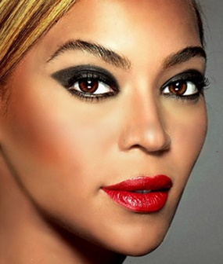
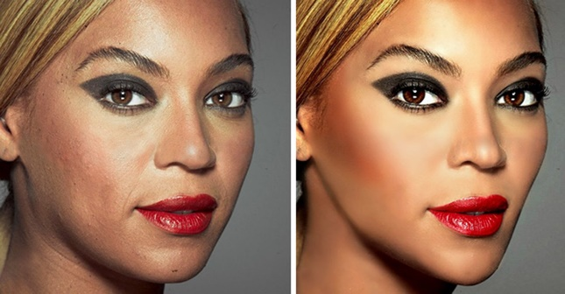
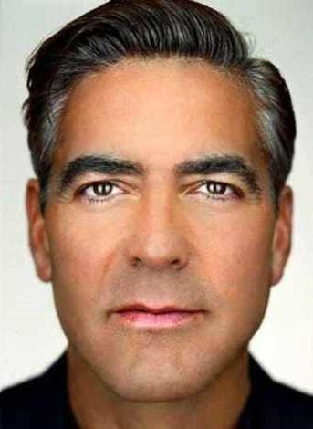
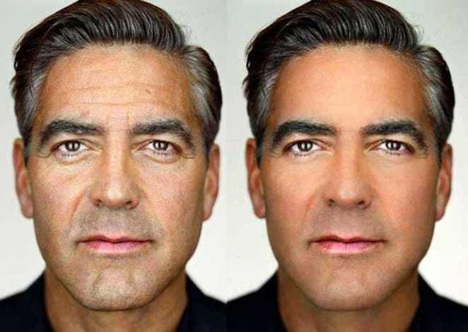


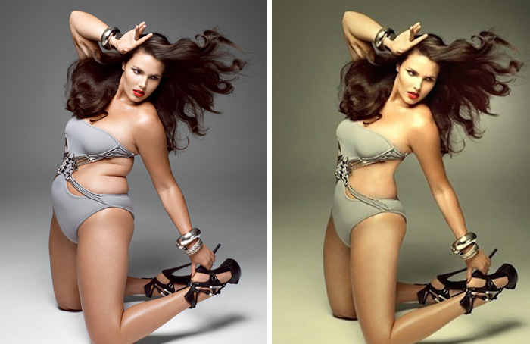

4
Is what we see in the media helpful or true?
Thumbs up/down (2 mins)
Which of these images are photoshopped? Click for answers.
All of these images are photoshopped!
Photoshop can get rid of lines, spots and even change the shape and colour of someone’s body!
Photoshop:
Computer software used to edit and enhance photographs.
©VotesForSchools2019
Notes:
Images:
1- https://betterafter50.com/cindy-crawford-un-photoshopped/
2- https://www.worldoffemale.com/celebrities-photoshopped-before-and-after/
3- https://swishtoday.com/celebrity/15-lowest-male-celebrity-photoshop-fails/

Slide 8

5
How does what we see affect our mental health?
Write down (2 mins)
Watch the video below to help. List all the ways we can make sure we stay mentally healthy. Click for answers.
Talking
Dancing
Rest
Music
Counselling
Exercise
0:00 -
2:42
Sleep
Eating well
Laughter
Art
Discuss (2 mins)
Other than these suggestions, what else did you come up with?
Do you know where you can get help in school?
Mental health:
The condition of a person’s psychological and emotional wellbeing.
https://safeshare.tv/x/ss5d0ce43caea01
©VotesForSchools2019
Notes:
Alternative video link:
1= https://www.youtube.com/watch?v=4ju2G3KtKNA

Slide 9




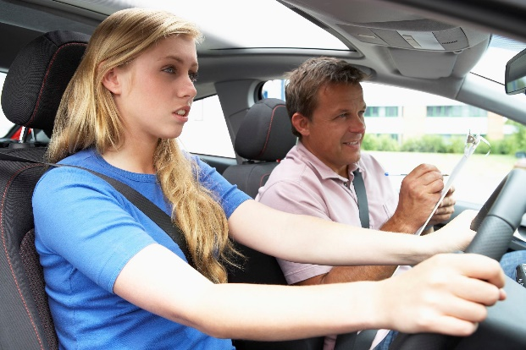


6
What is stress and how does it affect you?
Pair Activity (3-5 mins)
Can you remember a time that you experienced stress? How did it feel?
What caused it?
Stress:
The feeling of being under too much mental or emotional pressure. Pressure turns into stress when you feel unable to cope. Stress causes a surge of hormones in your body.
©VotesForSchools2019
Notes:
Images:
1- iStock

Slide 10


7
Where can you find support for stress and anxiety?
Pair discussion (1 min)
Where can you get help if you are feeling stressed or anxious?
Fact!
Recent research suggests that as many as 1 in 6 young people will experience an anxiety condition at some point in their lives. This means that up to 5 people in your class may be living with some form of anxiety, whether that be OCD (obsessive compulsive disorder), social anxiety and shyness, exam stress, worry or panic attacks.
There are people you can talk to in school if you are feeling stressed or anxious. Or, if you would rather speak to someone else, click the image to visit the Young Minds website for help and advice.
©VotesForSchools2019
©VotesForSchools2019
Notes:
Images:
1) https://socialsolihull.org.uk/localoffer/family-information-service-directory/4532/youngminds/

Slide 11
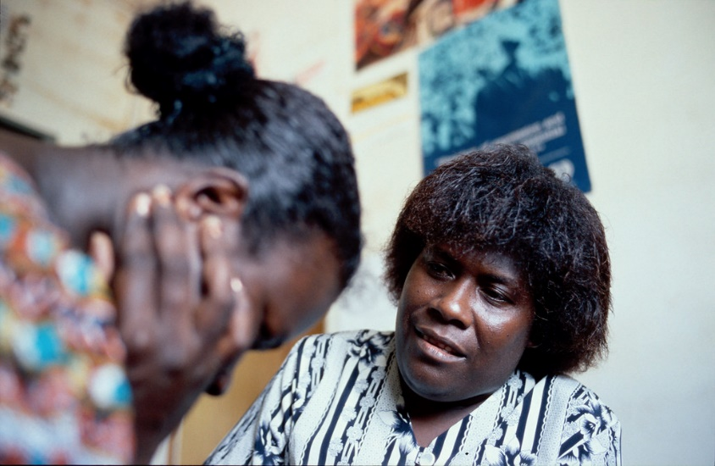
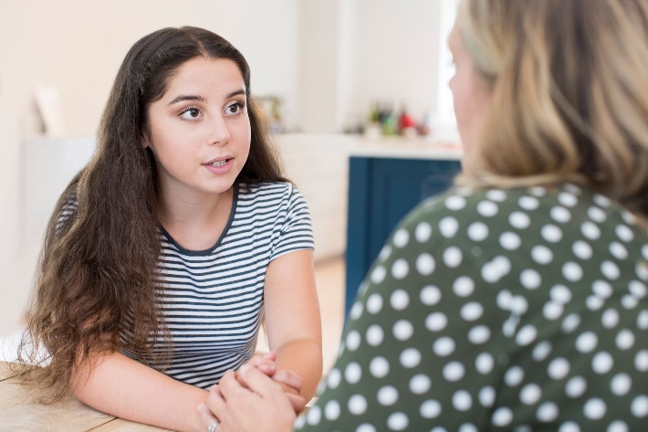

8
What about people’s right to privacy?
Pair discussion (1 min)
Why is confidentiality so important when it comes to your health? Can you think of an example of a situation in which confidentiality should not apply?
Confidentiality:
The state of keeping or being kept secret or private.
Many of the careers we have discussed require confidentiality. It is important that people feel safe discussing how they’re feeling and that their personal information is kept private, often between them and a family member or professional.
©VotesForSchools2019
©VotesForSchools2019
Notes:
Images:
1-https://pixabay.com/photos/doctor-patient-hospital-child-899037/
2- https://www.flickr.com/photos/dfataustralianaid/10713786424
3- https://www.flickr.com/photos/usembassyphnompenh/39417347234
4- https://www.med.navy.mil/sites/cpen/newSite/Pages/20150406.aspx
5- iStock

Slide 12
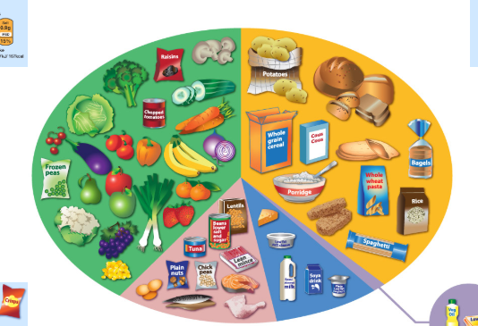



Useful websites for extension activities:
Healthy Diet
https://www.nhs.uk/live-well/eat-well/
Mental Health
https://youngminds.org.uk
Learn more about Allied Health Professions (AHP)
https://www.healthcareers.nhs.uk/explore-roles/allied-health-professionals
Safeguarding
https://learning.nspcc.org.uk
©VotesForSchools2019
©VotesForSchools2019
Notes:
For pathway progression use the link below:
https://www.rsaacademies.org.uk/projects/the-wow-show-health-careers-special-making-a-difference-teacher-resources/
Images:
https://www.nhs.uk/live-well/eat-well/the-eatwell-guide/
https://socialsolihull.org.uk/localoffer/family-information-service-directory/4532/youngminds/
https://www.healthcareers.nhs.uk/explore-roles/allied-health-professionals
https://learning.nspcc.org.uk/research-resources/schools/pants-teaching/

Slide 13
Making a Difference – A Health Careers Special
Lesson 2
In association with
©VotesForSchools2019

