Slide 1


Making a Difference
A Health Careers Special
In association with
Notes:
For pathway progression use the link below:
https://www.rsaacademies.org.uk/projects/the-wow-show-health-careers-special-making-a-difference-teacher-resources/

Slide 2
Learning objectives for today
To recognise they have the same rights to opportunities in learning and work as all people to challenge stereotypes and cultural expectations that put a ceiling on their aspirations.
The qualities and behaviours of positive relationships (teams, classes, friendships).
Keywords
Stereotypes – a widely held but fixed and over simplified image or idea of a particular type of person or thing.
Aspirations – a hope or ambition of achieving something.
Qualities – a distinctive attribute or characteristic possessed by someone.
Expectations – a strong belief that something will happen.
©VotesForSchools2019

Slide 3






1
What do you know about careers in health?
Pair discussion (2 mins)
What careers are there in health?
Has anyone considered a role?
Optician
Dentist
There are actually 360 roles to choose from!
Doctor
Nurse
Reflect and share (1 min)
Has anyone thought of a career in health?
Which field?
Healthcare:
The organized provision of medical care to individuals or a community.
©VotesForSchools2019

Slide 4
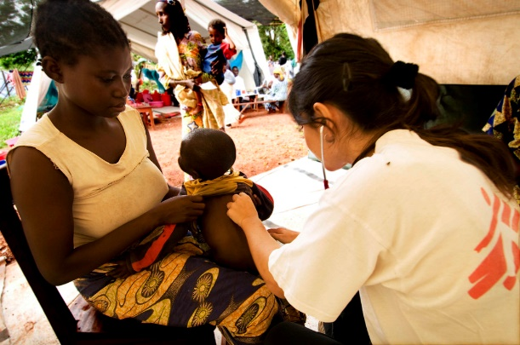



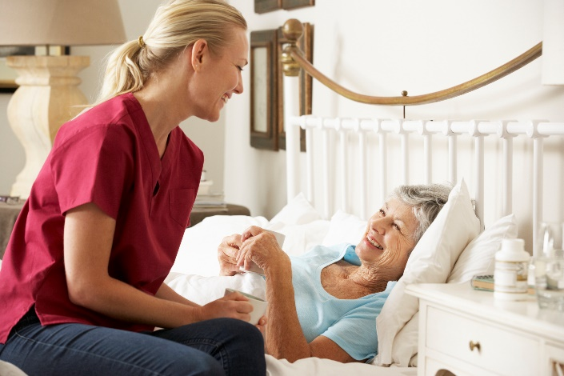
2
What comes to mind when you hear doctor or nurse?
Discuss (2 mins)
Do these photos fit what you were thinking? Did you think of the stereotypes for these roles?
Fun fact!
Do you know it can take nine years of study to become a doctor?
Salaries can vary with roles.
Stereotype:
A widely held but fixed and over simplified image or idea of a particular type of person or thing.
©VotesForSchools2019
Notes:
https://www.istockphoto.com/gb/photo/portrait-of-a-happy-female-doctor-gm177846383-24192462
https://www.istockphoto.com/gb/photo/gynecology-consultation-pregnant-woman-with-her-doctor-in-clinic-gm968350686-264036809
https://www.istockphoto.com/gb/photo/three-healthcare-colleagues-standing-outside-modern-hospital-gm998313718-270057946
https://www.istockphoto.com/gb/photo/confident-doctor-posing-at-the-hospital-gm938438758-256624789
https://www.flickr.com/photos/25296175@N04/3947340287
Istock

Slide 5
3
Did you know there are actually 14 AHP roles?
Discuss (2 mins)
Guess what these AHP roles are using the letters as clues. Click for answers. Do you know what any of these jobs involve?
Dramatherapist
Art _______
________ therapist
Art Therapist
O____ting practitioner
Phy________t
Operating Department Practitioner
Physiotherapist
C________ist/
podiatrist
Podiatrist
Music Therapist
M______ therapist
Orth_______
Prosthetist/
Orthotist
Orthoptist
Pros______t/
Orthotist
Di_______
Occ________ therapist
Dietitian
Occupational Therapist
Radiographer
R________er
Osteopath
O________th
AHP:
Allied Health Professional
S_______ and l_______ therapist
P_________c
Speech and Language Therapist
Paramedic

Slide 6
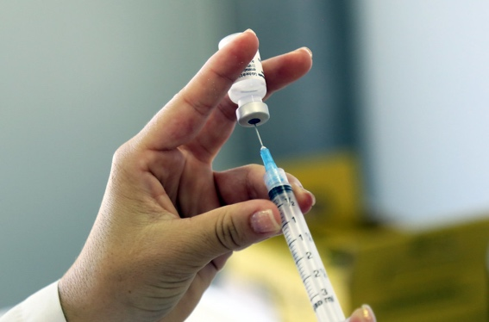
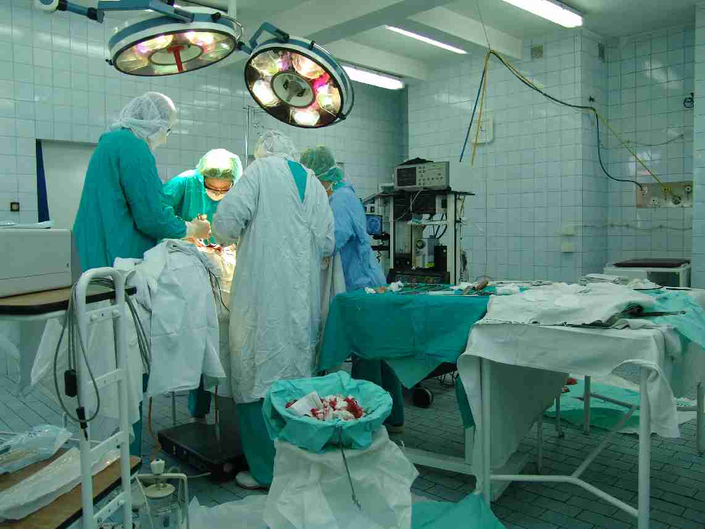
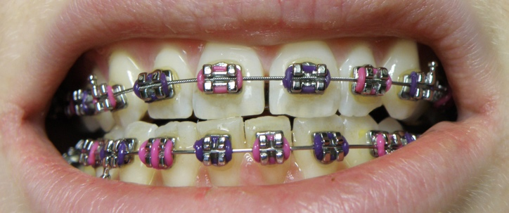
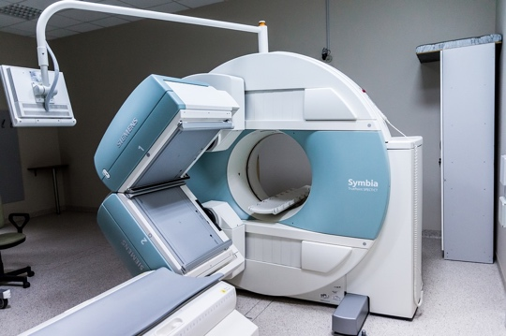
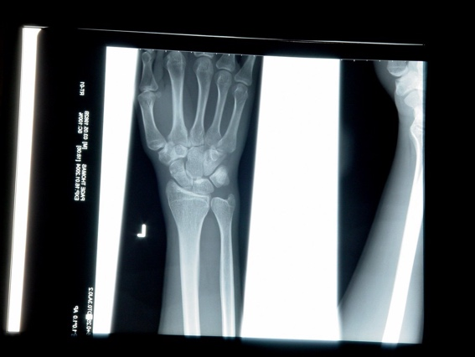
4
What experiences have you had of healthcare?
Table Activity (3-5 mins)
List all the different healthcare experiences you have had. Click for some common ones.
Most of you will have had vaccinations against childhood diseases or for holidays abroad.
Not all of these experiences will have needed a doctor, other specialists may have seen you for the procedure.
Notes:
Images:
1- https://www.flickr.com/photos/tompagenet/7981355
2- https://commons.wikimedia.org/wiki/File:Orthobraces_-_dental_braces_lower_upper_jaw.jpg
3- https://pixabay.com/photos/mri-magnetic-resonance-imaging-2813899/
4- https://www.flickr.com/photos/pahowho/13383716683
5- https://commons.wikimedia.org/wiki/File:Operating_theatre.jpg

Slide 7
5
Where did you experience healthcare?
Paired discussion task (1 min) Where do you think healthcare takes place?
Hospital
Doctor’s Surgery
Dentist
School
Field Hospital
Cruise Ship
Specialist
At Home
Ambulance
Community Group
Optician
Care Home
©VotesForSchools2019
Notes:
Images:
1- iStock

Slide 8

6
What qualities do you need for a career in health?
Individual task (2-4 mins)
What qualities do you need to have a career in health? Write them down. Then discuss why you would need these and whether you think you have what it takes.
understanding
resilience
empathy
co-operation
teamwork
Teamwork is important in healthcare as many people may be involved in the diagnosis and treatment of a person.
communication
Emotional resilience:
The ability to adapt to stressful situations or crises.
problem solving
interpersonal skills
©VotesForSchools2019

Slide 9
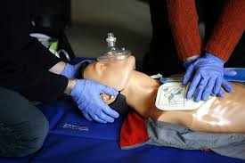
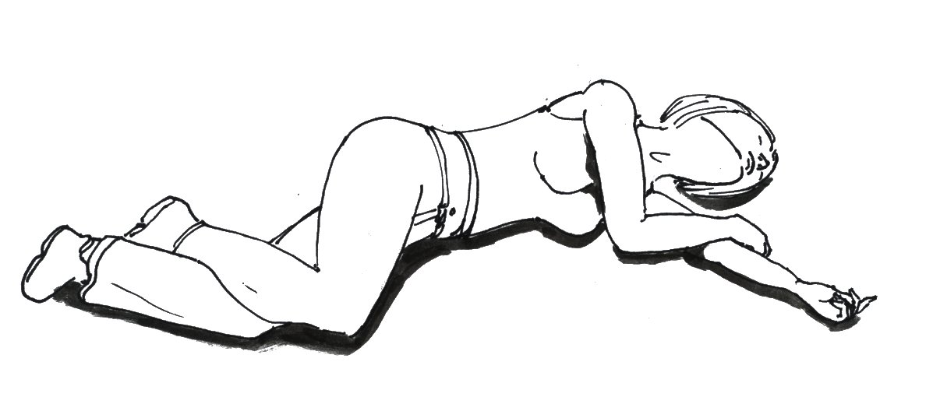
7
Basic First Aid
It can be really useful to be able to perform basic first aid in an emergency
Your school may provide training or you can search for yourself:
www.firstaidforlife.org.uk First Aid for teenagers
www.sja.org.uk St John’s ambulance
©VotesForSchools2019
Notes:
Images:
1- https://commons.wikimedia.org/wiki/File:CPR_training-05.jpg
2- https://commons.wikimedia.org/wiki/File:Recovery_position.jpg

Slide 10
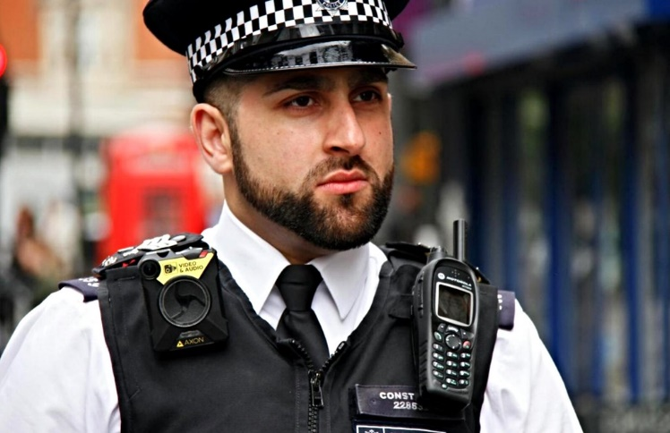
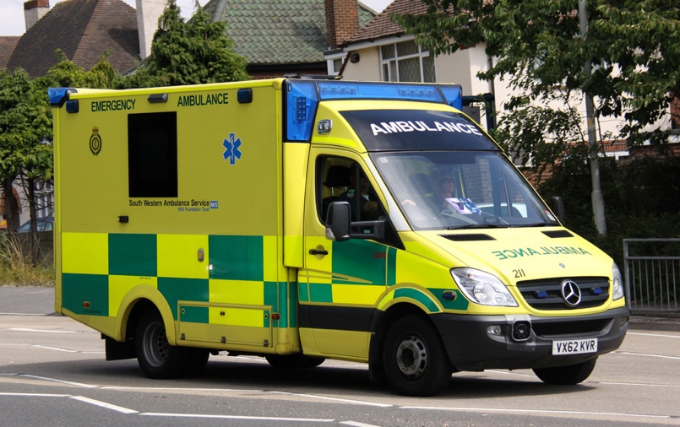
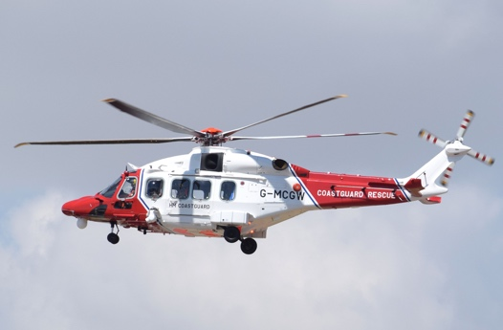
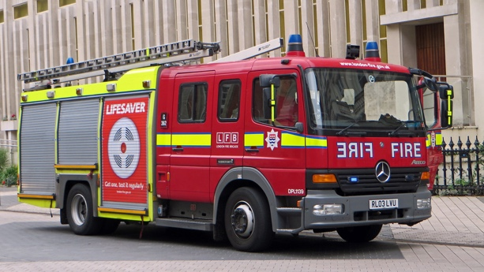
8
Getting help in emergency situations
In the UK dial 999 and ask for the service you need, remain calm and give as many details as possible.
In Europe dial 112 and ask for the service you need, remain calm and give as many details as possible.
www.Samaritans.org call 116 123
www.mind.org.uk call 0300 304 7000 for 24 hour emotional support
Childline 0800 1111
©VotesForSchools2019
Notes:
Images:
1- https://commons.wikimedia.org/wiki/File:A_UK_Box_Ambulance_by_WAS_GmbH.jpg
2- https://www.flickr.com/photos/hillview7/30934142341
3- https://www.flickr.com/photos/micsworld/18346024130

Slide 11

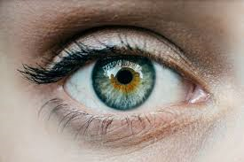
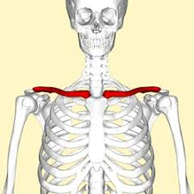
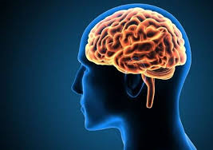
Fun facts about the body:
The word cancer comes from the Latin for crab – just like the zodiac sign
There are six muscles in the eye
The easiest bone to break is the clavicle
The brain weighs 1.36kg and contains 100 billion neutrons
©VotesForSchools2019

Slide 12
Making a Difference
A Health Careers Special
You can watch the show here at 10am on June 26th and then again on demand.
Notes:
For pathway progression use the link below:
https://www.rsaacademies.org.uk/projects/the-wow-show-health-careers-special-making-a-difference-teacher-resources/

