Slide 1




Jobs That Can Save the Planet
KS5 SEND Lesson
In association with
and
©VotesforSchools & TheWOWShow2023

Slide 2


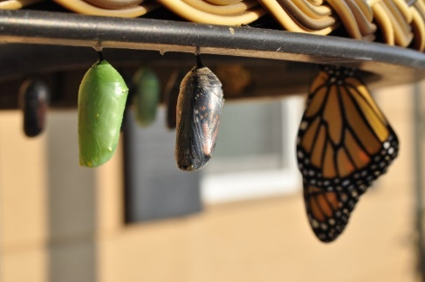




1
What is climate change?
Pair discussion (3-5 mins)
What does climate change mean? Look at the two groups of pictures and work out what they show. Use this to help describe what is affected by climate change!
climate
change
©VotesforSchools & TheWOWShow2023
Notes:
Images
Pixabay

Slide 3






1
What is climate change?
climate
change
Climate change is when the normal weather is
becoming different.
Let’s look at some examples...
©VotesforSchools & TheWOWShow2023
Notes:
Images
Pixabay
References
https://climate.nasa.gov/faq/12/whats-the-difference-between-climate-change-and-global-warming/

Slide 4



1
What is climate change?
Rain falling for longer.
Summer being longer and hotter.
Stronger storms happening more often.
Pair discussion (2-3 mins)
Why might these things be bad for our planet?
©VotesforSchools & TheWOWShow2023
Notes:
Images
Pixabay

Slide 5
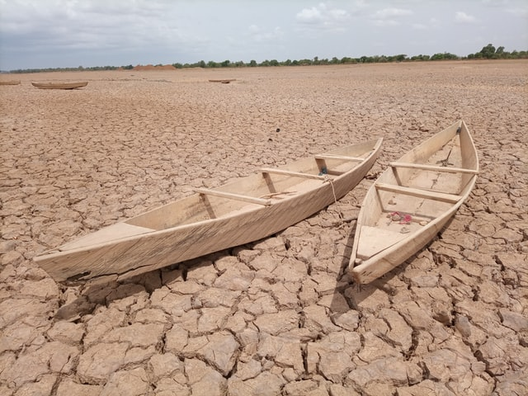
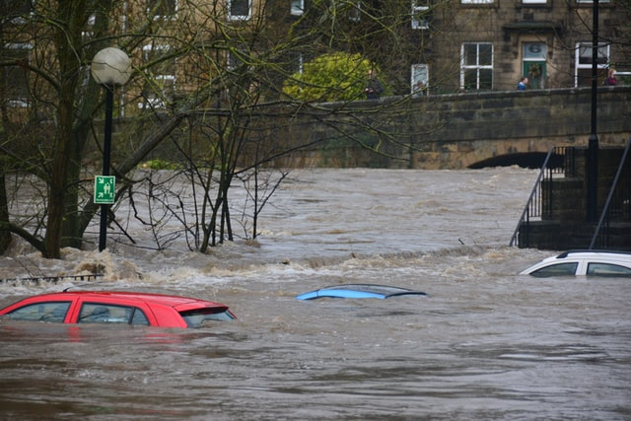

1
What is climate change?
Lots of rain might mean flooding happens.
Lots of heat might mean less water for growing food.
Storms like hurricanes might be more dangerous.
©VotesforSchools & TheWOWShow2023
Notes:
Images
Pixabay

Slide 6


2
Why is the climate changing?
Why is the climate changing?
©VotesforSchools & TheWOWShow2023
Notes:
Images
Pixabay

Slide 7



2
Why is the climate changing?
The air around the Earth is changing.
This is because of how humans live.
©VotesforSchools & TheWOWShow2023
Notes:
Images
Pixabay

Slide 8







2
Why is the climate changing?
Fumes and smoke from some cars and machines are harming our planet.
©VotesforSchools & TheWOWShow2023
Notes:
Images
Pixabay

Slide 9

3
What can we do about climate change?
The leaders of our country are called the Government. They can help in a big way!
So can the companies who create buildings, energy and cars.
©VotesforSchools & TheWOWShow2023
Notes:
Images
Pixabay

Slide 10


3
What can we do about climate change?
Companies can save electricity by using less.
We can work in jobs that help, for example, making electricity or powering cars in a way that is cleaner for our planet.
©VotesforSchools & TheWOWShow2023

Slide 11

4
Jobs that can save the planet
0:00- 12:38
Activity (15 mins)
Click the picture to watch The WOW Show’s film about jobs that can save the planet.
©VotesforSchools & TheWOWShow2023
Notes:
YouTube Video Link: https://www.youtube.com/watch?v=sozrqiEdFJk
SafeShare Video link: https://safeshare.tv/x/sozrqiEdFJk
Images
Via video

Slide 12

4
Jobs that can save a planet
Class discussion (1-2 mins)
Were there any jobs in the film that you thought you might like to do?
There will be more green jobs than ever when you leave school.
There are lots of jobs at lots of different levels.
The pay in green jobs is very good too.
©VotesforSchools & TheWOWShow2023
Notes:
Images:
Unsplash

Slide 13

4
Jobs that can save a planet - Transport
Class discussion (1-2 mins)
Would you like to work in transport?
What jobs do you think there are?
Are you interested in working with electric vehicles? In the making, driving or repairing of them?
©VotesforSchools & TheWOWShow2023
Notes:
Images:
Microsoft Office 365

Slide 14
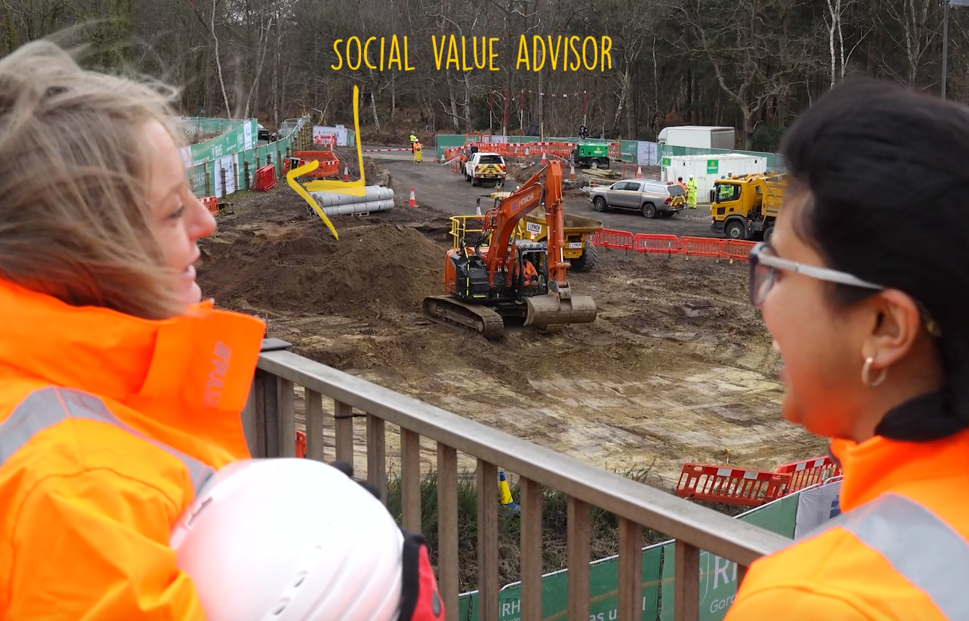
4
Jobs that can save a planet - Construction
Class discussion (1-2 mins)
Would you like to work in construction?
What jobs do you think there are?
There are 2 million jobs in construction. There are lots of different roles needing lots of different skills and qualifications.
©VotesforSchools & TheWOWShow2023
Notes:
Images:
Via video

Slide 15
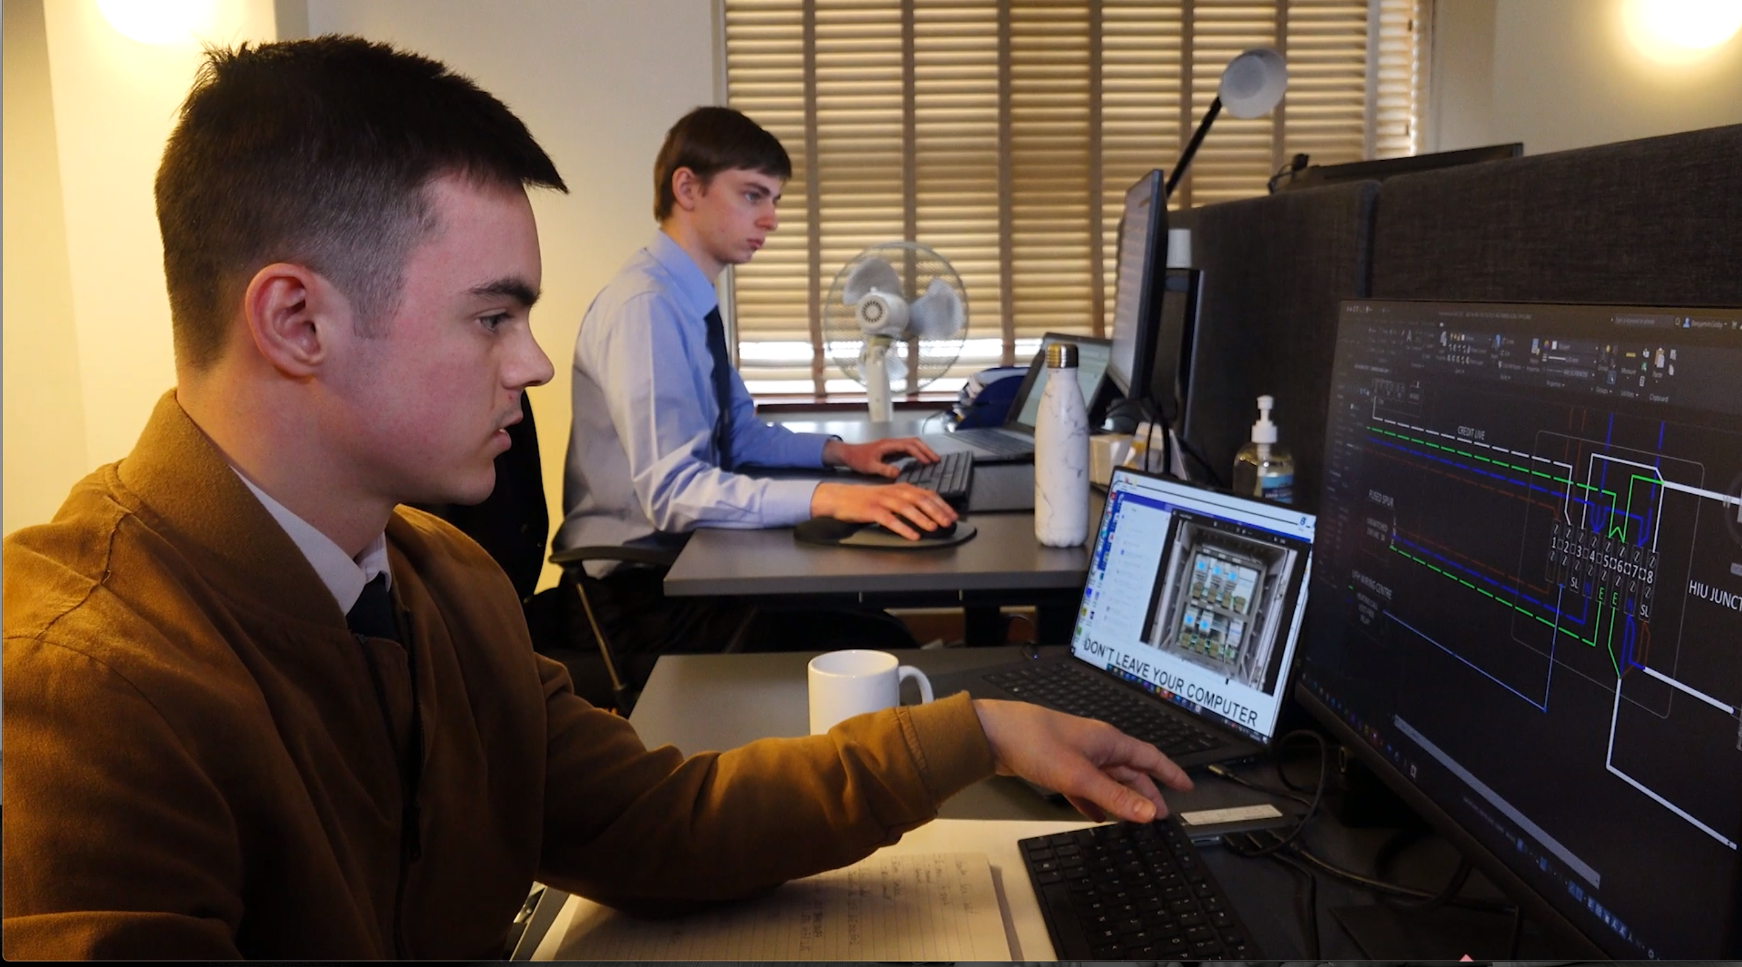
4
Jobs that can save a planet - Energy
Class discussion (1-2 mins)
Would you like to work in energy?
What jobs do you think there are?
Would you like to work with technology to help people use less energy in their everyday lives?
©VotesforSchools & TheWOWShow2023
Notes:
Images:
Via video

Slide 16

4
Jobs that can save a planet - Energy
There are also jobs available in making energy in ways that are good for the planet.
©VotesforSchools & TheWOWShow2023
Notes:
Images:
Unsplash

Slide 17

5
Which skills do you need?
0:00-1:38
Discuss
Before you watch the video, discuss which of the skills you’ve looked at today you think you have. Do you think this makes you a good person for a particular job?
©VotesforSchools & TheWOWShow2023
Notes:
Alternative Video Link – Employability Skills: https://www.youtube.com/watch?v=tKKPUYfOkvw
SafeShare Video Link: https://safeshare.tv/x/ss602199d2bb0de
Images
Via video

Slide 18

5
Which skills do you need?
Lots of jobs involve teamwork.
Teamwork:
Working together
Discussion
Do you work well with other people?
How can you practice working as part of a team?
©VotesforSchools & TheWOWShow2023
Notes:
Images
Microsoft Office 365

Slide 19

5
Which skills do you need?
Discussion
Are you a good problem-solver? Do you like solving problems?
Problem-solving:
Sorting out problems.
Lots of jobs that will help the planet will involve solving problems.
©VotesforSchools & TheWOWShow2023
Notes:
Images
Microsoft Office 365

Slide 20

5
Which skills do you need?
Discussion
Are you a good listener? How can you improve your listening skills?
Listening:
Hearing others.
In a job you will need to listen to others as well as speak for yourself.
©VotesforSchools & TheWOWShow2023
Notes:
Images
Microsoft Office 365

Slide 21

5
Which skills do you need?
Discussion
Are you confident speaking to other people? How can you improve your talking skills?
Speaking:
Talking to others.
As well as good listening you will need to speak to other people in your team.
©VotesforSchools & TheWOWShow2023
Notes:
Images
Microsoft Office 365

Slide 22

5
Which skills do you need?
As well as your skills, you will need some qualifications.
It is important to choose the right next steps to make sure you are qualified to do your dream job!
But, if you are not sure what you want to do, talk to your family and teachers.
©VotesforSchools & TheWOWShow2023

Slide 23

6
Pathways to employment
Let’s think about your next steps after school.
What you want to do in the future
Which subjects you are good at
Which subjects or topics you enjoy
Reflection (2 mins)
Have you thought about what you would like to do in the future?
©VotesforSchools & TheWOWShow2023
Notes:
Images
Unsplash
Microsoft Office 365
References
https://www.youtube.com/channel/UCPwftEor7g8nOg6cu-R0KXw (University of Exeter)
https://nationalcareersservice.direct.gov.uk/job-profiles/home

Slide 24


6
Pathways to employment
Class discussion (1-2 mins)
Are you ready to get a job or would you like to have more training?
It could help you get a job.
A supported internship could help you learn while you work.
©VotesforSchools & TheWOWShow2023
Notes:
Images
Microsoft Office 365
References:
https://www.surreylocaloffer.org.uk/young-people/education-and-training
https://www.surreylocaloffer.org.uk/young-people/preparing-for-adulthood/pathways-to-employment
https://www.surreylocaloffer.org.uk/young-people/preparing-for-adulthood/supported-internships

Slide 25


6
Pathways to employment
Or maybe a traineeship.
You could try an apprenticeship.
©VotesforSchools & TheWOWShow2023
Notes:
Images
Microsoft Office 365
References:
https://www.surreylocaloffer.org.uk/young-people/education-and-training
https://www.surreylocaloffer.org.uk/young-people/preparing-for-adulthood/pathways-to-employment
https://www.surreylocaloffer.org.uk/young-people/preparing-for-adulthood/supported-internships

Slide 26
6
Pathways to employment
Class discussion (1-2 mins)
If you know what job you would like to do, do you know how to get that job?
If you find a job that you want, then need to go for an interview.
We will now look at some important information for interviews.
©VotesforSchools & TheWOWShow2023
Notes:
References:
https://www.surreylocaloffer.org.uk/young-people/education-and-training
https://www.surreylocaloffer.org.uk/young-people/preparing-for-adulthood/pathways-to-employment

Slide 27

6
Pathways to employment
Be prepared:
Know about the job you are going for.
©VotesforSchools & TheWOWShow2023
Notes:
Images
Unsplash
References:
https://www.surreylocaloffer.org.uk/young-people/education-and-training
https://www.surreylocaloffer.org.uk/young-people/preparing-for-adulthood/pathways-to-employment

Slide 28

6
Pathways to employment
Look after yourself:
Before your interview, stay calm.
©VotesforSchools & TheWOWShow2023
Notes:
Images
Unsplash
References:
https://www.surreylocaloffer.org.uk/young-people/education-and-training
https://www.surreylocaloffer.org.uk/young-people/preparing-for-adulthood/pathways-to-employment

Slide 29

6
Pathways to employment
First impressions count:
Make a good impression by dressing smartly.
©VotesforSchools & TheWOWShow2023
Notes:
Images
Unsplash
References:
https://www.surreylocaloffer.org.uk/young-people/education-and-training
https://www.surreylocaloffer.org.uk/young-people/preparing-for-adulthood/pathways-to-employment

Slide 30

6
Pathways to employment
Concentrate:
Talk slowly and clearly and think about your answers.
©VotesforSchools & TheWOWShow2023
Notes:
Images
Microsoft Office 365
References:
https://www.surreylocaloffer.org.uk/young-people/education-and-training
https://www.surreylocaloffer.org.uk/young-people/preparing-for-adulthood/pathways-to-employment

Slide 31

6
Pathways to employment
Listen carefully:
Listen carefully to the questions.
©VotesforSchools & TheWOWShow2023
Notes:
Images
Microsoft Office 365
References:
https://www.surreylocaloffer.org.uk/young-people/education-and-training
https://www.surreylocaloffer.org.uk/young-people/preparing-for-adulthood/pathways-to-employment

Slide 32

6
Pathways to employment
Be honest:
Answer questions truthfully and ask questions of your own.
©VotesforSchools & TheWOWShow2023
Notes:
Images
Microsoft Office 365
References:
https://www.surreylocaloffer.org.uk/young-people/education-and-training
https://www.surreylocaloffer.org.uk/young-people/preparing-for-adulthood/pathways-to-employment

Slide 33

6
Pathways to employment
Class discussion (1-2 mins)
Once you have a job, what do you think is important to remember when you are there?
Dress smartly for your role.
©VotesforSchools & TheWOWShow2023
Notes:
Images
Microsoft Office 365
References:
https://www.surreylocaloffer.org.uk/young-people/education-and-training
https://www.surreylocaloffer.org.uk/young-people/preparing-for-adulthood/pathways-to-employment

Slide 34

6
Pathways to employment
Turn up on time.
©VotesforSchools & TheWOWShow2023
Notes:
Images
Microsoft Office 365
References:
https://www.surreylocaloffer.org.uk/young-people/education-and-training
https://www.surreylocaloffer.org.uk/young-people/preparing-for-adulthood/pathways-to-employment

Slide 35

6
Pathways to employment
Do a good job.
©VotesforSchools & TheWOWShow2023
Notes:
Images
Unsplash
References:
https://www.surreylocaloffer.org.uk/young-people/education-and-training
https://www.surreylocaloffer.org.uk/young-people/preparing-for-adulthood/pathways-to-employment

Slide 36

6
Pathways to employment
Don’t give up.
©VotesforSchools & TheWOWShow2023
Notes:
Images
Unsplash
References:
https://www.surreylocaloffer.org.uk/young-people/education-and-training
https://www.surreylocaloffer.org.uk/young-people/preparing-for-adulthood/pathways-to-employment

Slide 37

7
Final reflection
Final reflection…
Now you have completed this lesson, what do you think you would like to do for your future career?
©VotesforSchools & TheWOWShow2023
Notes:
Images:
Microsoft Office 365
References:
https://www.surreylocaloffer.org.uk/young-people/education-and-training

Slide 38

i
Information and support
Click the links to visit the websites, or make a note of their names to look at later.
You may wish to print this.
icould is a great place to get tips on GCSE options, apprenticeships, university, finding work (and more!).
The Prince’s Trust has lots of links to websites and resources to help career teaching.
BBC Bitesize has lots of information on course choices, CVs, interviews and much more.
Careerpilot has lots of information including quizzes, course information and an action planner.
Launch Your Career will help you find pathways to colleges, courses, apprenticeships and more.
National Careers Week has a huge collection of information and resources.
Coursesonline has a quiz to help see which careers you are suited to.
The National Careers Service provides careers information, advice and guidance for students age 13+.
©VotesforSchools & TheWOWShow2023
Notes:
Images
Pixabay
References
https://icould.com/
https://nationalcareers.service.gov.uk/
https://www.careerpilot.org.uk/
https://www.bbc.co.uk/bitesize/careers
https://www.princes-trust.org.uk/help-for-young-people/who-else/employment/careers-advice
https://nationalcareersweek.com/
https://launchyourcareer.com/en_UK
https://www.coursesonline.co.uk/enneagram-personality-test/

Slide 39
Jobs That Can Save the Planet
KS5 SEND Lesson
In association with
and
©VotesforSchools & TheWOWShow2023

