Slide 1




Jobs That Can Save the Planet
KS5 Lesson
In association with
and
©VotesforSchools & TheWOWShow2023

Slide 2


1
What do you know about climate change?
Climate change: we’ve all heard about it, but what does it mean?
Pair discussion (1 min)
Quickly explain what you know about climate change, using only 3 words!
©VotesforSchools & TheWOWShow2023
Notes:
Images
Pixabay

Slide 3






1
What do you know about climate change?
The climate is the average pattern of weather over a long time. For example, Spain has a particular climate based on its weather over many years.
Weather, of course, changes daily. Climate change considers what is different over time.
The increase in the average temperatures around the world is called global warming. Higher average temperatures are causing climate change and its effects.
©VotesforSchools & TheWOWShow2023
Notes:
Images
Pixabay
References
https://climate.nasa.gov/faq/12/whats-the-difference-between-climate-change-and-global-warming/

Slide 4


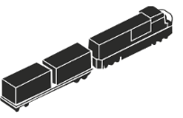



1
What do you know about climate change?
Climate change is caused by increasing amounts of greenhouse gases in the atmosphere.
Greenhouse gases in the atmosphere trap heat on Earth. The most commonly released greenhouse gas is carbon dioxide (CO₂). Think of it like layering more blankets keeping heat in.
Class activity (1-2 mins)
Which processes do you think release carbon dioxide into the atmosphere?
A major way carbon dioxide is released is when fuels are burned to generate power for activities like transport, electricity generation and powering machines.
©VotesforSchools & TheWOWShow2023
Notes:
Images
Pixabay

Slide 5

1
What do you know about climate change?
Many businesses are working on environmental sustainability by shrinking their carbon footprint, cutting down on waste, and reducing their water and energy use to help the environment.
The environment is damaged by pollution, loss of habitats and loss of diversity as well as the impact of climate change.
Sustainability to a business could mean saving money, having a good reputation with customers, and making a difference to the planet itself.
Definition: Carbon footprint
The amount of carbon released to the atmosphere.
Definition: Sustainability
Causing little or no damage to the environment over a long period of time.
©VotesforSchools & TheWOWShow2023
Notes:
Images
1) Microsoft Office 365
References
Carbon neutral v carbon net zero - https://dodo.eco/blog/whats-the-difference-between-carbon-neutral-and-net-zero?gclid=Cj0KCQjwhqaVBhCxARIsAHK1tiNcnH3hU3Ta4e_4AS7wh9WX4H6nKKG4Yx7gubMbvdJYB0z7bHWMeMUaArXiEALw_wcB
https://www.cbi.org.uk/articles/is-your-company-ready-to-save-the-planet/
https://www.greenjournal.co.uk/2022/09/5-ways-british-companies-are-saving-the-planet/
https://blog.shorts.uk.com/sustainable-business-practices
https://dictionary.cambridge.org/dictionary/english/carbon-footprint
https://dictionary.cambridge.org/dictionary/english/sustainability

Slide 6

1
What do you know about climate change?
Definition: Carbon neutral
Balancing emissions through offsetting activities.
Definition: Net-zero
Reducing greenhouse gases (GHG) emissions as much as possible and then offsetting any remaining.
The aim is for businesses to become “carbon neutral” or to be “net-zero”.
Definition: Offsetting
Activities to remove carbon such as planting trees.
Since 1990, the UK has almost halved greenhouse gas emissions, and in 2019 the UK set a target of reaching net-zero emissions by 2050.
Over the next few slides, we will look closely at how you can find your future in a green career and help to save the planet!
©VotesforSchools & TheWOWShow2023
Notes:
Teacher notes:
Carbon neutral: A balance between the amount of carbon dioxide emitted by an activity, and the amount of carbon dioxide removed from the atmosphere.
Net zero: the amount of GHGs emitted into the atmosphere has been reduced as much as possible, then the remaining GHGs that are still being emitted are being balanced by removing carbon dioxide from the atmosphere
Images
Microsoft Office 365
References:
Carbon neutral v carbon net zero - https://dodo.eco/blog/whats-the-difference-between-carbon-neutral-and-net-zero?gclid=Cj0KCQjwhqaVBhCxARIsAHK1tiNcnH3hU3Ta4e_4AS7wh9WX4H6nKKG4Yx7gubMbvdJYB0z7bHWMeMUaArXiEALw_wcB
https://www.gov.uk/government/publications/net-zero-strategy
https://www.cbi.org.uk/articles/is-your-company-ready-to-save-the-planet/
https://www.greenjournal.co.uk/2022/09/5-ways-british-companies-are-saving-the-planet/
https://blog.shorts.uk.com/sustainable-business-practices
https://assets.publishing.service.gov.uk/government/uploads/system/uploads/attachment_data/file/1033990/net-zero-strategy-beis.pdf
https://dictionary.cambridge.org/dictionary/english/offset

Slide 7

2
Jobs that can save the planet
0:00- 12:38
Activity (15 mins)
Click the picture to watch The WOW Show’s film about jobs that can save the planet. As you watch, think about what your career could look like.
©VotesforSchools & TheWOWShow2023
Notes:
YouTube Video Link: https://www.youtube.com/watch?v=jyMibjfy9lU
SafeShare Video link: https://safeshare.tv/x/jyMibjfy9lU
Images
Via video

Slide 8

3
What are green careers?
Discussion (2-4 mins)
So, now you’ve watched the film, what do you think the term “green careers” means?
“Green career” is a difficult term to explain simply, as it can mean many things. For example, it could mean a job that deals directly with climate change, such as creating and installing solar panels. Or, it could be less obviously linked to tackling global warming, such as working as an accountant for a company that has pledged to reduce carbon emissions to help save the planet.
Whether there is a particular career that you aspire to, or you just want to be involved in saving the planet, a green career could be a great choice for you.
©VotesforSchools & TheWOWShow2023
Notes:
Images
Microsoft Office 365
References
https://educationhub.blog.gov.uk/2022/11/07/what-is-a-green-job-everything-you-need-to-know/
https://www.ons.gov.uk/economy/environmentalaccounts/methodologies/thechallengesofdefiningagreenjob

Slide 9

3
What are green careers?
Nationally, green jobs are set to rise by 600% by 2050, resulting in 2 million jobs.
The same level of qualifications will mean 8% higher wages in green jobs.
In 2020, between 3-5% of the jobs in Surrey were in green careers. But, this is set to double, meaning thousands of new jobs!
Average salaries in net-zero roles are £42,600, compared to £33,400 in other roles.
Challenge:
Other than those covered in the film, can you name three other green careers you have heard about?
©VotesforSchools & TheWOWShow2023
Notes:
Images
Microsoft Office 365
References
The WOW Show film

Slide 10

3
What are green careers?
Discuss (2-4 mins)
Talk to a partner: would you like to work in construction? Which area are you interested in? Do you know where to find information to help you?
The Government launched a Green Jobs Taskforce in 2020.
Traditionally, green careers have been in renewable energy, waste management and recycling.
Modern technology has brought with it many more opportunities for careers that will help the environment.
©VotesforSchools & TheWOWShow2023
Notes:
Images
Microsoft Office 365
References
https://www.gov.uk/government/groups/green-jobs-taskforce
https://assets.publishing.service.gov.uk/government/uploads/system/uploads/attachment_data/file/1003570/gjtf-report.pdf

Slide 11

4
Why are they important?
Individual activity (2 mins)
Write down 3 things that climate change could lead to. Click for some ideas if you’re not sure.
Sea levels will increase if ice, particularly in polar regions, keeps melting. Many low-lying areas, like some coastal regions and islands, will experience flooding if sea levels rise.
Extreme weather events are expected to become more common over time too. This would include heavy rains, droughts, and disasters (such as hurricanes) being stronger.
Food and water availability will be affected by a changing climate. Fresh water will become harder to access over time as rainfalls change and droughts occur.
©VotesforSchools & TheWOWShow2023
Notes:
Images
Microsoft Office 365

Slide 12
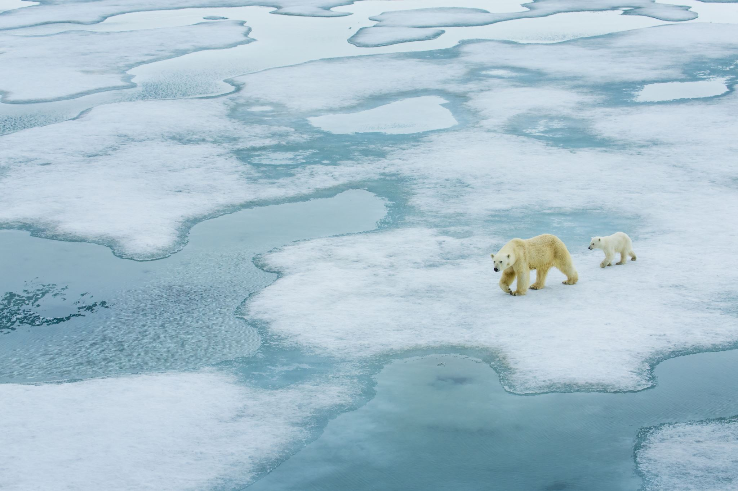
4
Why are they important?
Activity (3-5 mins)
In pairs or small groups, write down three reasons why green careers are important for the future.
Did you think about global climate change and its impact on everything else?
Did you think about changing technologies and behaviour from people?
Challenge:
Share your ideas: which careers are needed to help save the planet and why?
Did you think about transport, homes and energy?
©VotesforSchools & TheWOWShow2023
Notes:
Images
Microsoft Office 365

Slide 13

5
Is there a green career for you?
Discuss (2-4 mins)
Over the next few slides, think about the careers you saw in the film. Did the career interest you? What would you need to do to have a similar job in the future? Let’s start with a Data Analyst…
In the film, we met lots of people with very different green careers. There are many different skills and routes into these roles.
At the end of the lesson there are links to further information.
©VotesforSchools & TheWOWShow2023
Notes:
Images
The WOW Show
Teacher Notes: https://www.gov.uk/guidance/data-analyst
The ability to pay attention to detail when working with data in order to make accurate conclusions and predictions
Strong verbal and written communication skills to effectively share findings with shareholders
A solid understanding of data sources, data organisation and storage
Strong IT and mathematical skills
In-depth knowledge of statistical methodologies and data analysis techniques
Knowledge of relevant relational databases

Slide 14
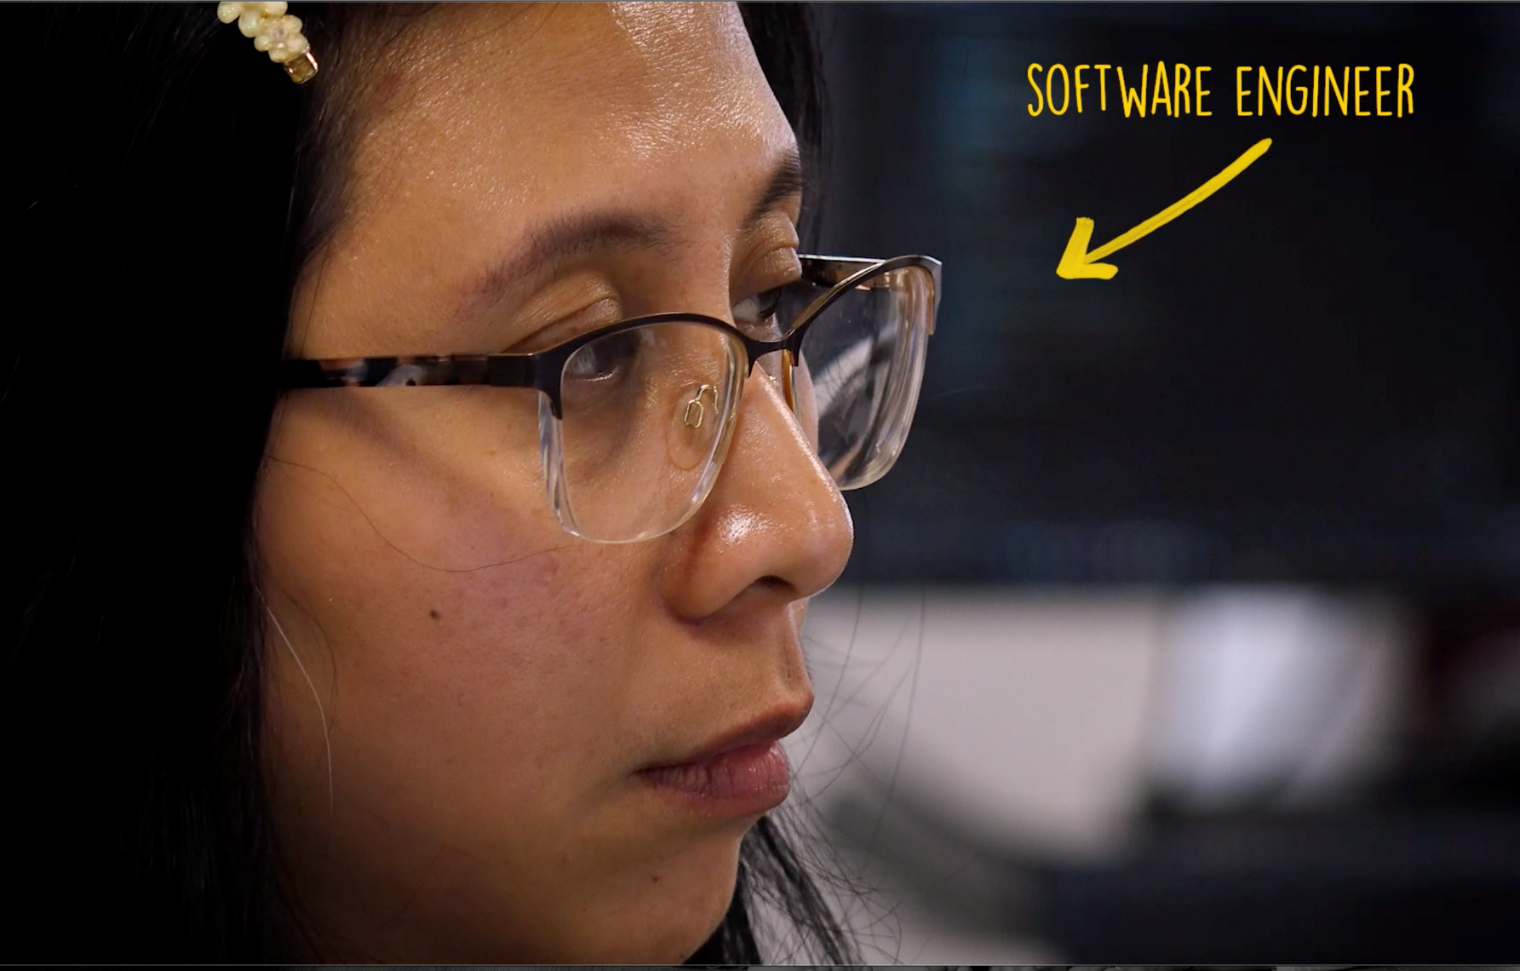
5
Is there a green career for you?
What would you need to do to become a Software Engineer?
©VotesforSchools & TheWOWShow2023
Notes:
Images
The WOW Show
Teacher Notes: https://uk.indeed.com/career-advice/career-development/software-engineer-skills
analytical thinking skills
maths knowledge for understanding programming
to be thorough and pay attention to detail
the ability to come up with new ways of doing things
complex problem-solving skills
excellent verbal communication skills for sharing ideas
persistence and determination
the ability to write computer programs
to have a thorough understanding of computer systems and applications

Slide 15
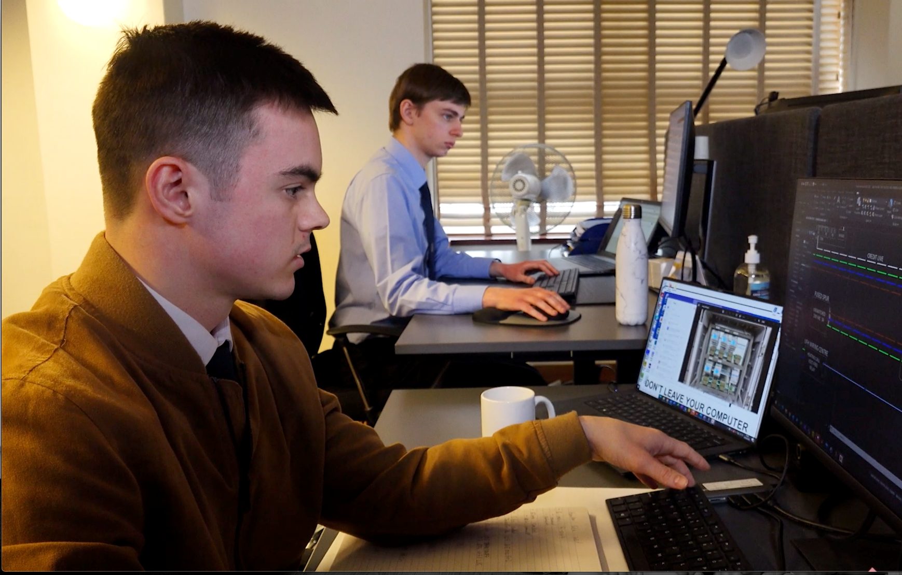
5
Is there a green career for you?
We also met an Application Engineer.
What routes into further education and training are there locally for these skills?
©VotesforSchools & TheWOWShow2023
©VotesforSchools & TheWOWShow2023
Notes:
Images
The WOW Show
Teacher Notes: https://uk.indeed.com/career-advice/finding-a-job/how-to-be-application-engineer
Attention to detail: Meticulous attention to detail is vital for carrying out various duties as an application engineer, such as advising clients on new product changes and clearly documenting service calls.
Teamwork: Application engineers work across multiple departments and as part of an engineering team, so working well with others is an essential skill to develop for this role.
Interpersonal skills: Application engineers work with many different professionals, and good interpersonal skills allow them to understand goals clearly, work with others to achieve a common goal and resolve conflicts within teams.
Technical support: One of an application engineer's main duties involves providing technical support and responding to customer service queries, so these professionals require strong technical support and customer service skills to perform this part of the role to a high standard.
Understanding technical specifications: There are lots of technical details that an application engineer requires knowledge of, like server types, hardware requirements or the types of software a client requires.

Slide 16
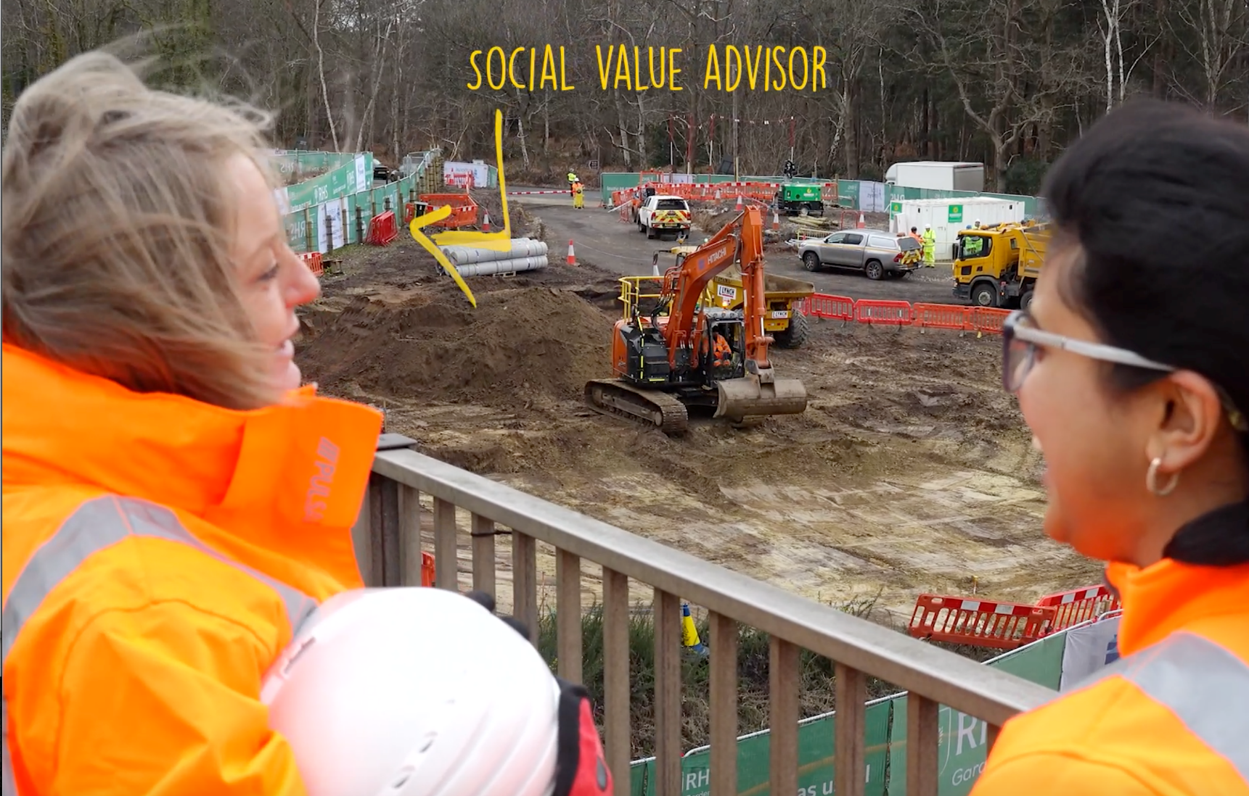
5
Is there a green career for you?
Are there any volunteering opportunities in your area to improve your communication skills?
©VotesforSchools & TheWOWShow2023
Notes:
Images
The WOW Show
Teacher Notes: https://www.talk-recruitment.co.uk/job/social-value-advisor-405.aspx
To be considered for this Social Value Coordinator role you must meet the following criteria:
Previous employment as a Social Value Manager, Social Value Coordinator, Social Value Officer or Social Value Champion, Responsible Business Coordinator / Manager or similar to be considered.
Ideally Previous Main Contractor employment but not essential.
High level of communication skills.
Experience in a social value or CSR role within construction, civil engineering or training/skills background.
Strong analytical and data interpretation and management skills.
Strong literacy skills and excellent attention to detail.
Excellent communication, networking and relationship management skills.
Ability to engage well with others and influence a range of key stakeholders.
Confidence in meeting and working with a diverse range of people from a variety of backgrounds.

Slide 17
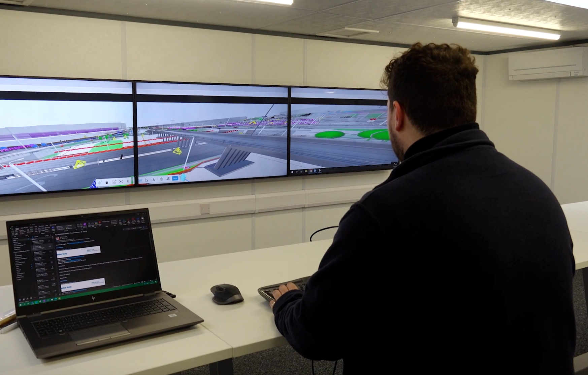
5
Is there a green career for you?
We met a Digital Delivery Engineer as well.
Digital Delivery Engineers work at computer screens every day. Is that something you would enjoy?
©VotesforSchools & TheWOWShow2023
Notes:
Images
The WOW Show
Teacher Notes: https://www.gov.uk/government/collections/digital-data-and-technology-profession-capability-framework
knowledge of computer operating systems, hardware and software
to be thorough and pay attention to detail
customer service skills
the ability to use your initiative
the ability to work well with others
maths knowledge
excellent verbal communication skills
analytical thinking skills
to be flexible and open to change
to have a thorough understanding of computer systems and applications

Slide 18

6
Thinking about your future
Heading off to university or into your first job aren’t the only options! A future pathway that you may not have explored is an apprenticeship.
Pair activity (1 min)
You have 60 seconds to discuss what you know about apprenticeships with your partner!
Apprenticeships allow you to combine work and study by mixing on-the-job training with classroom learning. You'll be employed to do a real job while studying for a formal qualification, usually for one day a week either at a college, a training centre or in the workplace.
©VotesforSchools & TheWOWShow2023
Notes:
Images
Microsoft Office 365
References
https://findapprenticeshiptraining.apprenticeships.education.gov.uk/#
https://www.northeastgrowthhub.co.uk/scheme/business-support/apprenticeship-training/
https://amazingapprenticeships.com/apprenticeships/

Slide 19

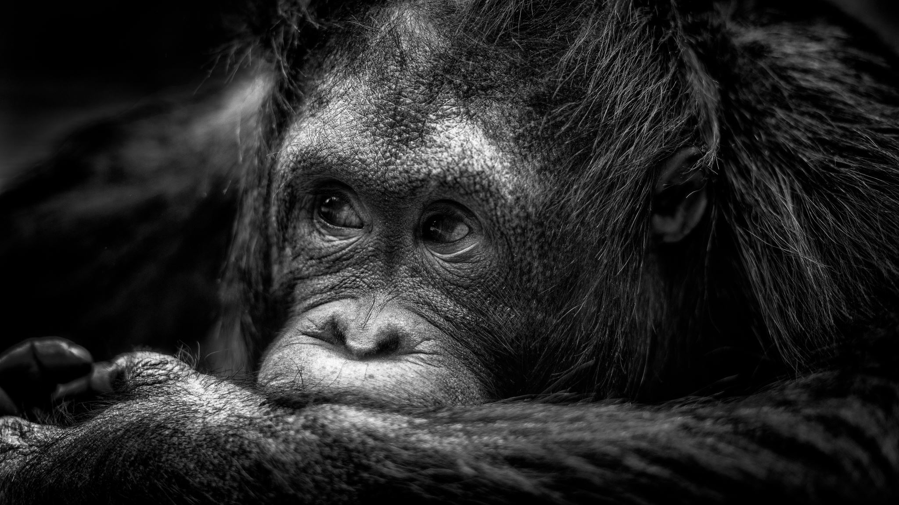
6
Thinking about your future
There are over 600 different apprenticeships available, from accountancy to zoo keeping.
Pair activity (2 mins)
Based on what you have heard, discuss the advantages and disadvantages of an apprenticeship. Could it be an option for you?
Challenge:
Amazing Apprenticeships have lots of information about apprenticeships, as well as a huge selection of vacancies from national employers. Why not check out their website?
©VotesforSchools & TheWOWShow2023
Notes:
Images
Microsoft Office 365
References
https://findapprenticeshiptraining.apprenticeships.education.gov.uk/#
https://www.northeastgrowthhub.co.uk/scheme/business-support/apprenticeship-training/
https://amazingapprenticeships.com/apprenticeships/

Slide 20
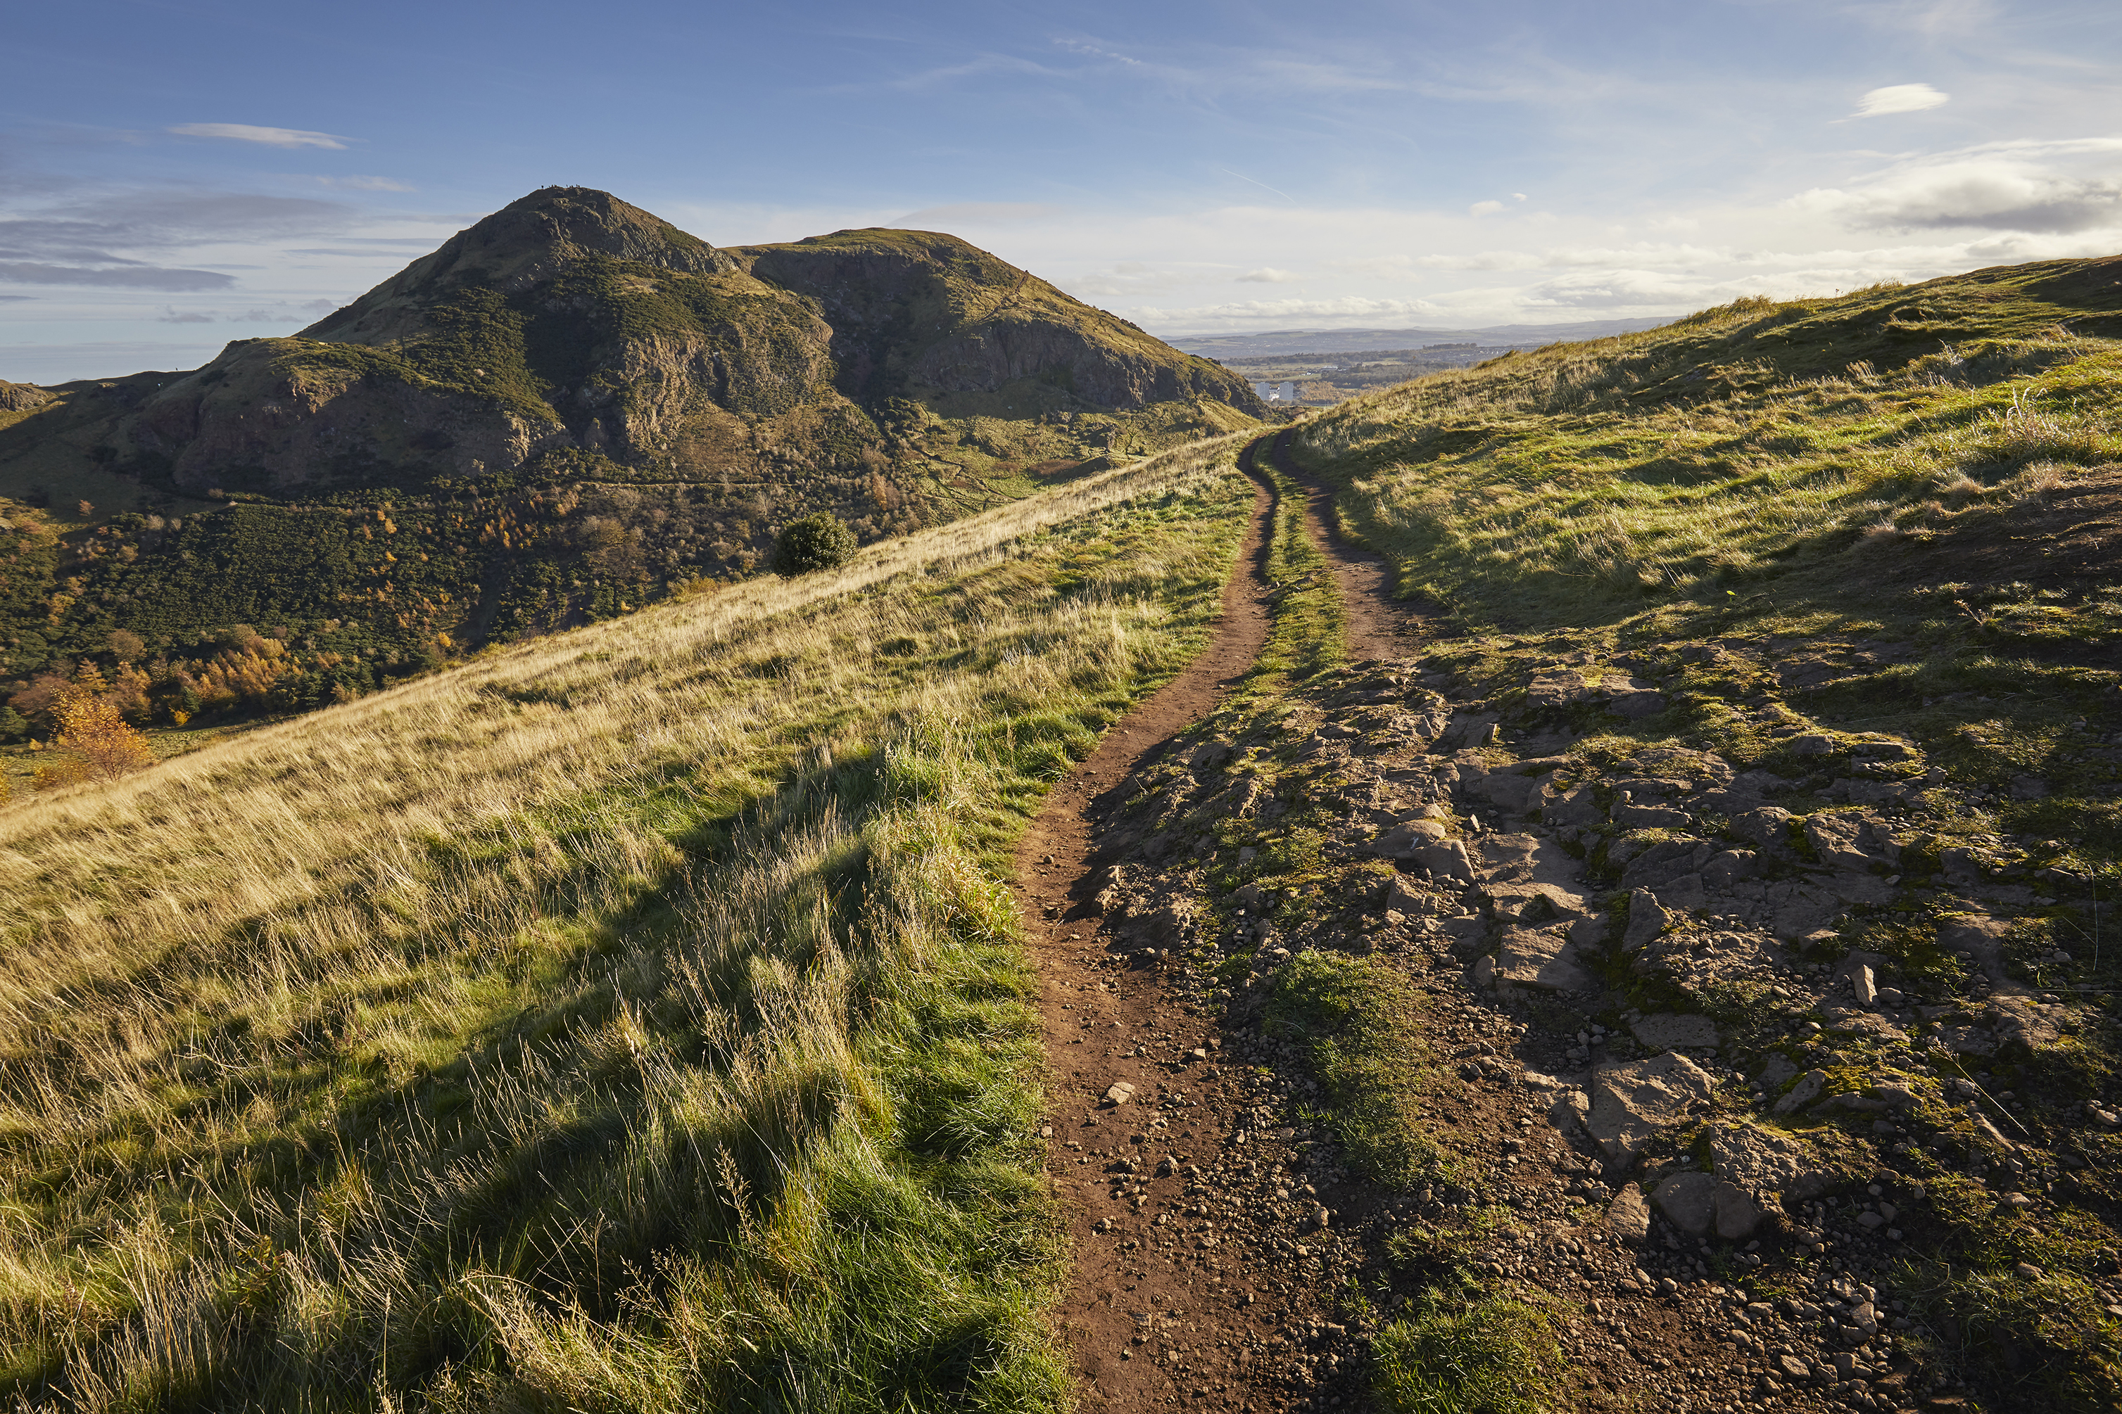
6
Thinking about your future
Another possible future pathway is Higher Education or Institute of Technology. Routes to your future could take different forms, including Traineeships, Vocational Qualifications, Employment, University or Internships.
Individual activity (2-3 mins)
Consider what your ideal career would be. Does it require further training or qualifications? Where could you get these things from?
Definition: Institute of Technology (IoT):
collaborations between further education (FE) providers, universities (HE) and employers.
Making decisions about the future can seem scary, but your careers teacher can provide information and guidance you can feel confident in your choices.
Definition: Higher Education:
Education at a college or university where subjects are studied at an advanced level.
©VotesforSchools & TheWOWShow2023
Notes:
Teacher Notes:
https://www.gov.uk/government/publications/institutes-of-technology--2/institutes-of-technology
IoTs are very new and you may not yet have this option in your local area.
Higher Education (education at a college or university where subjects are studied at an advanced level): https://dictionary.cambridge.org/dictionary/english/higher-education
Link: https://successatschool.org/advicedetails/860/what-is-further-higher-education
Images
Microsoft Office 365
References
https://www.goodschoolsguide.co.uk/careers/further-education/what-is-further-education
https://nationalcareers.service.gov.uk/careers-advice/career-choices-at-16
https://resources.careersandenterprise.co.uk/resources/my-choices-guide-students

Slide 21

6
Thinking about your future
Some jobs require specialist qualifications and skills. It’s good to be aware of this if you’re interested in a specific career so you can get onto the right study pathway as early as possible.
Pair discussion (2-3 mins)
Do you know where to look for extra information on the careers you are interested in?
You could share useful websites, apps and YouTube channels that you think will help with job hunting, applications and being successful in interviews.
©VotesforSchools & TheWOWShow2023
Notes:
Images
Microsoft 365

Slide 22

6
Thinking about your future
There are lots of resources and websites that will help you find your future no matter which direction you are heading in.
Individual activity (2-3 mins)
Have you heard of any of the sources below when it comes to careers? Click the links to find out more!
UCAS
Careers and
Enterprise Company
National Careers Service
©VotesforSchools & TheWOWShow2023
Notes:
Teacher Notes:
Further Education (education below the level of a university degree for people who have left school): https://dictionary.cambridge.org/dictionary/english/further-education
Higher Education (education at a college or university where subjects are studied at an advanced level): https://dictionary.cambridge.org/dictionary/english/higher-education
Link: https://successatschool.org/advicedetails/860/what-is-further-higher-education
Images
Microsoft Office 365
References
https://www.goodschoolsguide.co.uk/careers/further-education/what-is-further-education
https://nationalcareers.service.gov.uk/careers-advice/career-choices-at-16
https://resources.careersandenterprise.co.uk/resources/my-choices-guide-students

Slide 23



6
Thinking about your future
Pair activity (4-5 mins)
Share with a partner where you look and how you keep a record of feedback or good websites and sources of information.
No matter your career aspirations, it’s always useful to spend some time considering what’s coming next.
Maybe you can set aside a little bit of time each week to look at opportunities on the internet with friends or family members?
There are lots of great websites that can help with writing job applications and making sure you fit the person specification and job description.
Or, you could give your CV or personal statement to others to get some feedback on how well it represents you.
©VotesforSchools & TheWOWShow2023
Notes:
Teacher Notes: The Mix and iCould have excellent information for students.
Images
Unsplash
References
https://dictionary.cambridge.org/dictionary/english/feedback
https://icould.com/explore/categories/career-paths/getting-a-job/getting-a-job
https://www.themix.org.uk/work-and-study
https://icould.com/

Slide 24





6
Thinking about your future
Activity (1-2 mins)
When you eventually apply for jobs, there are five simple steps to the recruitment and selection process. Click to see them in action!
Identify the vacancy:
A business may need more people or someone may leave.
1
Job analysis:
The business then decides what it needs from a new employee.
Create a job description:
This will contain information about pay, conditions, duties and hours.
2
3
Create a person specification:
What the business needs is matched to qualifications & skills.
Advertise the job:
The job advert is released so that people can apply.
4
5
©VotesforSchools & TheWOWShow2023
Notes:
Images
Unsplash
References
https://www.bbc.co.uk/bitesize/guides/z3s9fcw/revision/2 - A good source of information on this area of the framework

Slide 25
6
Thinking about your future
1
2
Identify the vacancy
Job analysis
Challenge:
Knowing how jobs are created could help you with an application. Think about and discuss how this information helps you with writing a successful application.
3
4
5
Create a job description
Create a person specification
Advertise the job
©VotesforSchools & TheWOWShow2023
Notes:
Images
Unsplash
References
https://www.bbc.co.uk/bitesize/guides/z3s9fcw/revision/2 - A good source of information on this area of the framework

Slide 26

6
Thinking about your future
Individual reflection (3-5 mins)
Now you’ve listened to everything in this lesson, do you have a better idea of where you want to go and what you would like to do? If so, have you thought of what you need to prioritise to get there? What targets do you need to set yourself to reach your goals? Use the ideas below to help you.
Map out the small steps you need to take to keep you focused and on track to your best future.
Discuss what you want to do and how you will get there with friends and family.
Set yourself SMART targets to get there. SMART targets are Specific, Measurable, Accepted, Realistic and Time-bound.
Seek opportunities for work experience (in person or virtual) in employment sectors you are interested in.
©VotesforSchools & TheWOWShow2023
Notes:
Images
Microsoft 365
References
SMART: https://www.bbc.co.uk/bitesize/guides/zwr34j6/revision/3
Specific – state exactly what will need to be done
Measurable – clear what success will look like
Accepted – decided on by all participants in the process
Realistic – know it is practical (steps can be taken to do it)
Time-bound – state when it will be achieved

Slide 27

i
Information and support
Click the links to visit the websites, or make a note of their names to look at later.
You may wish to print this.
icould is a great place to get tips on GCSE options, apprenticeships, university, finding work (and more!).
The Prince’s Trust has lots of links to websites and resources to help career teaching.
BBC Bitesize has lots of information on course choices, CVs, interviews and much more.
Careerpilot has lots of information including quizzes, course information and an action planner.
Launch Your Career will help you find pathways to colleges, courses, apprenticeships and more.
National Careers Week has a huge collection of information and resources.
Coursesonline has a quiz to help see which careers you are suited to.
The National Careers Service provides careers information, advice and guidance for students age 13+.
©VotesforSchools & TheWOWShow2023
Notes:
Images
Pixabay
References
https://icould.com/
https://nationalcareers.service.gov.uk/
https://www.careerpilot.org.uk/
https://www.bbc.co.uk/bitesize/careers
https://www.princes-trust.org.uk/help-for-young-people/who-else/employment/careers-advice
https://nationalcareersweek.com/
https://launchyourcareer.com/en_UK
https://www.coursesonline.co.uk/enneagram-personality-test/

Slide 28
Jobs That Can Save the Planet
KS5 Lesson
In association with
and
©VotesforSchools & TheWOWShow2023

