Slide 1




Jobs That Can Save the Planet
KS4 Short Lesson
In association with
and
©VotesforSchools & TheWOWShow2023

Slide 2


1
What do you know about climate change?
Climate change: we’ve all heard about it, but what does it mean?
Pair discussion (1 min)
Quickly explain what you know about climate change, using only 3 words!
©VotesforSchools & TheWOWShow2023
Notes:
Images
Pixabay

Slide 3


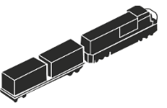


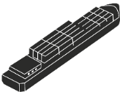
1
What do you know about climate change?
Climate change is caused by increasing amounts of greenhouse gases in the atmosphere.
Greenhouse gases in the atmosphere trap heat on Earth. The most commonly released greenhouse gas is carbon dioxide (CO₂). Think of it like layering more blankets keeping heat in!
Class activity (1-2 mins)
Which processes do you think release carbon dioxide into the atmosphere?
A major way carbon dioxide is released is when fuels are burned to generate power for activities like transport, electricity generation and powering machines.
©VotesforSchools & TheWOWShow2023
Notes:
Images
Pixabay

Slide 4
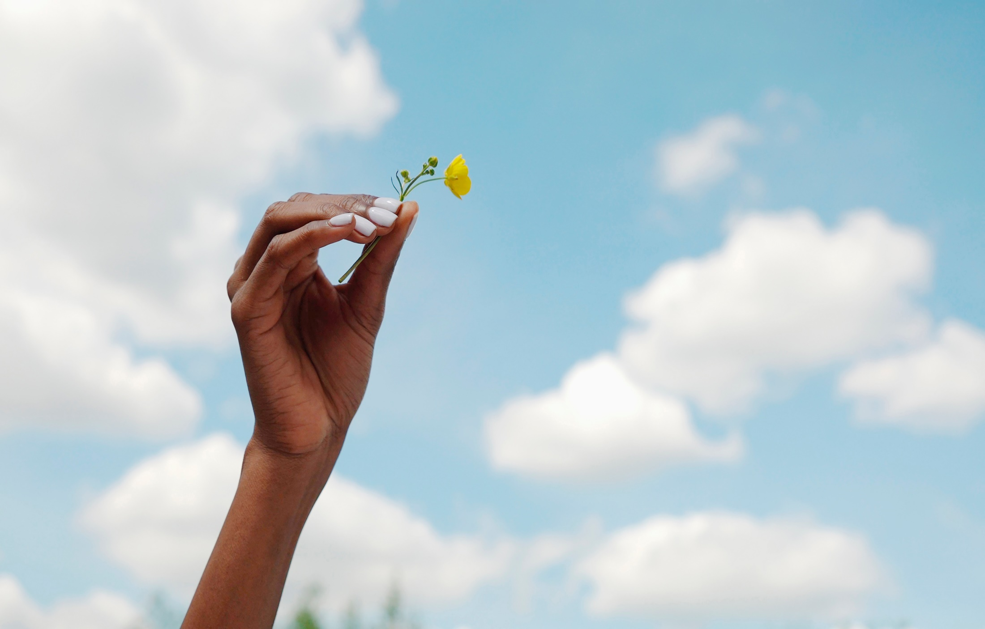
1
What do you know about climate change?
Many businesses are working on environmental sustainability by shrinking their carbon footprint, cutting down on waste, and reducing their water and energy use to help the environment.
The environment is damaged by pollution, loss of habitats and loss of diversity as well as the impact of climate change.
Sustainability to a business could mean saving money, having a good reputation with customers, and making a difference to the planet itself.
Definition: Carbon footprint
The amount of carbon released to the atmosphere.
Definition: Sustainability
Causing little or no damage to the environment over a long period of time.
©VotesforSchools & TheWOWShow2023
Notes:
Images
1) Microsoft Office 365
References
Carbon neutral v carbon net zero - https://dodo.eco/blog/whats-the-difference-between-carbon-neutral-and-net-zero?gclid=Cj0KCQjwhqaVBhCxARIsAHK1tiNcnH3hU3Ta4e_4AS7wh9WX4H6nKKG4Yx7gubMbvdJYB0z7bHWMeMUaArXiEALw_wcB
https://www.cbi.org.uk/articles/is-your-company-ready-to-save-the-planet/
https://www.greenjournal.co.uk/2022/09/5-ways-british-companies-are-saving-the-planet/
https://blog.shorts.uk.com/sustainable-business-practices
https://dictionary.cambridge.org/dictionary/english/carbon-footprint
https://dictionary.cambridge.org/dictionary/english/sustainability

Slide 5
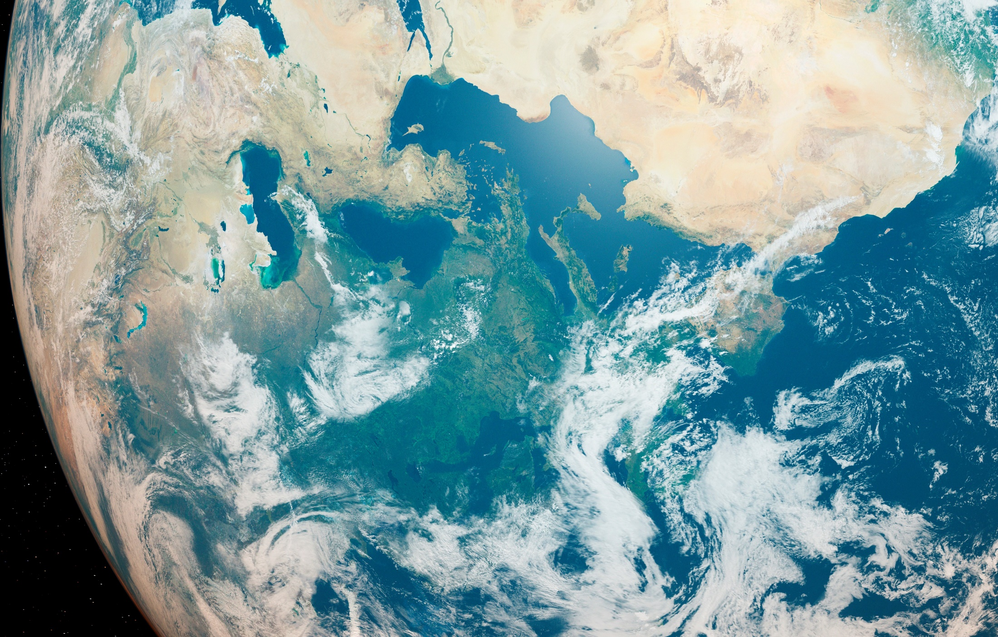
1
What do you know about climate change?
Definition: Carbon neutral
Balancing emissions through offsetting activities.
Definition: Net-zero
Reducing greenhouse gases (GHG) emissions as much as possible and then offsetting any remaining.
The aim is for businesses to become “carbon neutral” or to be “net-zero”.
Definition: Offsetting
Activities to remove carbon such as planting trees.
Since 1990, the UK has almost halved greenhouse gas emissions, and in 2019 the UK set a target of reaching net-zero emissions by 2050.
Over the next few slides, we will look closely at how you can find your future in a green career and help to save the planet!
©VotesforSchools & TheWOWShow2023
Notes:
Teacher notes:
Carbon neutral: A balance between the amount of carbon dioxide emitted by an activity, and the amount of carbon dioxide removed from the atmosphere.
Net zero: the amount of GHGs emitted into the atmosphere has been reduced as much as possible, then the remaining GHGs that are still being emitted are being balanced by removing carbon dioxide from the atmosphere
Images
Microsoft Office 365
References:
Carbon neutral v carbon net zero - https://dodo.eco/blog/whats-the-difference-between-carbon-neutral-and-net-zero?gclid=Cj0KCQjwhqaVBhCxARIsAHK1tiNcnH3hU3Ta4e_4AS7wh9WX4H6nKKG4Yx7gubMbvdJYB0z7bHWMeMUaArXiEALw_wcB
https://www.gov.uk/government/publications/net-zero-strategy
https://www.cbi.org.uk/articles/is-your-company-ready-to-save-the-planet/
https://www.greenjournal.co.uk/2022/09/5-ways-british-companies-are-saving-the-planet/
https://blog.shorts.uk.com/sustainable-business-practices
https://assets.publishing.service.gov.uk/government/uploads/system/uploads/attachment_data/file/1033990/net-zero-strategy-beis.pdf
https://dictionary.cambridge.org/dictionary/english/offset

Slide 6

2
What are green careers?
Discussion (2-4 mins)
When you hear the term “green careers”, what do you think about?
Definition: Green career
A job that would help protect the environment in some way.
“Green career” is a hard term to explain simply. It could mean an obviously “green” job like creating and installing solar panels, or it could be more indirect, such as working as an accountant for a company committed to reducing carbon emissions to help save the planet.
Whether there is a particular career that you aspire to, or you just want to be involved in saving the planet, a green career could be a great choice for you.
©VotesforSchools & TheWOWShow2023
Notes:
Images
Microsoft Office 365
References
https://educationhub.blog.gov.uk/2022/11/07/what-is-a-green-job-everything-you-need-to-know/
https://www.ons.gov.uk/economy/environmentalaccounts/methodologies/thechallengesofdefiningagreenjob

Slide 7

2
What are green careers?
Nationally, green jobs are set to rise by 600% by 2050, resulting in 2 million jobs.
The same level of qualifications will mean 8% higher wages in green jobs.
In 2020, between 3-5% of the jobs in Surrey were in green careers. But, this is set to double, meaning thousands of new jobs!
Average salaries in net-zero roles are £42,600, compared to £33,400 in other roles.
©VotesforSchools & TheWOWShow2023
Notes:
References
The WOW Show film

Slide 8
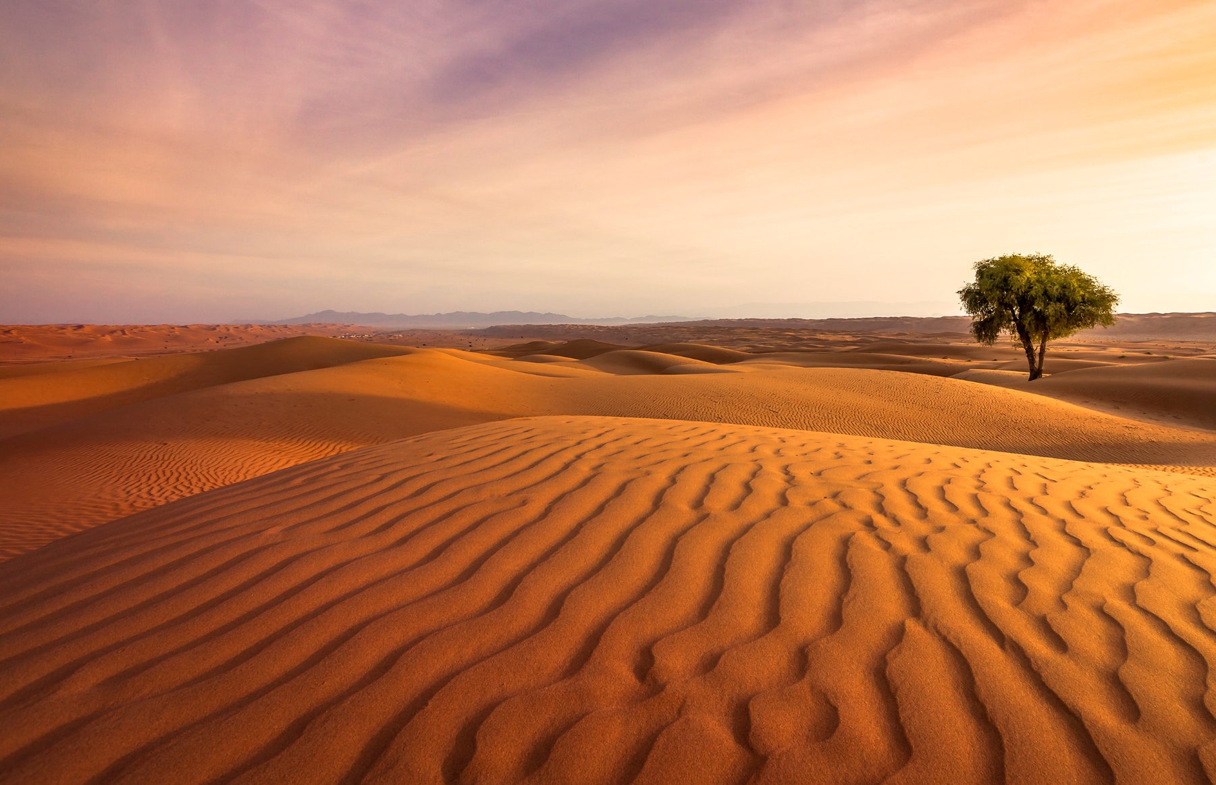
3
Why are they important?
Individual activity (2 mins)
Write down 3 things that climate change could lead to. Click for some ideas if you’re not sure.
Sea levels will increase if ice, particularly in polar regions, keeps melting. Many low-lying areas, like some coastal regions and islands, will experience flooding if sea levels rise.
Extreme weather events are expected to become more common over time too. This would include heavy rains, droughts, and disasters (such as hurricanes) being stronger.
Food and water availability will be affected by a changing climate. Fresh water will become harder to access over time as rainfalls change and droughts occur.
©VotesforSchools & TheWOWShow2023
Notes:
Images
Microsoft Office 365

Slide 9
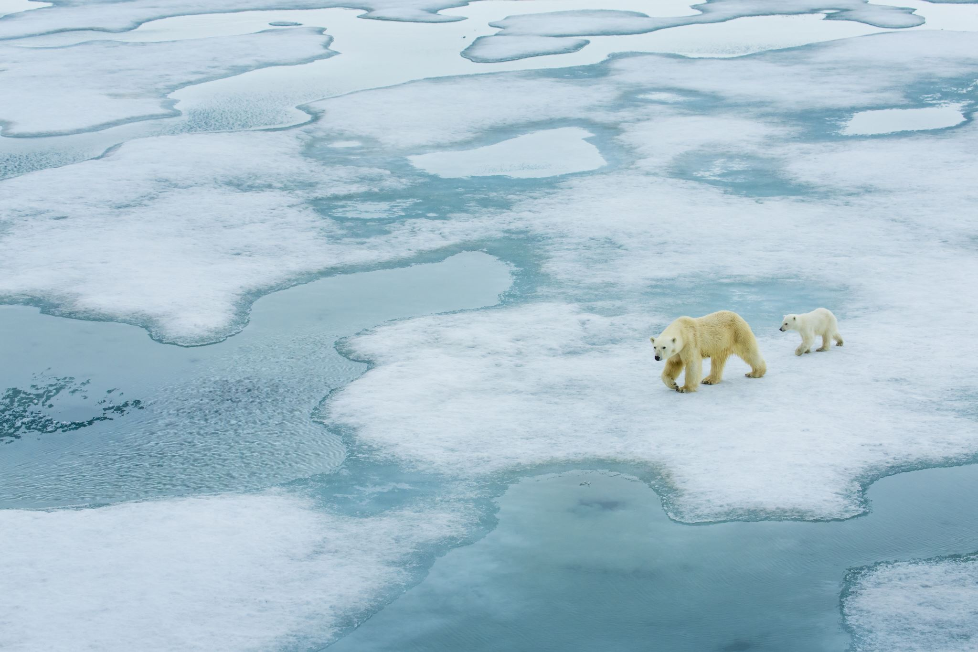
3
Why are they important?
Activity (3-5 mins)
In pairs or small groups, write down three reasons why you think green careers are important for the future.
Did you think about global climate change and its impact on everything else?
Did you think about changing technologies and behaviour from people?
Challenge:
Share your ideas: which careers are needed to help save the planet and why?
Did you think about transport, homes and energy?
©VotesforSchools & TheWOWShow2023
Notes:
Images
Microsoft Office 365

Slide 10








4
Which skills do you need?
Pair activity (3-5 mins)
As well as qualifications and specialist skills, the other types of skills employers look for are known as “soft skills”. Can you write a list of the skills you think are needed to be employable? Click if you need a little help!
Leadership
Teamwork
Logic
Listening
Aiming High
Speaking
Creativity
Optimism
©VotesforSchools & TheWOWShow2023
Notes:
Images
Unsplash

Slide 11

4
Which skills do you need?
Watch & discuss (12-20 mins)
Over the next few slides, you will watch 3 short films about green jobs. Click the link on the picture to watch each one and then head to the next slide for some discussion questions.
©VotesforSchools & TheWOWShow2023
Notes:
Images
Microsoft Office 365
References
Green Skills Report 2022

Slide 12

4
Which skills do you need? - Transport
0:00-2:45
Transport electrification will need people with specialist skills in electrification, batteries, power electronics and electric machines. These skills will be needed to meet the growing demand for design engineers, development engineers, systems engineers, electronics technicians, and vehicle technicians.
©VotesforSchools & TheWOWShow2023
Notes:
YouTube Video Link: https://www.youtube.com/watch?v=jQP8Vm31hro
SafeShare Video Link: https://safeshare.tv/x/jQP8Vm31hro
Images
The WOW Show
References
Green Skills Report 2022

Slide 13
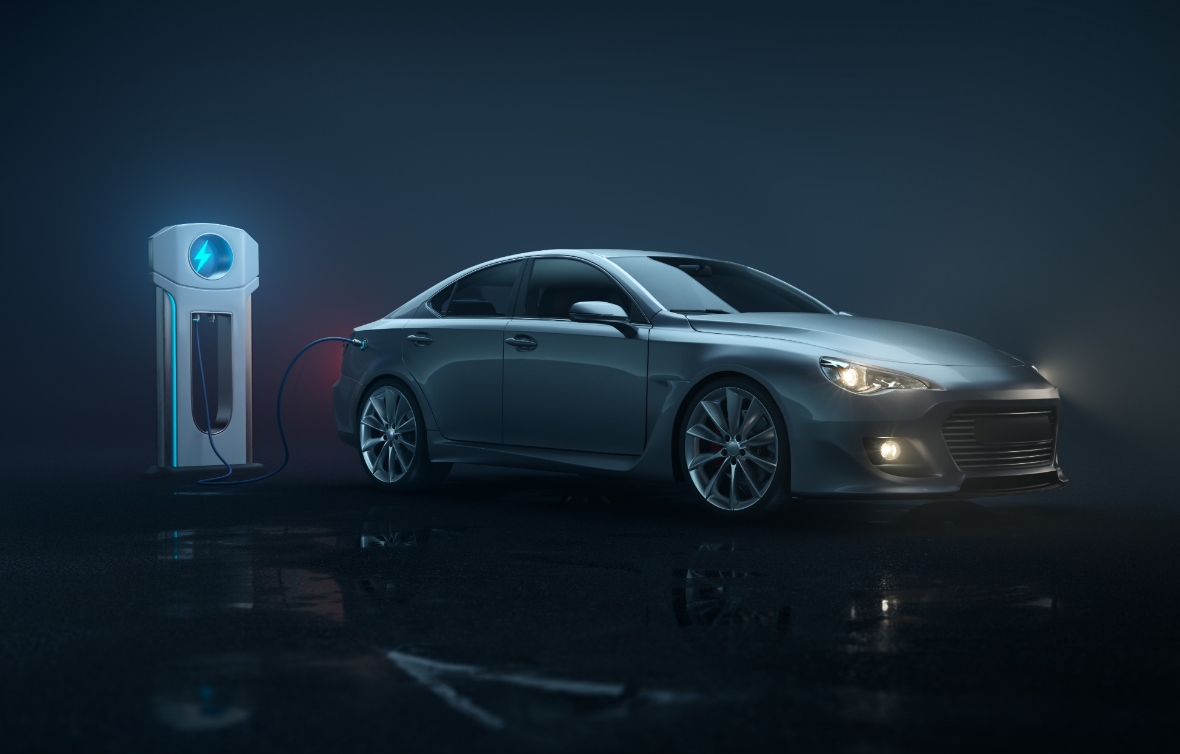
4
Which skills do you need? - Transport
Discuss (2-4 mins)
Did any of the careers in the film interest you? What is your opinion on electric cars?
Most people agree Electric Vehicles are the future. They will need designers, engineers, mechanics and people to develop batteries further.
If you have a passion for vehicles or for helping the planet, maybe these options are for you?
Depending on which area of transport you wish to work in there are GCSEs and
training choices for you – just ask your Careers teacher.
©VotesforSchools & TheWOWShow2023
Notes:
Images
Microsoft Office 365
References
Green Skills Report 2022

Slide 14
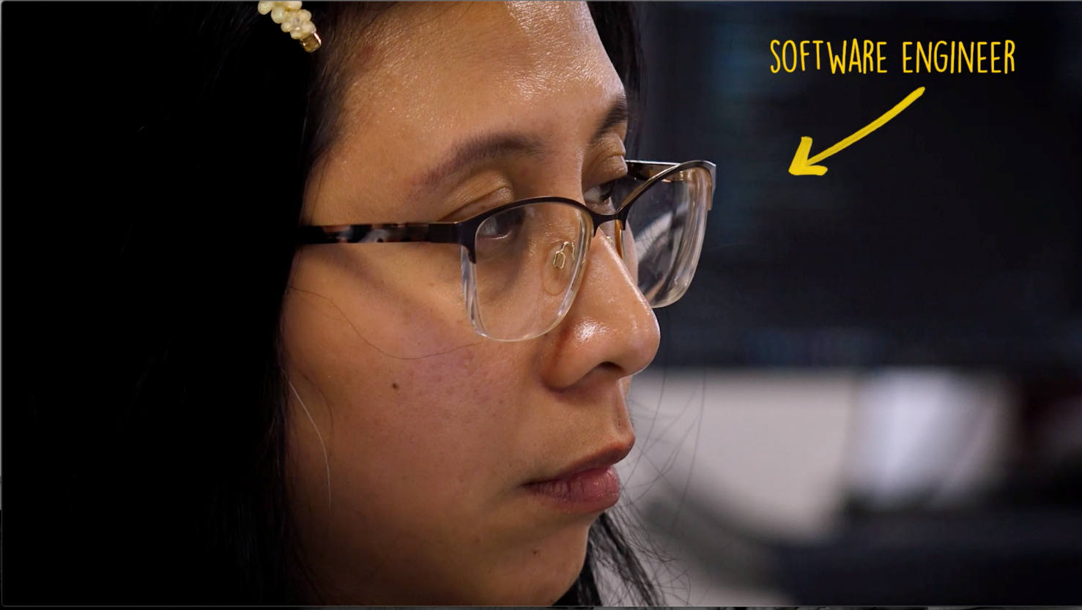
4
Which skills do you need? - Energy
0:00- 3:13
Becoming carbon neutral by 2050 is all about finding new and sustainable energy sources and using them efficiently.
©VotesforSchools & TheWOWShow2023
Notes:
YouTube Video Link: https://www.youtube.com/watch?v=mF4rOkY1zSA
SafeShare Video Link: https://safeshare.tv/x/mF4rOkY1zSA
Images
The WOW Show
References
Green Skills Report 2022

Slide 15

4
Which skills do you need? - Energy
Discuss (2-4 mins)
Are there any jobs featured in the film that interest you for your future career?
There are lots new technologies in wind, solar power, biofuels, hydropower and hydrogen to produce energy.
But as well as generating energy it is important to analyse energy use and then using that information to reduce usage and be more efficient.
Within energy jobs, new engineering skills will be needed to create new technology. As you heard, waste food can also be used to create energy.
©VotesforSchools & TheWOWShow2023
Notes:
Images
Microsoft Office 365
References
Green Skills Report 2022

Slide 16
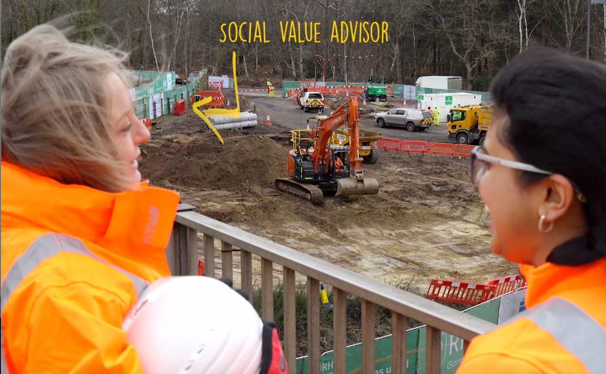
4
Which skills do you need? - Construction
0:00- 2:24
The skills gap within construction is very big. A recent survey showed a shortage of skills in this area across the UK. There are currently 2 million roles in construction.
©VotesforSchools & TheWOWShow2023
Notes:
YouTube Video Link: https://www.youtube.com/watch?v=so4TFJBFU1c
SafeShare Video Link: https://safeshare.tv/x/so4TFJBFU1c
Images
The WOW Show
References
Green Skills Report 2022
https://www.surrey-chambers.co.uk/report/green-skills-test-report/
Images
The WOW Show

Slide 17

4
Which skills do you need? - Construction
Discuss (2-4 mins)
Talk to a partner: did you like any of the jobs discussed in the film? Is a career in construction something you considered?
Construction projects need lots of different skills and people, whether it is a new building project or a retrofit. Retrofitting old buildings can reduce energy use by 80%.
Define: Retrofit
Changing an existing building’s technology and materials to make it more energy efficient.
Replacing windows, doors or rooves make buildings more energy efficient, reducing energy use.
New heating and hot water systems would also reduce energy use.
©VotesforSchools & TheWOWShow2023
Notes:
Images
Microsoft Office 365
References
Green Skills Report 2022
https://www.surrey-chambers.co.uk/report/green-skills-test-report/
https://www.gov.uk/government/publications/retrofit-for-the-future-a-guide-to-making-retrofit-work

Slide 18

5
Thinking about your future
During the two years in KS4, you may change ideas about your future, but there is time to find out more.
If you are not sure what you want to do, try to choose a good balance to keep your options open.
It is important to choose the right pathway to make sure you are qualified to do your dream job.
Don’t forget, most of us work for about 40 years, so it’s important you choose things that you enjoy!
©VotesforSchools & WOWShow2023
Notes:
Images
The WOW Show
References
https://www.prospects.ac.uk/careers-advice/getting-a-job/skills-shortages-and-covid-19
https://dictionary.cambridge.org/dictionary/english/transition

Slide 19
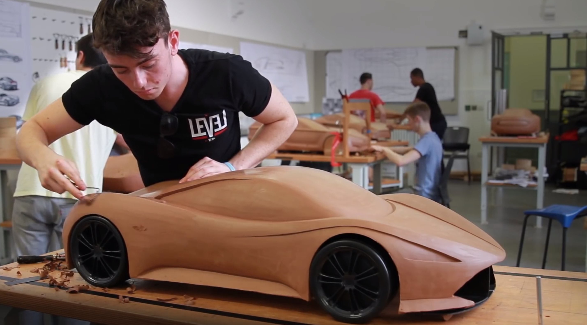
5
Thinking about your future
0:00-1:57
Pair discussion (3-5 mins)
Click the image to watch a video about choices after GCSEs. Discuss with your partner: what can you do to make sure you are making the best choice(s) for your success?
Before kickstarting your career, some transitions need to take place! This can be a move into sixth form, further education, a traineeship, an apprenticeship or a job.
Define: Transition
The change from one part of your life to a new phase.
©VotesforSchools & WOWShow2023
Notes:
YouTube Video Link: https://www.youtube.com/watch?v=f_xAQNNi4pA
SafeShare Video Link: https://safeshare.tv/x/f_xAQNNi4pA
Images
The WOW Show
References
https://www.prospects.ac.uk/careers-advice/getting-a-job/skills-shortages-and-covid-19
https://dictionary.cambridge.org/dictionary/english/transition

Slide 20

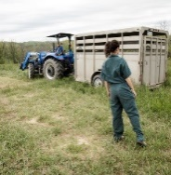



5
Thinking about your future
Apprenticeships
Post-16, there are a number of pathways into the job you want. The pathway you take will depend on the kind of job you want and the type of learner you are.
Traineeships
T Levels
Pair/Small group discussion (2-3 mins)
Discuss with a partner or in a small group: what career are you interested in? How can you get there? Click if you need some inspiration!
A Levels
Internships
University
©VotesforSchools & TheWOWShow2023
Notes:
Images
Unsplash
Amazing Apprenticeships
Microsoft Office 365
References
https://amazingapprenticeships.com/resource/tlevels-guide/
https://www.gov.uk/government/publications/t-levels-resources-for-teachers-and-careers-advisers
https://amazingapprenticeships.com/resources

Slide 21
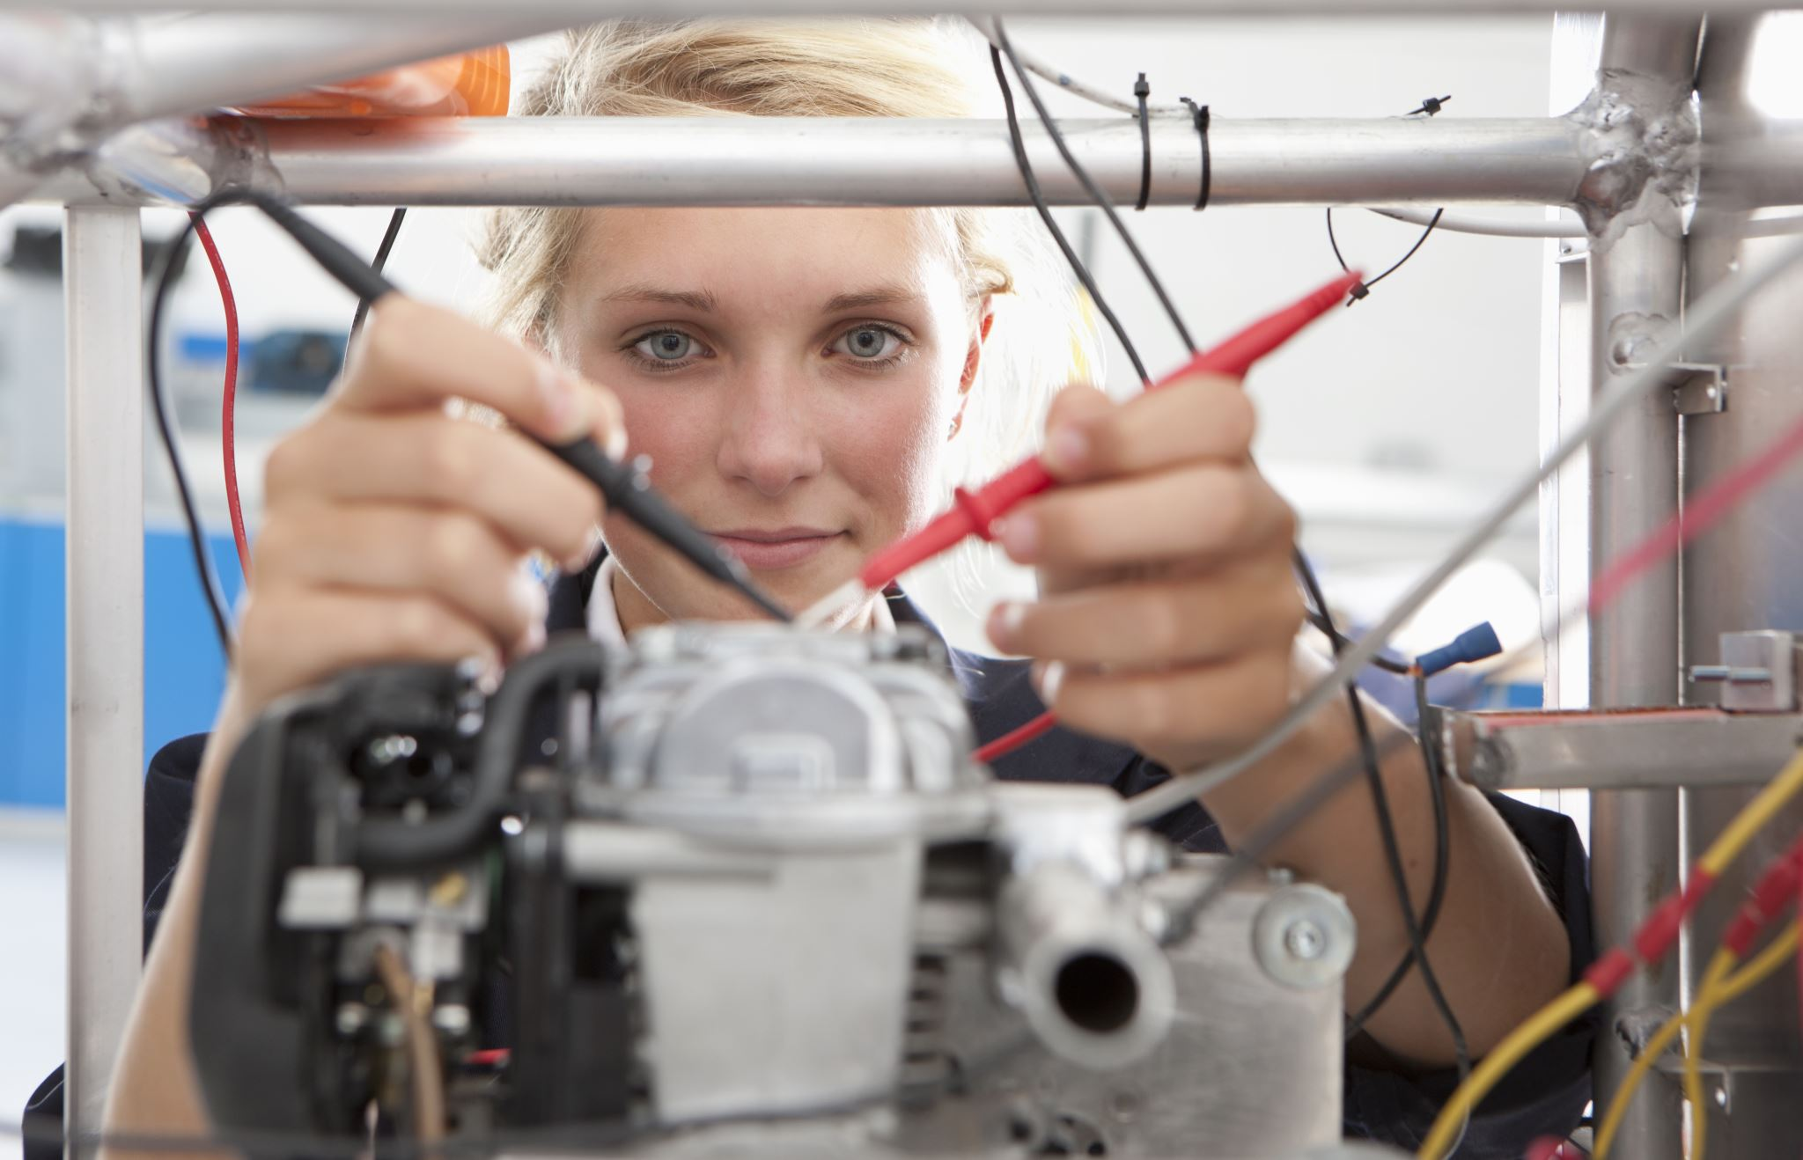
5
Thinking about your future
Pair activity (2-3 mins)
Talk to a different partner about your future plans. Are you thinking about further education, or would you prefer a practical way to gain the skills you need?
Definition: T Levels
A two-year qualification as an alternative to A Levels, apprenticeships or other post-16 courses.
T Levels are an option you may not have considered when it comes to planning your future. They combine classroom learning with industry experience that is specifically designed for a certain sector or employer.
Challenge:
Search for T Levels in your local area.
©VotesforSchools & TheWOWShow2023
Notes:
Images
Microsoft Office 365
References
https://www.tlevels.gov.uk/students
https://www.gov.uk/government/publications/introduction-of-t-levels/introduction-of-t-levels
https://www.gov.uk/government/publications/providers-selected-to-deliver-t-levels - List of T level providers.

Slide 22
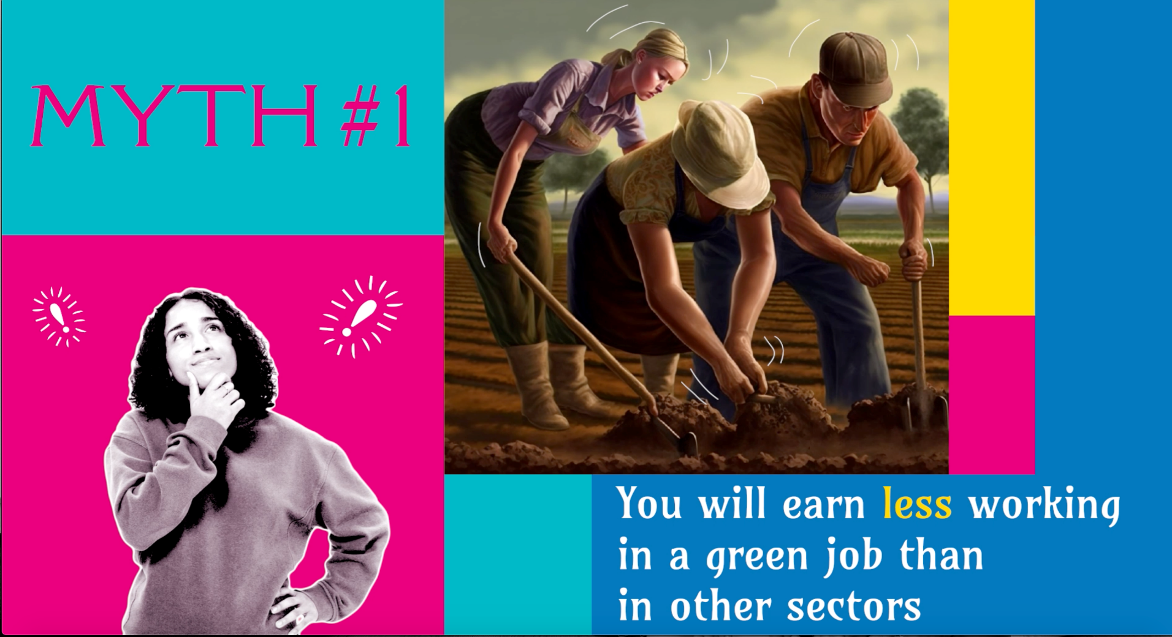
?
Teacher’s Note:
Skip if short on time.
Extension: Myth buster quiz
0:00- 1:37
Activity (5+ mins)
Click the image to see some interesting facts about green jobs.
©VotesforSchools & TheWOWShow2023
Notes:
YouTube Video Link: https://www.youtube.com/watch?v=XQi4gPT8jKc
SafeShare Video Link: https://safeshare.tv/x/XQi4gPT8jKc
Images
1) Via video

Slide 23

i
Information and support
Click the links to visit the websites, or make a note of their names to look at later.
You may wish to print this.
icould is a great place to get tips on GCSE options, apprenticeships, university, finding work (and more!).
The Prince’s Trust has lots of links to websites and resources to help career teaching.
BBC Bitesize has lots of information on course choices, CVs, interviews and much more.
Careerpilot has lots of information including quizzes, course information and an action planner.
Launch Your Career will help you find pathways to colleges, courses, apprenticeships and more.
National Careers Week has a huge collection of information and resources.
Coursesonline has a quiz to help see which careers you are suited to.
The National Careers Service provides careers information, advice and guidance for students age 13+.
©VotesforSchools & TheWOWShow2023
Notes:
Images
Pixabay
References
https://icould.com/
https://nationalcareers.service.gov.uk/
https://www.careerpilot.org.uk/
https://www.bbc.co.uk/bitesize/careers
https://www.princes-trust.org.uk/help-for-young-people/who-else/employment/careers-advice
https://nationalcareersweek.com/
https://launchyourcareer.com/en_UK
https://www.coursesonline.co.uk/enneagram-personality-test/

Slide 24
Jobs That Can Save the Planet
KS4 Short Lesson
In association with
and
©VotesforSchools & TheWOWShow2023

