Slide 1
What’s in a building? Jobs you didn’t know existed
In association with VotesforSchools and The WOW Show
©VotesforSchools The WOW Show 2023

Slide 2
Learning objectives for today
Challenge stereotypes and their relationship to life roles, work-life balance and career destinations.
Listen to speakers talking about the roles that are available in their workplace and sector.
Prepare pupils for experiences of work by helping them to develop questions to find out about the roles available in the workplaces that they are visiting, what qualifications people need to get those roles and how you progress within the organisation.
To research your education, training, apprenticeship, employment and volunteering options including information about the best progression pathways through to specific goals.
©VotesforSchools The WOW Show 2023
Notes:
References:
https://dictionary.cambridge.org/dictionary/english/employability
https://dictionary.cambridge.org/dictionary/english/curriculum vitae

Slide 3
1
Careers in Construction
Discuss (3 mins)
What do you think of when you hear the word construction?
Come up with your 3 main thoughts and share them with the class.
©VotesforSchools The WOW Show 2022
Notes:
References
1)
Images
OxLEP
Pixabay
Icons8

Slide 4
1
Careers in Construction
0:00-8:38
Activity (10 mins)
Click on the image to watch the film and think about the varied careers available in construction.
©VotesforSchools The WOW Show 2023
Notes:
YouTube Video Link: https://www.youtube.com/watch?v=R1vyMQXvbi4
SafeShare TV Video Link: https://safeshare.tv/x/uDi2IBnMjJw
A short version with the trades only:
YouTube Video Link: https://www.youtube.com/watch?v=vRRfMmM4nVo
SafeShare TV Video Link: https://safeshare.tv/x/vRRfMmM4nVo#
References
1)
Images
OxLEP
Pixabay
Icons8

Slide 5
1
Careers in Construction
Activity (2 mins)
As a group, discuss what you thought about the roles you saw in the film. Then click on the image below to watch the short film from Go Construct to see the 170 plus roles available.
Construction employs around 3.1 million people, which is around 9% of the UK workforce. See if there are any that you think would suit you and your future.
There are so many roles available in construction from Accountant to Wood machinist, and everything in between.
0:00-1:46
©VotesforSchools The WOW Show 2023
Notes:
YouTube Video Link: https://www.youtube.com/watch?v=JGjJnWwkNXQ
SafeShare TV Video Link: https://safeshare.tv/x/JGjJnWwkNXQ
References:
https://www.goconstruct.org/construction-careers/browse-all-job-roles/
https://banbury.activatelearning.ac.uk/courses/career-pathways/construction/

Slide 6
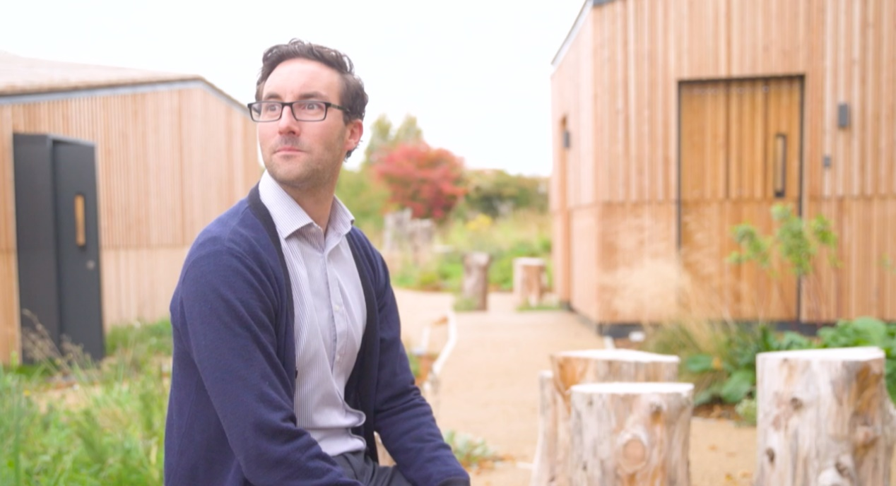
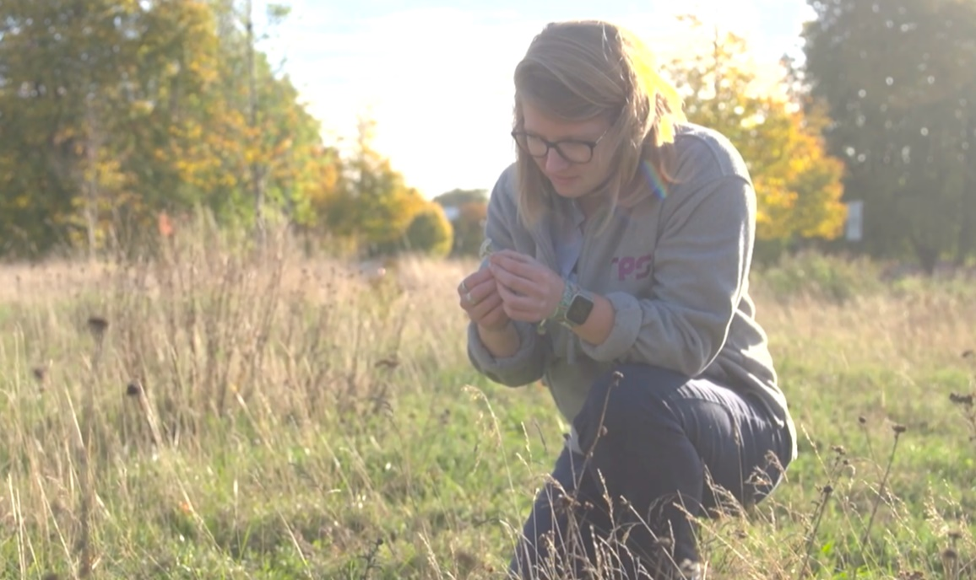
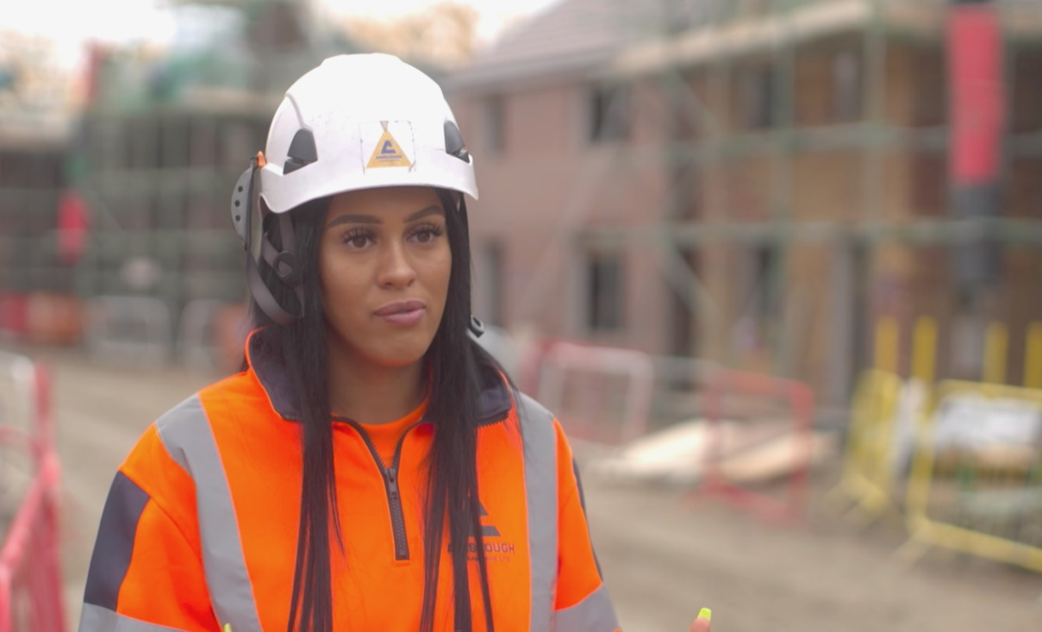
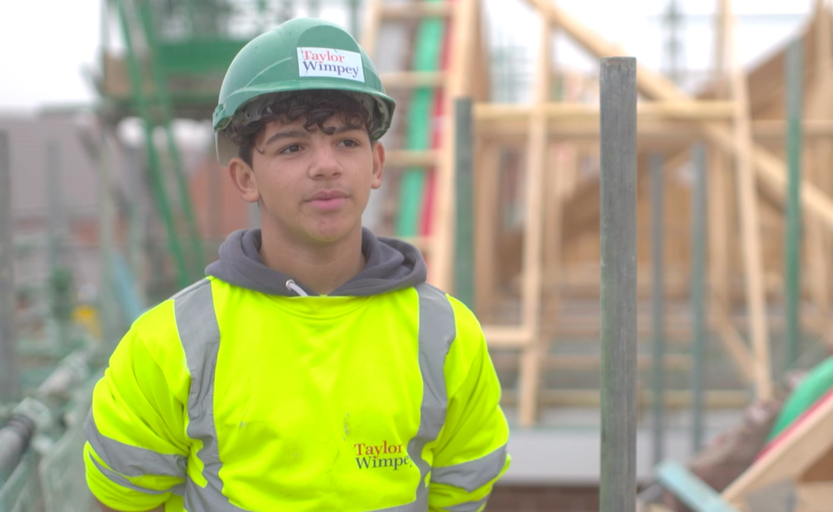
1
Careers in Construction
As you have heard construction has so many different opportunities for lots of different careers.
Whether you are interested in the environment, planning, design or the actual build, there could well be something for you!
Activity (2 mins)
A quick show of hands, raise your hand if there are any careers that you have seen that would interest you. Did any of the careers surprise you?
©VotesforSchools The WOW Show 2023
Notes:
References:
Images:
1) The WOW Show film

Slide 7
2
Routes into construction
Discuss (2 mins)
Which routes can you think of to enter a career in the construction industry?
Apprenticeships
There are 100s of apprenticeships where you can earn money while you learn.
Work experience
This can help you get a feel for a job you’re interested in and will improve your CV, making you more employable.
College courses
Courses are available, such as bricklaying, carpentry and joinery, civil engineering, heritage skills and technician trades.
University degree
At university, you’ll have a chance to focus on a specific subject and study with experts in your field.
©VotesforSchools The WOW Show 2023
Notes:
References
1) https://www.goconstruct.org/get-started-in-construction/
https://dictionary.cambridge.org/dictionary/
Images
Icons8

Slide 8
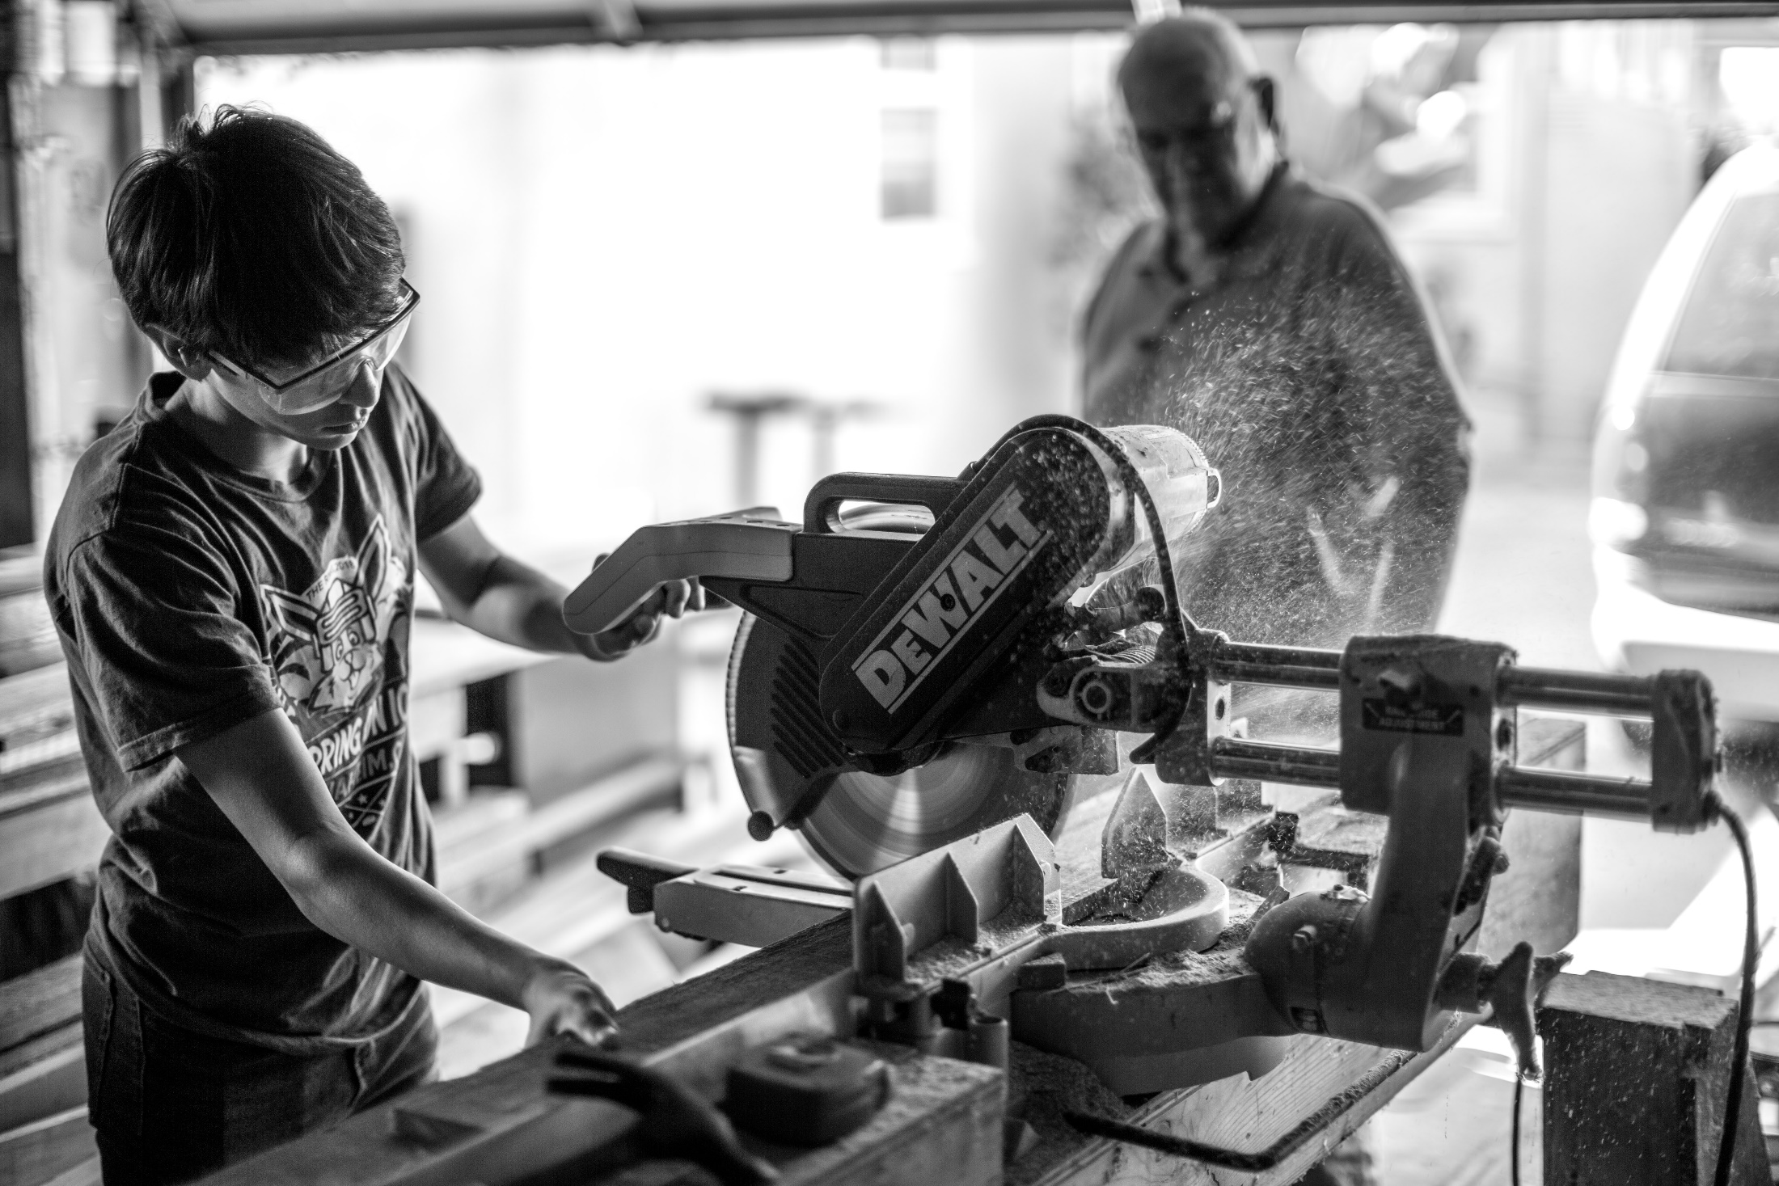
2
Routes into construction - Apprenticeships
An apprenticeship is a job with training and is for anyone aged 16 and over.
During an apprenticeship, you’ll work with experienced staff and gain qualifications by doing practical and academic learning.
Your employer will give you tasks to perform, and a training provider will equip you with the theoretical skills to perform those tasks.
There are 100's of diverse, rewarding construction apprenticeships to choose from. You could be behind a drawing board, developing project management skills, training as a craftsperson and more.
©VotesforSchools The WOW Show 2023
Notes:
References
1) https://www.goconstruct.org/get-started-in-construction/apprenticeships/
Images
Unsplash

Slide 9
2
Routes into construction - College
Colleges can prepare you for a specific career or higher-level qualifications.
Through further education (FE), you can build technical, vocational or academic skills in a wide variety of subjects.
Further education is for anyone who has left school. You can go to college to continue studying straight after finishing your GCSEs, or at a later stage in life.
There are several colleges or training providers within your local area, two are featured at the end of the lesson.
©VotesforSchools The WOW Show 2023
Notes:
References
1) https://www.goconstruct.org/get-started-in-construction/college/
Images
Icons8

Slide 10
2
Routes into construction - University
At university, you can focus on a specific subject and study with experts. There are lots of degrees for a career in the construction and built environment sector.
If you have a specific role in mind, you could look at the universities which offer courses in your chosen field.
Student loans are available in England, Scotland and Wales to help cover tuition fees and living costs.
Prospects and UCAS are good places to start researching degree courses.
©VotesforSchools The WOW Show 2023
Notes:
References:
https://www.goconstruct.org/get-started-in-construction/university/
Images:
Unsplash

Slide 11
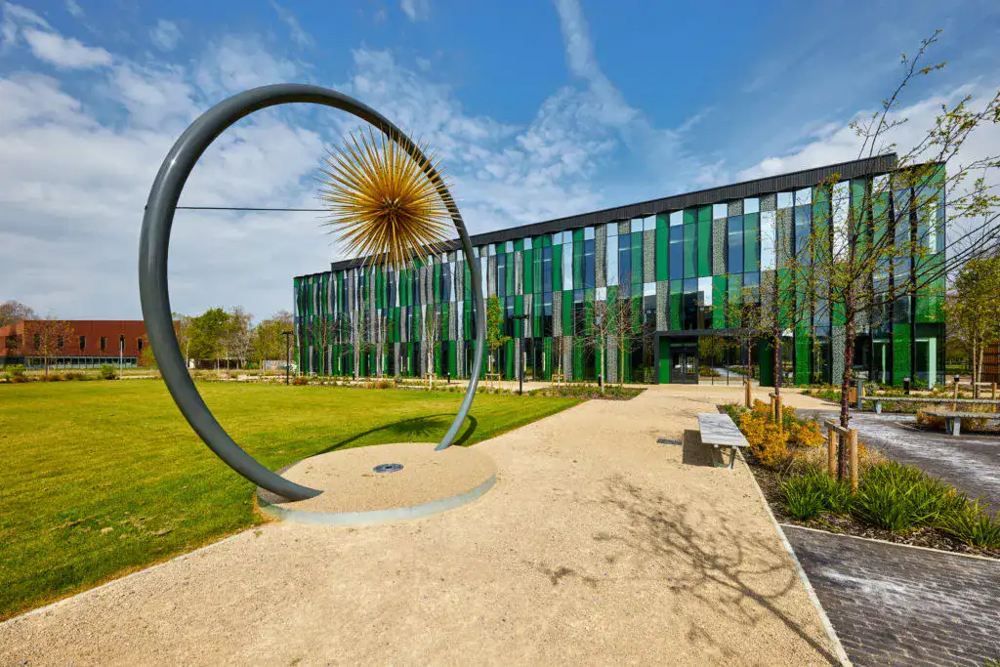
3
Harwell Science and Innovation Campus
Harwell Science and Innovation Campus has a long history as a place for Science and Technology. Achievements here include the world’s first transistorised computer; the development of the lithium-ion battery and vital work to develop the COVID-19 vaccination.
Currently Harwell Campus, one of the main construction developers, has plans to deliver over 140,000 sqm of new cutting-edge labs, offices and advanced manufacturing space alongside a hotel and conference centre.
©VotesforSchools The WOW Show 2023
Notes:
References:
https://www.harwellcampus.com/
Images:
1) https://www.harwellcampus.com/visit-harwell/

Slide 12
3
Harwell Science and Innovation Campus
Discuss (2 mins)
Have you heard about Harwell, do you know what else they are known for?
£3bn of national facilities pushing scientific discovery and understanding.
A unique collaboration of government, academia and industry working on the critical problems facing our planet.
An important place with a history of invention and inspiring future generations.
A community of 6,000 people within 700 acres of beautiful countryside.
©VotesforSchools The WOW Show 2023
Notes:
References:
https://www.harwellcampus.com/
Images:
1) https://www.harwellcampus.com/visit-harwell/

Slide 13
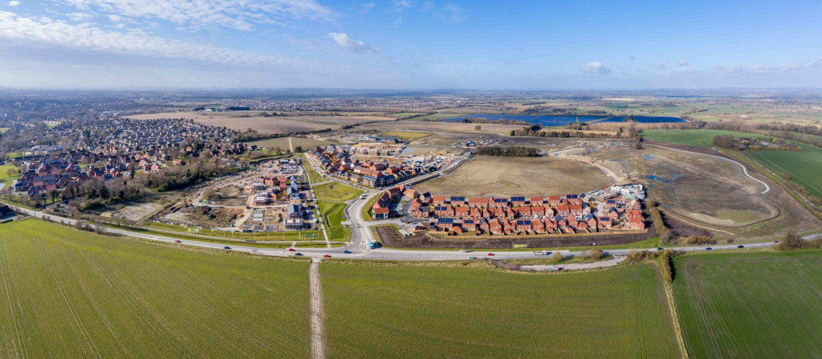
4
Other construction projects
Activity (2 mins)
Talk to a partner about other construction projects you have seen in your local area. What are your thoughts and opinions on them?
Kingsgrove, Wantage is a project providing 1500 homes, a neighbourhood centre, a primary school, a care home and open space in the town of Wantage.
Planning permission was approved in 2019 and since then the development has begun its build with several contractors and housebuilders on site including ACS Construction, Bellway, CALA homes, Taylor Wimpey and St Modwen Homes.
©VotesforSchools The WOW Show 2023
Notes:
References:
https://kingsgrovewantage.co.uk/vision/
Images:
1) https://kingsgrovewantage.co.uk/gallery/

Slide 14
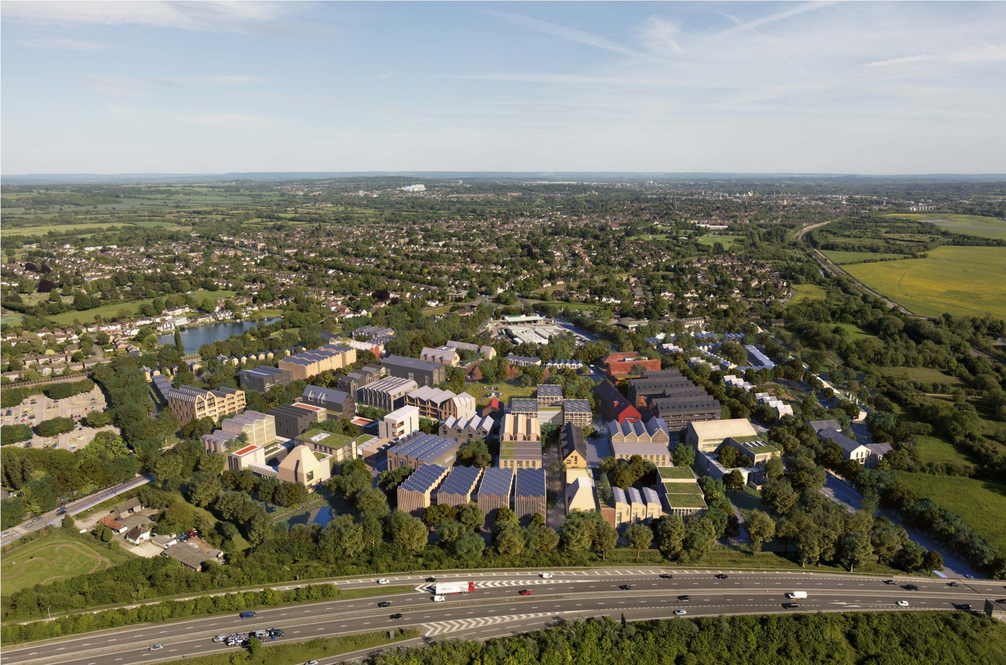
4
Other construction projects
Oxford North, Oxford City is important within the Oxford Local Plan 2036 and is currently being developed by Thomas White Oxford, on behalf of St John’s College, Oxford in a joint venture with Cadillac Fairview and Stanhope.
Proposals include a new sustainable development on 64 acres of land, creating 480 homes for 1,500 people, 1 million sq. ft of labs and offices for 4,500 jobs, three new public parks and shops, bars and restaurants for Oxford.
©VotesforSchools The WOW Show 2023
Notes:
References:
https://www.oxfordnorth.com/
Images:
1) https://www.oxfordnorth.com/

Slide 15
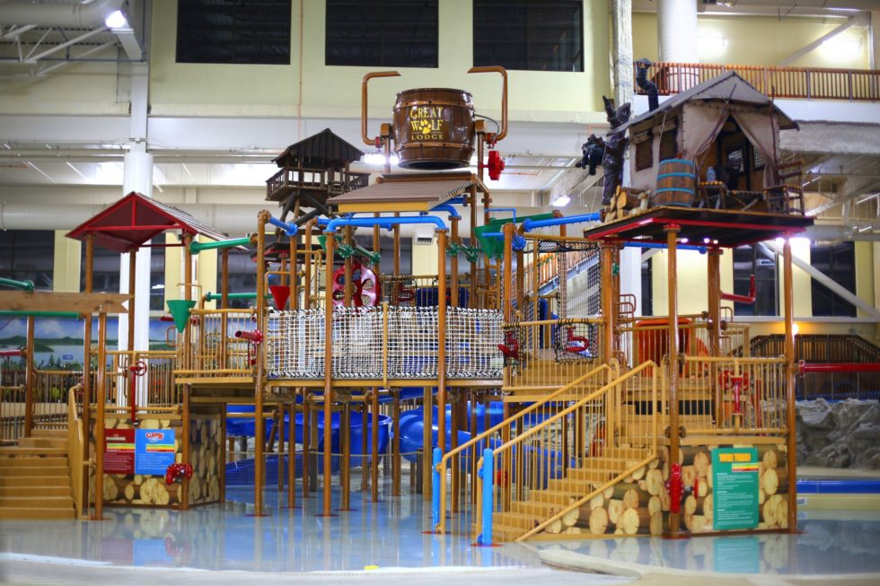
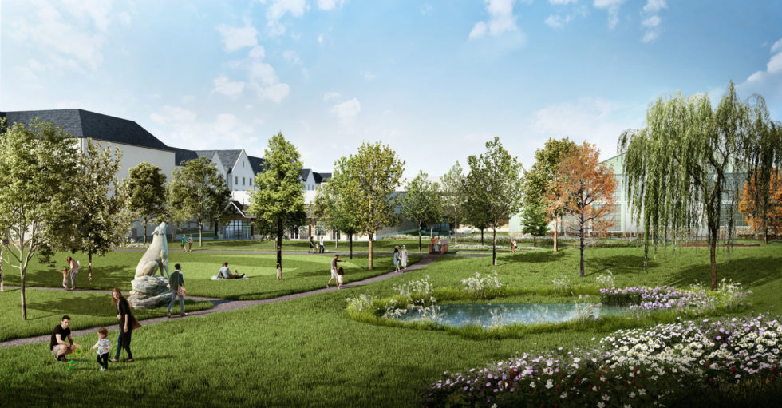
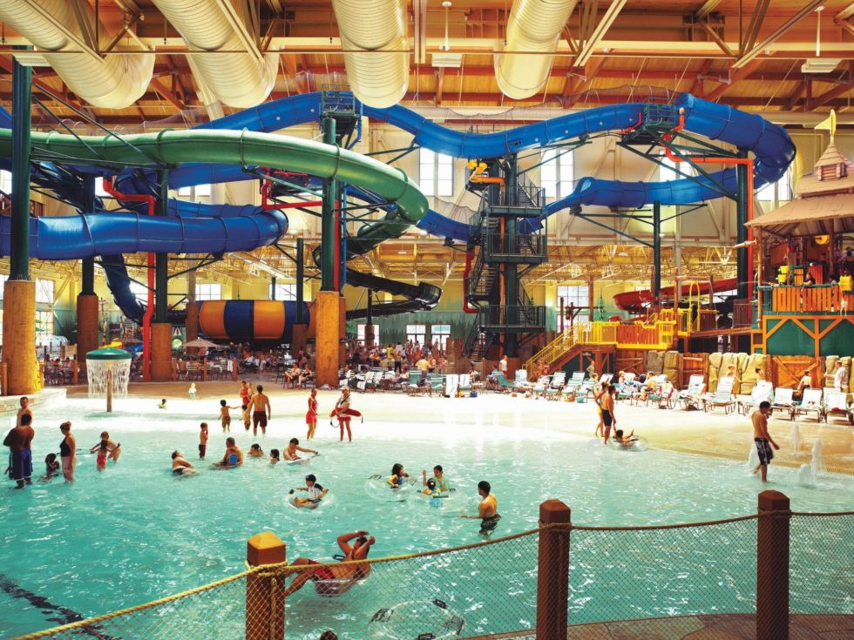
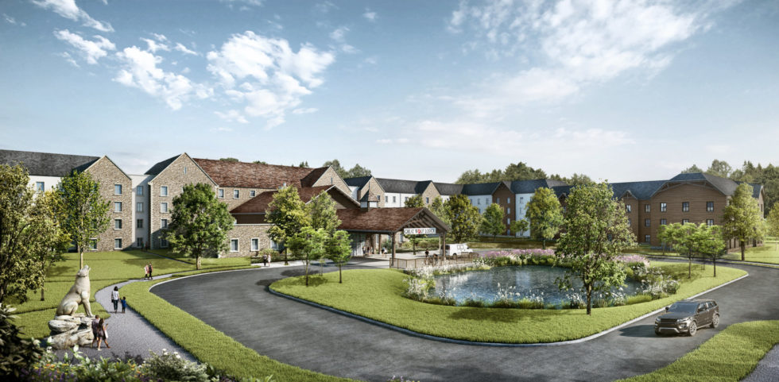
4
Other construction projects
Great Wolf, Bicester submitted plans in 2021. Proposals include a water park with twisty slides, a 498-room four-storey hotel, an adventure park, 900-space car park, 559sqm conference centre, a restaurant and public nature trail.
SISK Builders are understood to be the main contractor appointed to complete the build of the development which aims to begin on site late 2022/early 2023.
©VotesforSchools The WOW Show 2023
Notes:
References:
https://greatwolfuk.co.uk/
Images:
1) https://greatwolfuk.co.uk/gallery/

Slide 16
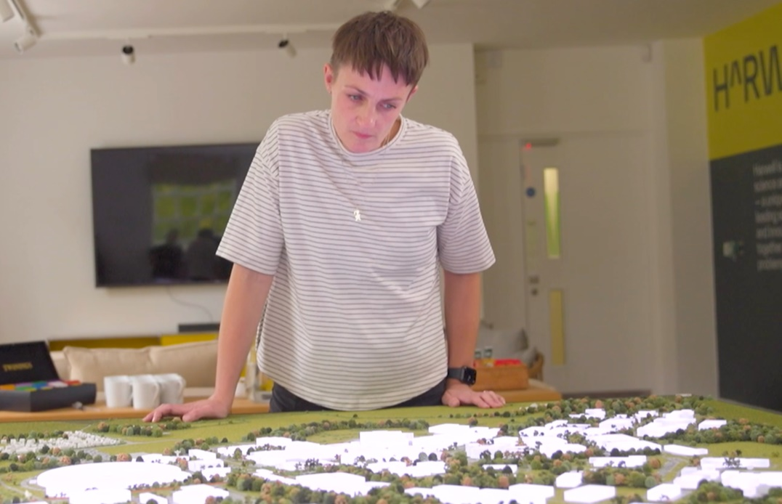
5
Meet Rebecca, the architect
Rebecca, the architect studied Art & Design, Physics and Maths at A level. She then completed a BSc Hons in Architecture, followed by a MSC in Architecture, Urbanism and Building Sciences. She is a strategic thinker, a problem solver and a designer. There are a few different routes to this if it is something for you.
Challenge:
Does this role excite you? Can you see yourself doing this as a career?
©VotesforSchools The WOW Show 2023
Notes:
References:
1)
Images:
1) Icon 8

Slide 17
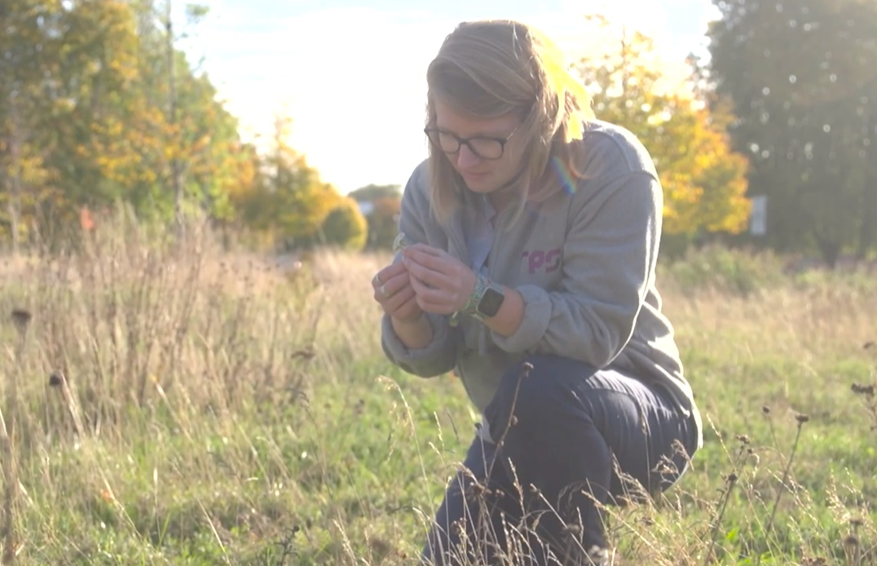
5
Meet Hannah, the ecologist
Activity (2 mins)
How could construction be a driving force in combatting climate change?
Hannah, the ecologist studied Geography at college and then went to university to study an MSc in Biodiversity and Conservation. She looks at the environment and wildlife and how the project can protect or improve biodiversity.
Challenge:
Does this role excite you? Can you see yourself doing this as a career?
©VotesforSchools The WOW Show 2023
Notes:
References:
1)
Images:
1) Icon 8

Slide 18
5
Meet Emmanuel, the sustainability manager
Define: Sustainability Manager
Someone who monitors the environmental impacts of the work being carried out, to ensure that the project adheres to the most environmentally friendly methods possible.
Emmanuel studied the equivalent of A-Levels with a focus on sciences, then a Degree in Environmental Sciences and an Engineering Degree in Biotechnologies. Finally, he studied for a Master of Sciences in Environmental Diagnostics.
Challenge:
Does this role excite you? Can you see yourself doing this as a career?
©VotesforSchools The WOW Show 2023
Notes:
References:
https://www.goconstruct.org/construction-careers/what-jobs-are-right-for-me/sustainability-manager/
Images:
1) The WOW Show film

Slide 19
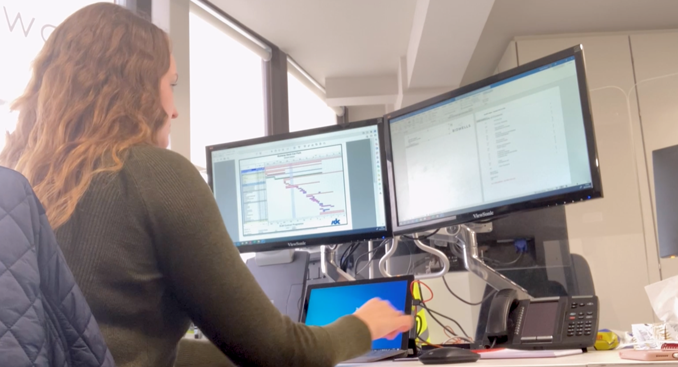
5
Meet Natalie, the project manager
Natalie studied Art, Design & Technology and Maths at A level. She studied Industrial Design and Technology at University.
Project managers ensure everyone works together for the best result on the project.
Challenge:
Does this role excite you? Can you see yourself doing this as a career?
©VotesforSchools The WOW Show 2023
Notes:
References:
1)
Images:
1) Icon 8

Slide 20
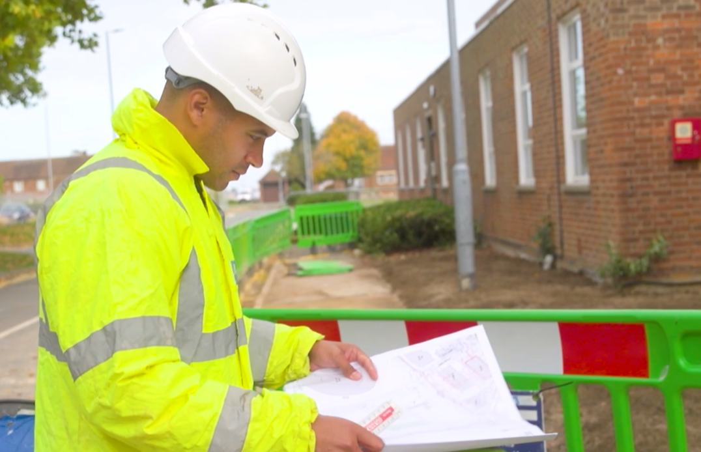
5
Meet Gavin, the civil engineer
Define: Civil Engineer
Civil engineers plan, design and manage large construction projects.
Gavin, the Civil Engineer studied: Maths, English, Sciences, IT & Business Studies, French and Art. He then studied for a BTEC in Civil / Structural Engineering and a HNC in Civil Engineering and finally, a Bachelor of Engineering (Hons) Degree.
This role needs an inquisitive and problem solving mind.
Challenge:
Does this role excite you? Can you see yourself doing this as a career?
©VotesforSchools The WOW Show 2023
Notes:
References:
1) https://www.goconstruct.org/construction-careers/what-jobs-are-right-for-me/civil-engineer/
Images:
1) The WOW Show film

Slide 21
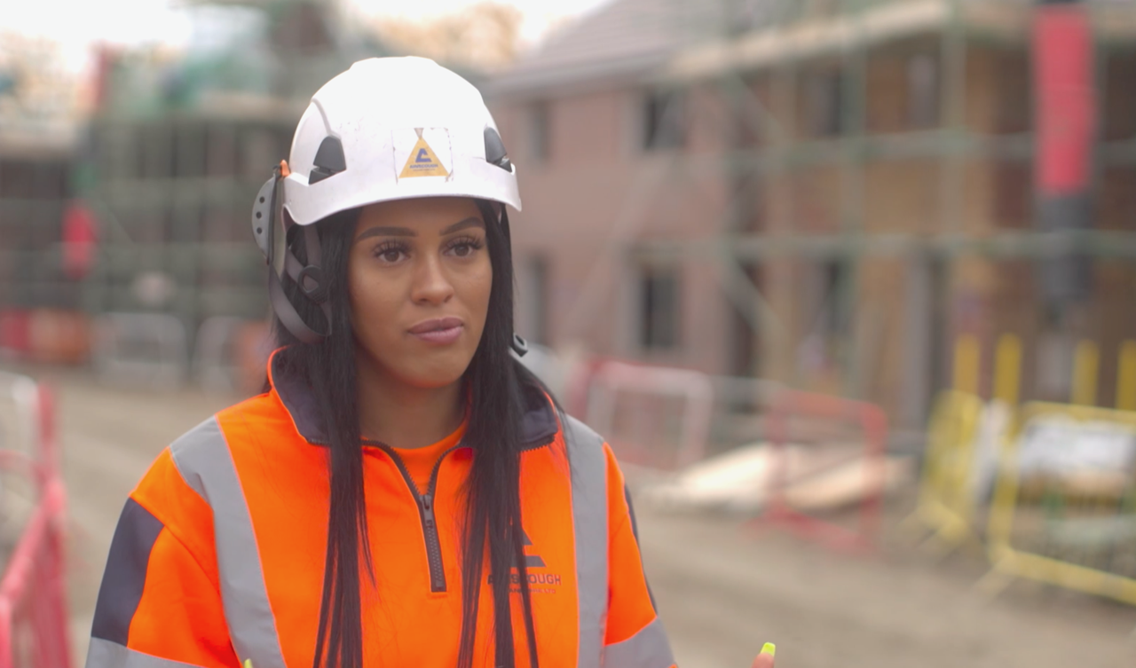
5
Meet Kelsey, the crane driver
Define: Aptitude test
A test to see if someone has a natural ability for a particular type of work.
Kelsey is currently working as a crane operator. She is at the beginning of her crane career and has her sights set on a heavy crane world record one day. She began her apprenticeship, after applying and completing an interview and aptitude test.
Challenge:
Does this role excite you? Can you see yourself doing this as a career?
©VotesforSchools The WOW Show 2023
Notes:
References:
https://www.ainscough.co.uk/people/my-ainscough-story-kelsey-binding/
https://dictionary.cambridge.org/dictionary/english/aptitude-test
Images:
1) The WOW Show film

Slide 22
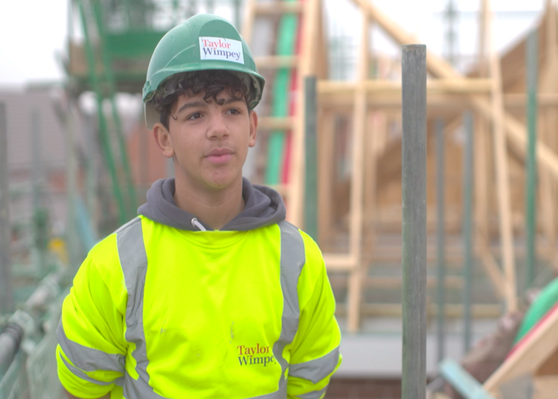
5
Meet Remeyo, apprentice bricklayer
Remeyo is only one month into his bricklaying apprenticeship. He is learning and earning money at the same time.
Bricklaying is the most in demand trade in the construction industry.
Challenge:
Does this role excite you? Can you see yourself doing this as a career?
©VotesforSchools The WOW Show 2023
Notes:
References:
Images:
1) The WOW Show film

Slide 23
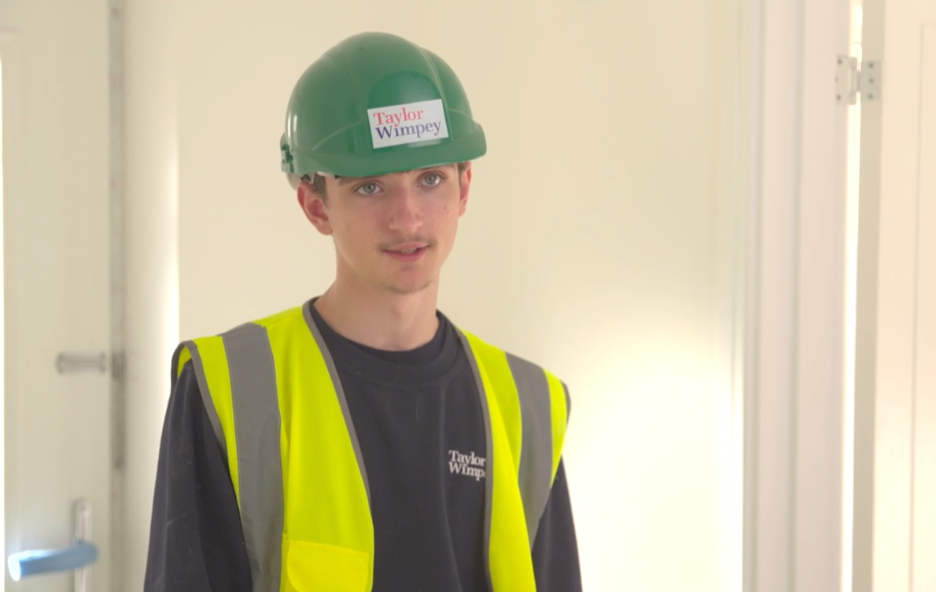
5
Meet Dominic, Project Maintenance Operative
Dominic studied PE, IT and computer science at school. He chose an apprenticeship as he wanted a mixture of hands on experience, classroom learning and also wanted to earn some money. Dominic enjoys the variety of his role as Project Maintenance Operative as every day is different.
Challenge:
Does this role excite you? Can you see yourself doing this as a career?
©VotesforSchools The WOW Show 2023
Notes:
References:
Images:
1) The WOW Show film

Slide 24
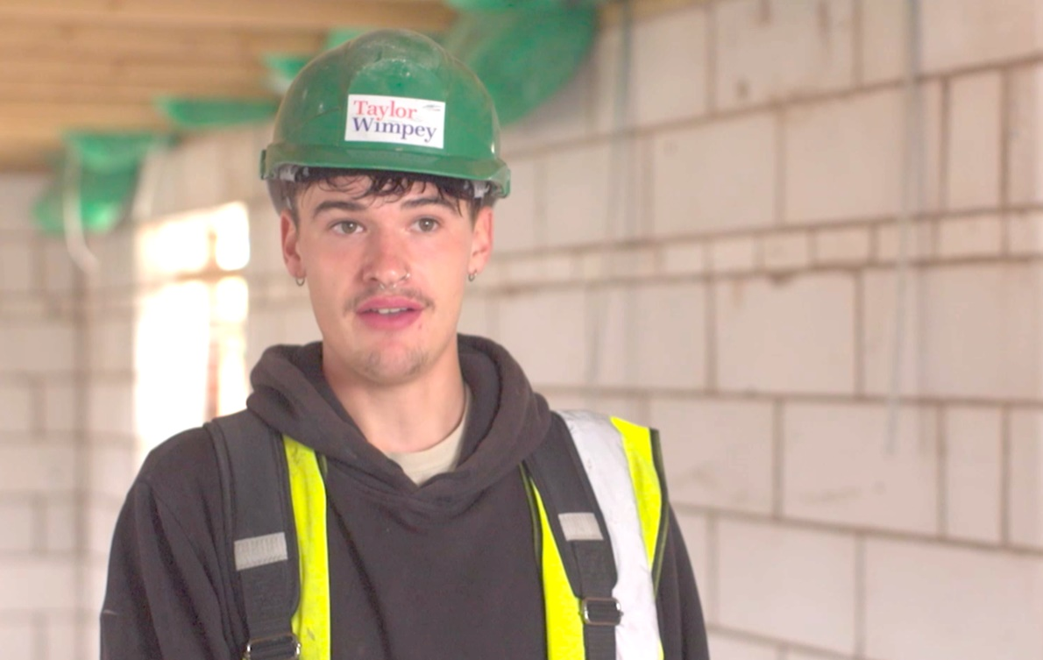
5
Meet Keiran, the carpenter
Keiran studied Photography and Maths at school then completed a college course in art and design. He chose the apprentice route to earn and learn at the same time. Keiran’s next step is Level 2 Site carpentry.
Challenge:
Does this role excite you? Can you see yourself doing this as a career?
©VotesforSchools The WOW Show 2023
Notes:
References:
1)
Images:
1) The WOW Show film

Slide 25
6
Where? Abingdon and Whitney College
Abingdon and Whitney college is a great example of a provider of training and courses for careers in construction. On the next page you will see the construction courses available there.
©VotesforSchools The WOW Show 2023
Notes:
References:
https://www.abingdon-witney.ac.uk/
Images:
1) Icon 8

Slide 26
6
Where? Abingdon and Whitney College
©VotesforSchools The WOW Show 2022
Notes:
References:
https://www.abingdon-witney.ac.uk/
https://www.abingdon-witney.ac.uk/school-leaver-prospectus-2023-24
Images:
1) Icon 8

Slide 27
6
Where? Banbury and Bicester College
Banbury and Bicester College programmes focus heavily on the practical elements of learning: working in industry placements and practicing in our college’s excellent facilities.
As well as general construction multi-skills they also run courses specifically for:
plumbing
carpentry
electrical installation
©VotesforSchools The WOW Show 2023
Notes:
References:
https://banbury.activatelearning.ac.uk/courses/career-pathways/construction/
Images:
1) Icon 8

Slide 28
Finding help & information
Oxfordshire's new careers platform, Find Your Future, is the next step for you to find out more and plan your future here in Oxfordshire.
Navigate your way around the platform by clicking on Find Your Future.
There is a guide on Find Your Future for students and parents to explore Your Fabulous Future in Oxfordshire. Take time to get excited and make plans!
©VotesforSchools The WOW Show 2023
Notes:
Teacher note: Please use the link to inform parents of the choices available for their child.
https://www.oxfordshirelep.com/sites/default/files/uploads/FindYourFutureParentsGuide.pdf
Images
https://www.oxfordshirelep.com/findyourfuture
References
https://www.oxfordshirelep.com/findyourfuture
https://www.oxfordshirelep.com/sites/default/files/uploads/FindYourFutureParentsGuide.pdf

Slide 29
Signposting to your future
There are lots of great websites to look at if this is something you are interested in:
Go Construct provides resources for anyone looking for a career in the construction and built environment sector. They showcase the many rewarding opportunities available and help people from all backgrounds to enter an exciting and growing industry.
Institution of Civil Engineers (ICE) promotes and advances civil engineering around the globe. We lead the infrastructure debate to create a more sustainable future and ensure high standards through awarding professional qualifications.
IEMA is the professional body for everyone working in environment and sustainability.
CIEEM are the leading professional membership body representing and supporting ecologists and environmental managers in the UK, Ireland and abroad. Their vision is of a healthy natural environment for the benefit of current and future generations.
©VotesforSchools The WOW Show 2023
Notes:
References:
https://www.goconstruct.org/about-go-construct/
https://www.ice.org.uk/
https://www.iema.net/about-us/what-we-do
https://cieem.net/
Images:
1) Icon 8

Slide 30
Signposting to your future
There are lots of great websites to look at if this is something you are interested in:
The Royal Instutute of Chartered Surveyors (RICS) promotes and enforces the highest professional standards in the development and management of land, real estate, construction and infrastructure.
SISK are leaders in the construction industry completing large, complex, multidisciplinary building programmes. They are committed to sustainability and lasting community legacies.
The Royal Institute of British Architects is a global professional membership body driving excellence in architecture. They work to deliver better buildings and places, stronger communities and a sustainable environment.
©VotesforSchools The WOW Show 2023
Notes:
References:
https://www.rics.org/uk/
https://www.johnsiskandson.com/uk/
https://www.architecture.com/

Slide 31
What’s in a building? Jobs you didn’t know existed
In association with VotesforSchools and The WOW Show
©VotesforSchools The WOW Show 2023

