Slide 1
What’s in a building? Jobs you didn’t know existed
In association with VotesforSchools and The WOW Show
©VotesforSchools The WOW Show 2023

Slide 2
Learning objectives for today
Challenge stereotypes and their relationship to life roles, work-life balance and career destinations.
Listen to speakers talking about the roles that are available in their workplace and sector.
Prepare pupils for experiences of work by helping them to develop questions to find out about the roles available in the workplaces that they are visiting, what qualifications people need to get those roles and how you progress within the organisation.
To research your education, training, apprenticeship, employment and volunteering options including information about the best progression pathways through to specific goals.
©VotesforSchools The WOW Show 2023
Notes:
References:

Slide 3
Use of these resources
The film and lesson have been created by Oxfordshire Careers Hub, Harwell Science and Innovation Campus, The CEC, The WOW Show and VotesforSchools.
Please use the Power Point as a slideshow to ensure the information is presented in the correct order. Teacher notes are under each slide with references. The lesson is suitable for secondary school use (all year groups).
All of the information in this lesson has been created for Oxfordshire however the power point can be edited so that other careers hubs can create their own bespoke slides featuring their own college provision and local construction projects.
The key contributors can be contacted with the following emails:
Nikki Wakefield Nikki.Wakefield@oxfordshirelep.com
Bill Hayward bill.hayward@thewowshow.org
Jude Hadfield Judith@votesforschools.com
www.oxfordshirelep.com
https://www.thewowshow.org/
https://www.votesforschools.com/
©VotesforSchools The WOW Show 2023
Notes:
References:

Slide 4
What’s in a building? Short film Lesson
Lesson Plan: 30 minutes
N/A | Learning objectives | Whole class | Share the learning objectives with the class.
8-10 mins | 1. Careers in construction | Whole class | Students watch The WOW Show short film to show the many and varied careers within the trades needed in construction.
2-4 mins | 2. Routes into construction | Paired talk | There are 4 links provided here to share the 4 main routes into the construction industry. Then further pages highlighting apprenticeships, traineeships and college courses.
2-4 mins | 3. Harwell Science and Innovation Campus | Paired talk | Students talk about what they know about Harwell’s Science and Innovation Campus and the fantastic work done there. They also learn about the construction projects which are ongoing.
2-4 mins | 4. Other construction projects | Whole class | Students see other fantastic construction projects happening in their local area. These can be substituted for other projects over time or in other geographical areas.
5 mins | 5. Meet the people | Whole class | Students learn a little more about the people they met in the film, what they do and what route they took into their chosen career.
4-6 mins | 6. Where? Abingdon and Whitney College/Banbury and Bicester College | Whole class | Students see two of the local colleges that offer construction courses and training. This can be edited for other provision in different areas of the country.
N/A | Signposting and further help and support | Whole class | A selection of websites and links for further information to take the lesson forward for interested students.
©VotesforSchools The WOW Show 2023

Slide 5
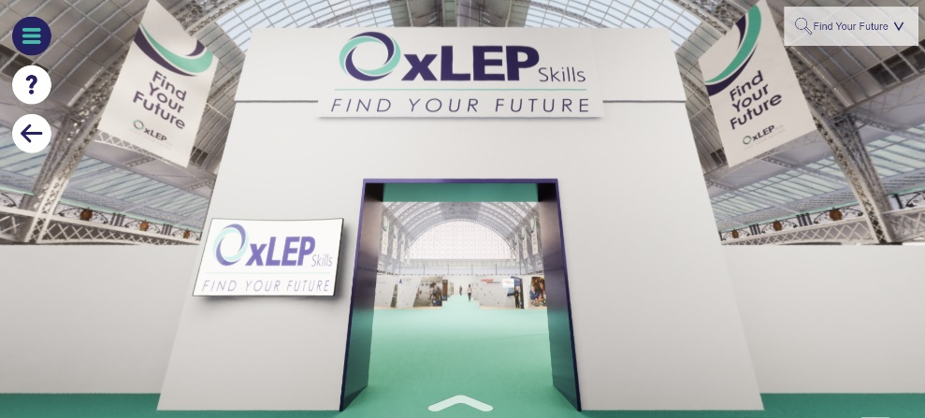
Finding help & information
Oxfordshire's new careers platform, Find Your Future, is the next step for you to find out more and plan your future here in Oxfordshire.
Navigate your way around the platform by clicking on Find Your Future.
There is a guide on Find Your Future for students and parents to explore Your Fabulous Future in Oxfordshire. Take time to get excited and make plans!
©VotesforSchools The WOW Show 2023
Notes:
Teacher note: Please use the link to inform parents of the choices available for their child.
https://www.oxfordshirelep.com/sites/default/files/uploads/FindYourFutureParentsGuide.pdf
Images
https://www.oxfordshirelep.com/findyourfuture
References
https://www.oxfordshirelep.com/findyourfuture
https://www.oxfordshirelep.com/sites/default/files/uploads/FindYourFutureParentsGuide.pdf

Slide 6
Signposting to your future
There are lots of great websites to look at if this is something you are interested in:
Go Construct provides resources for anyone looking for a career in the construction and built environment sector. They showcase the many rewarding opportunities available and help people from all backgrounds to enter an exciting and growing industry.
Institution of Civil Engineers (ICE) promotes and advances civil engineering around the globe. We lead the infrastructure debate to create a more sustainable future and ensure high standards through awarding professional qualifications.
IEMA is the professional body for everyone working in environment and sustainability.
CIEEM are the leading professional membership body representing and supporting ecologists and environmental managers in the UK, Ireland and abroad. Their vision is of a healthy natural environment for the benefit of current and future generations.
©VotesforSchools The WOW Show 2023
Notes:
References:
https://www.goconstruct.org/about-go-construct/
https://www.ice.org.uk/
https://www.iema.net/about-us/what-we-do
https://cieem.net/
Images:
1) Icon 8

Slide 7
Signposting to your future
There are lots of great websites to look at if this is something you are interested in:
The Royal Instutute of Chartered Surveyors (RICS) promotes and enforces the highest professional standards in the development and management of land, real estate, construction and infrastructure.
SISK are leaders in the construction industry completing large, complex, multidisciplinary building programmes. They are committed to sustainability and lasting community legacies.
The Royal Institute of British Architects is a global professional membership body driving excellence in architecture. They work to deliver better buildings and places, stronger communities and a sustainable environment.
©VotesforSchools The WOW Show 2023
Notes:
References:
https://www.rics.org/uk/
https://www.johnsiskandson.com/uk/
https://www.architecture.com/

