Slide 1
Employability
The skills you didn’t even know you had!
Wellbeing and Self-belief
Lesson plan
©VotesforSchools The WOW Show 2022

Slide 2
Key to text boxes
Activity type & timing
Activity description
Video timing & link
Information box 1
Information box 2
Information box 3
Definition of key vocabulary
Challenge activity or prompt question

Slide 3
Learning objectives for today
Recognising the value of challenging themselves and trying new things.
Researching how recruitment and selection processes work and what they need to do to succeed in them.
Thinking about how they deal with and learn from challenges and setbacks.
Developing friendships and relationships and reflecting on their relationship to their career.
Reflecting on their physical and mental wellbeing and considering how they can improve these.
Exploring the relationship between career, community and society.
©VotesforSchools The WOW Show 2022

Slide 4
Keywords
Employability: Having the skills and abilities needed to have a job or career.
Frustration: The feeling of being annoyed or less confident because you cannot achieve what you are trying to do.
Resilience: The ability to try again and not give up after something didn’t work.
Sector: The areas into which the economic activity of a country is divided.
Self-belief: When you can trust in your own ability to do something.
Wellbeing: Feeling healthy and happy.
©VotesforSchools The WOW Show 2022
Notes:
References:
https://dictionary.cambridge.org/dictionary/english/self-belief
https://dictionary.cambridge.org/dictionary/english/resilience
https://dictionary.cambridge.org/dictionary/english/frustration
https://dictionary.cambridge.org/dictionary/english/well-being?q=wellbeing
https://dictionary.cambridge.org/dictionary/english/sector
https://dictionary.cambridge.org/dictionary/english/employability

Slide 5
Wellbeing Lesson Plan
Lesson Duration: 30-40 minutes
Time | Objective | Group | Task
1-2 mins | Learning objectives & keywords | Class | Learners look at the learning objectives and keywords for the lesson.
12-15 mins | 1. What is wellbeing? | Class/ Individual | Learners watch a WOW Show animation film about the personal skills and attributes that everybody has and can develop. They then discuss what they think wellbeing is and talk about the different elements that make up wellbeing and how they can safeguard theirs. They think about sleep, eating and exercise contributing to wellbeing.
5-6 mins | 2. Talk to someone | Class | Learners think about who they can talk to when they are worried about their wellbeing.
5-8 mins | 3. What is self-belief? | Pair/Class | Learners talk about what self-belief and confidence are and how they can improve theirs.
 | 4. Final reflection | Pair/Class | Learners consider the steps they could take to get them on the path to a healthy future. They can talk to a friend and create a plan to safeguard or improve their wellbeing.
©VotesforSchools The WOW Show 2022
©VotesforSchools The WOW Show 2022

Slide 6
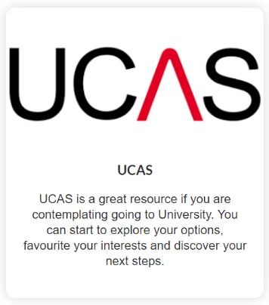
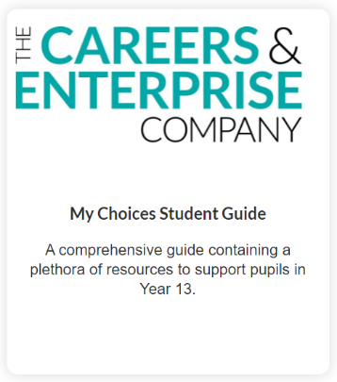
?
Further help and information
There are lots of resources and websites that will help you find your future no matter which direction you are heading in. Here are just a few.
Whilst making decisions about the future can seem scary, but with all of the information and guidance available, you can feel confident in your choices.
©VotesforSchools The WOW Show 2022
Notes:
References:
https://www.prospects.ac.uk/further-education/post-16-career-choices
https://www.ucas.com/
https://nationalcareers.service.gov.uk/get-a-job/career-choices-at-18
https://resources.careersandenterprise.co.uk/resources/my-choices-guide-students
https://nationalcareers.service.gov.uk/
https://www.sortyourfuture.com/
https://www.bbc.co.uk/bitesize/careers

Slide 7
?
Further help and information
The City and Guilds Foundation support over 4 million people each year to develop skills that help them into a job, develop on that job and to prepare for their next job. As a charity, we’re proud that everything we do is focused on achieving this purpose.
City and Guilds offer many vocational qualifications across many different industries. With everything from animal keeping to wind-farming, over 2 million learners gain a City & Guilds qualification each year and vocational courses are highly rated by employers.
With e-certifications, traineeships, apprenticeships, awards and digital credentials to share your achievements, City and Guilds could offer the key to your future!
©VotesforSchools The WOW Show 2022
Notes:
References:
https://cityandguildsfoundation.org/
https://www.cityandguilds.com/
https://www.cityandguilds.com/what-we-offer/learners

