Slide 1


Employability
The skills you didn’t even know you had!
Leadership & Interpersonal Skills
©VotesforSchools The WOW Show 2022

Slide 2






Learning objectives for today
Recognising the value of challenging themselves and trying new things.
Researching how recruitment and selection processes work and what they need to do to succeed in them.
Thinking about how they deal with and learn from challenges and setbacks.
Developing friendships and relationships and reflecting on their relationship to their career.
Reflecting on their physical and mental wellbeing and considering how they can improve these.
Exploring the relationship between career, community and society.
©VotesforSchools The WOW Show 2022

Slide 3
Keywords
Employability: Having the skills and abilities needed to have a job or career.
Frustration: The feeling of being annoyed or less confident because you cannot achieve what you are trying to do.
Resilience: The ability to try again and not give up after something didn’t work.
Sector: The areas into which the economic activity of a country is divided.
Self-belief: When you can trust in your own ability to do something.
Wellbeing: Feeling healthy and happy.
©VotesforSchools The WOW Show 2022
Notes:
References:
https://dictionary.cambridge.org/dictionary/english/self-belief
https://dictionary.cambridge.org/dictionary/english/resilience
https://dictionary.cambridge.org/dictionary/english/frustration
https://dictionary.cambridge.org/dictionary/english/well-being?q=wellbeing
https://dictionary.cambridge.org/dictionary/english/sector
https://dictionary.cambridge.org/dictionary/english/employability

Slide 4

1
Getting started…
Pair reflection (2-3 mins)
What do you think about the common phrase below?
“Leaders are born, not made.”
©VotesforSchools The WOW Show 2022
Notes:
Images
Unsplash

Slide 5
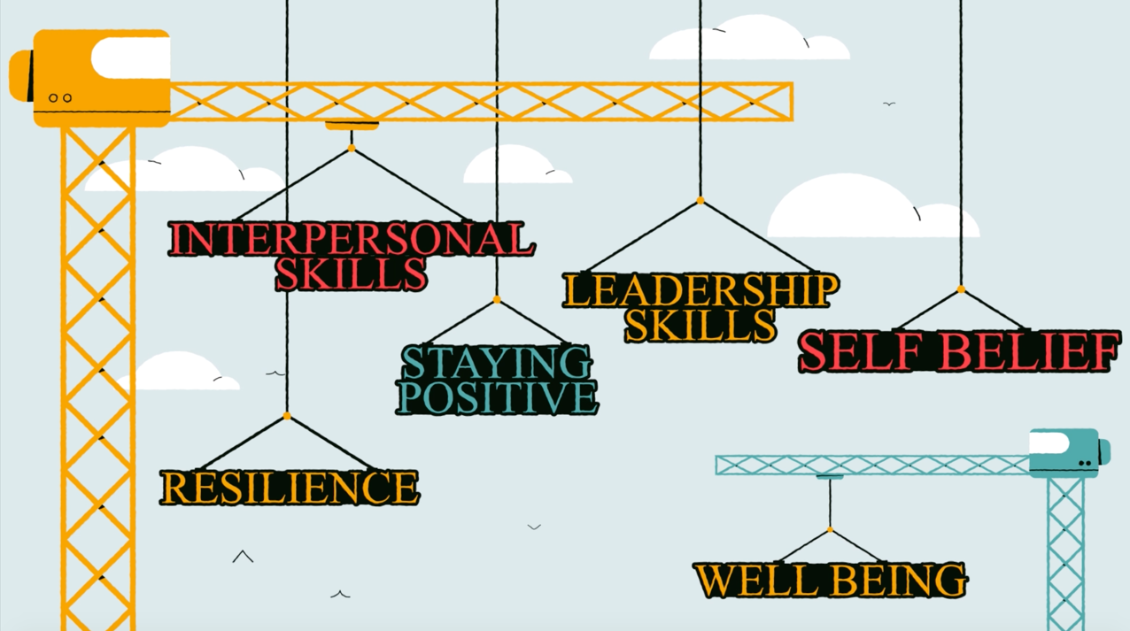
2
What is leadership?
Discuss (5 mins)
Watch a WOW Show animation film about the personal skills and attributes that everybody has and can develop. Then discuss which leadership skills you show during your normal week.
Are you a great problem-solver?
0:00-2:29
Can you take the initiative?
Are you a good decision-maker?
Can you get the best out of others?
Challenge:
How can you help a friend with their skills ready for the world of work?
©VotesforSchools The WOW Show 2022
Notes:
Safeshare TV Video link: https://safeshare.tv/x/zJvgycHpJQk
References
1)
Images
1)

Slide 6

2
What is leadership?
Pair reflection (2-3 mins)
What do you think makes a good leader?
It has been reported that there is a shortage of leadership skills in companies around the world. Some managers are not able to lead their teams effectively, which means that the working output for some teams is lower than it should be.
Leaders, and perhaps more importantly leadership skills, are going to be needed in the years ahead. Are you going to be leading in the future?
In this session, you are going to explore the role leadership has in all of our futures and where we use these skills in our everyday lives.
©VotesforSchools The WOW Show 2022
Notes:
Images
Unsplash

Slide 7



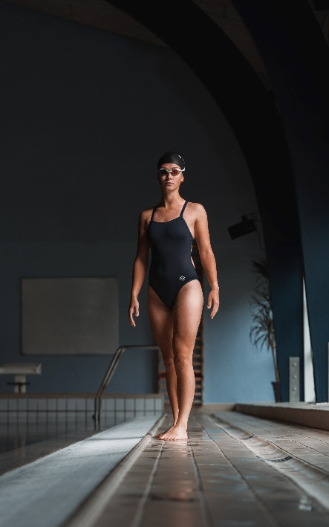
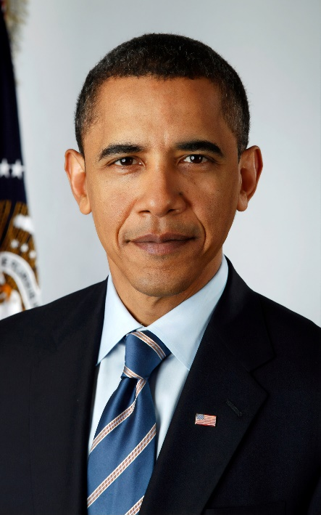
2
What is leadership?
Individual reflection (1-2 mins)
Think of a leader that you admire. They can be from any walk of life, from friends and family, to businesspeople, sportspeople or politicians.
Pair discussion (3-5 mins)
Share your chosen leader with your partner. As a pair, come to a decision about the three most important skills or qualities your leaders share.
©VotesforSchools The WOW Show 2022
Notes:
Images
Unsplash
Pixabay

Slide 8

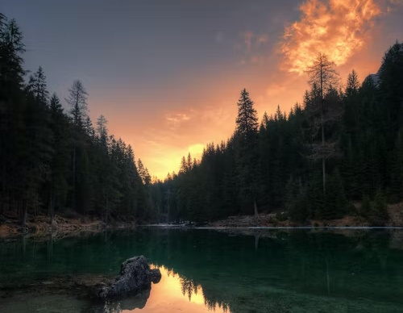

3
What is leadership in real life?
Class discussion (6-9 mins)
Over the next few slides, read the scenarios about people showing leadership skills in everyday life and then think carefully about which leadership skills are needed to help in each case.
©VotesforSchools The WOW Show 2022
Notes:
Images
Unsplash

Slide 9
3
What is leadership in real life?
A group of Year 9 friends were sharing their feelings about some people going hungry in their community.
The friends started collecting food donations from fellow students, which they are going to send to a local charity. The charity will then give the food to people who need it most.
Class discussion (2-3 mins)
What skills would they need to make this happen?
Developing friendships and relationships is key to building your skills for your chosen career. Most careers involve working with others and being a good communicator is vital.
©VotesforSchools The WOW Show 2022
Notes:
Images
Unsplash

Slide 10
3
What is leadership in real life?
Emily mentioned to her friends that she wanted to learn more about outdoor skills. She said she wanted to join the Scouts.
Her friends laughed and said it wouldn’t be right for her. A few months later, Emily managed to make new connections in her Scout troop and successfully led a team on a night hike!
Class discussion (2-3 mins)
What skills did Emily need to make this happen?
Challenge:
What do you have in your local community that could improve your skills?
Building quality relationships with your local community is excellent practise for a career. It may even help you find your future!
©VotesforSchools The WOW Show 2022
Notes:
Images
Unsplash

Slide 11

3
What is leadership in real life?
Some Year 11s made some changes in preparation for their GCSEs, as lots of them were feeling very stressed and overwhelmed.
They shared ideas for calming activities and encouraged each other to cut down their screen time. One of them even came into school with blueberry smoothies before a revision session!
Class discussion (2-3 mins)
What skills would they need to make this happen?
Often, when we feel worried it is good to talk to people who are feeling the same as us.
Challenge:
What does kindness look like in leadership?
Why is it important?
©VotesforSchools The WOW Show 2022
Notes:
Images
Unsplash

Slide 12




4
Where are you headed?
Reflection (2-3 mins)
Think back to the scenarios you just looked at. How are you building your leadership skills? This could be through things like hobbies or jobs, or it could be things you do every day without realising!
We will all have choices to make in our lives: where to go, who to help and what to be.
Every day we all use skills that are needed for leadership.
Even for short periods, we can be leaders and show leadership skills. Understanding the skills of leadership and when we should use them is important.
©VotesforSchools The WOW Show 2022
Notes:
Images:
1) Unsplash

Slide 13

4
Where are you headed?
Different people show different leadership skills at different times of their life. By knowing what the skills are, we can have more control over the path we take in life.
©VotesforSchools The WOW Show 2022

Slide 14
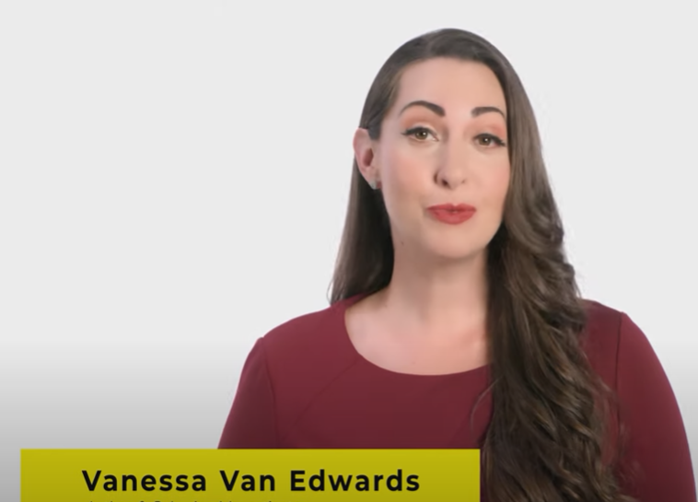


5
What are interpersonal skills?
Group discussion (3-5 mins)
In your groups, discuss what you think interpersonal skills are. Share your top one with the class. Then watch the video to find out more.
Definition: Interpersonal
Relationships between people.
0:00-3:12
Interpersonal skills are the skills we have when dealing with other people. You will need these for relationships, both personal and professional. These are skills we use every day, so it is easy to practice them regularly.
©VotesforSchools The WOW Show 2022
Notes:
YouTube Video link: https://www.youtube.com/watch?v=Ib09GqWP5rY (0:29 – 3:42)
Safeshare Video Link: https://safeshare.tv/x/Ib09GqWP5rY
References
https://dictionary.cambridge.org/dictionary/english/interpersonal

Slide 15

5
What are interpersonal skills?
Pair discussion (2-3 mins)
Let’s think about working in hospitality. For example, when you go to a restaurant, how do you expect the members of staff to behave when you arrive?
Definition: Hospitality
Hotels, pubs, restaurants and entertainment sectors.
When you go into anywhere in the hospitality sector, body language is important. In your ideal scenario, does the person who greets you at the restaurant maintain eye contact? How do their facial expressions make you feel? What effect does this have on your experience there?
It goes without saying that we feel happy and more comfortable when people smile at us. A friendly welcome also makes us more likely to come back.
Challenge:
Try it out with a friend: change your body language and see how it makes them feel!
©VotesforSchools The WOW Show 2022
Notes:
References:
https://dictionary.cambridge.org/dictionary/english/hospitality
Images:
1) Unsplash

Slide 16


5
What are interpersonal skills?
Pair discussion (3-5 mins)
Talk to a partner: how good are your speaking and listening skills? If you could rank them out of 10, what would you give them and why?
Speaking and listening are other skills you can practice every day. However, it’s worth remembering that some of us find this more difficult than others.
Careers can involve working alone, in teams, with the general public, or speaking to thousands of people at once. With a little practice, you will know what you are comfortable with and can choose a job that works to your strengths.
Challenge:
Consider: what are your strengths? What do you need to work on?
©VotesforSchools The WOW Show 2022
Notes:
Images
Unsplash

Slide 17


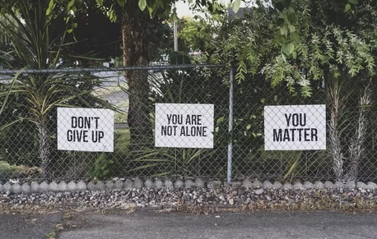
5
What are interpersonal skills?
Pair discussion (3-5 mins)
Can you think of any other everyday skills that will be important in the workplace? Click for some ideas.
Respect:
Showing respect for others in our everyday lives is key to building good relationships. The same is true in the workplace.
Manners:
It is also important to show good manners to the people around us, whether they are old friends or new acquaintances.
Empathy:
Understanding how others feel about issues is important for good leadership, communication & relationships.
©VotesforSchools The WOW Show 2022
Notes:
References:
https://dictionary.cambridge.org/dictionary/english/respect
https://dictionary.cambridge.org/dictionary/english/manners
https://dictionary.cambridge.org/dictionary/english/empathy
Images:
1) Unsplash

Slide 18

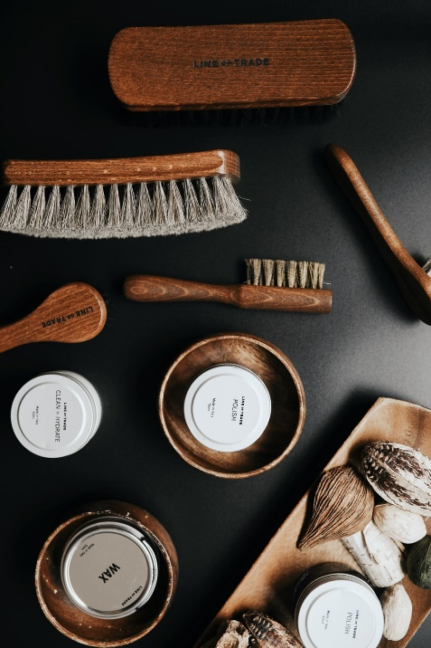
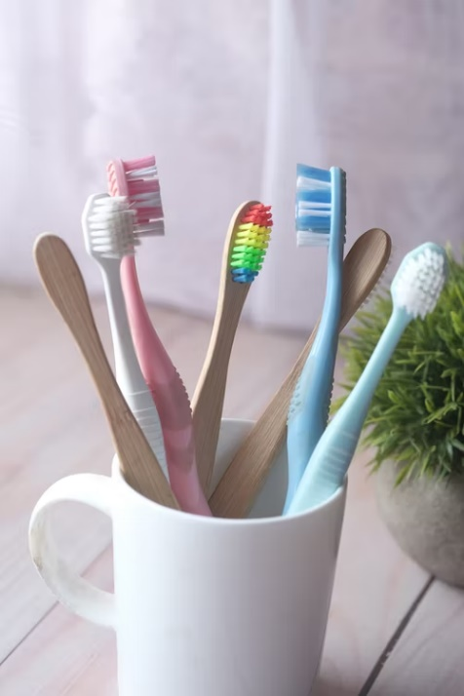


5
What are interpersonal skills?
There are also some more basic things that are linked to making a good impression when it comes to your professional life.
These include things like personal hygiene, appearance and timekeeping.
Being clean with tidy hair, teeth brushed and smart clothes are expected in most workplaces. Some places of work also have policies on appearance or a uniform to wear.
©VotesforSchools The WOW Show 2022
Notes:
Images
Unsplash

Slide 19





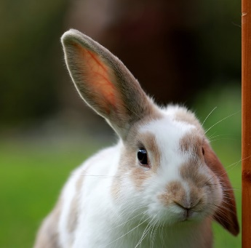
6
Final reflection…
The world of work needs a diverse cross-section of people to make successful businesses. Most careers involve working with other people or teams.
Practising and improving your skills, such as communication, are important not only for an interview but for a successful career.
Reflection
How are your communication skills? Do you always make sure to do the things below?
Value and respect the speaker?
Look at the person speaking?
Ask thoughtful questions?
Wait your turn to speak?
Think about what is being said?
Listen to all of the information?
©VotesforSchools The WOW Show 2022
Notes:
Images
Unsplash

Slide 20

6
Final reflection…
Self-belief
Leadership
Interpersonal skills
Resilience
Wellbeing
Staying positive
Final reflection…
Have a think about the skills you have, the skills you need to work on, and what you see for your future! Click for some ideas.
©VotesforSchools The WOW Show 2022
Notes:
Images
Unsplash

Slide 21


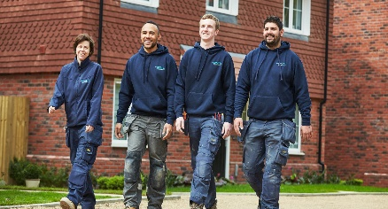
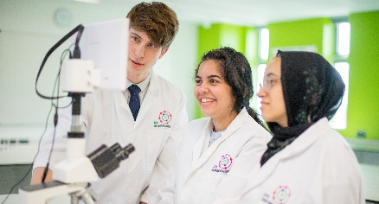
?
Further help and information
Some jobs require specialist qualifications and skills. It’s good to be aware of this if you’re interested in a specific career so you can get on to the right study pathway as early as possible.
Pair discussion (2-3 mins)
Do you know where to look for extra information on the careers you are interested in? You could find out more at home too!
You could share useful websites, apps and YouTube channels that you think will help with job hunting, applications and being successful in interviews.
Challenge:
Think about and discuss with friends, family and parents how to make a plan for your future career. What do you want to do and how are you going to get there?
©VotesforSchools The WOW Show 2022

Slide 22
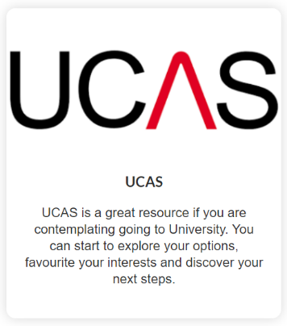





?
Further help and information
There are lots of resources and websites that will help you find your future no matter which direction you are heading in. Here are just a few.
Whilst making decisions about the future can seem scary, but with all of the information and guidance available, you can feel confident in your choices.
©VotesforSchools The WOW Show 2022
Notes:
References:
https://www.prospects.ac.uk/further-education/post-16-career-choices
https://www.ucas.com/
https://nationalcareers.service.gov.uk/get-a-job/career-choices-at-18
https://resources.careersandenterprise.co.uk/resources/my-choices-guide-students
https://nationalcareers.service.gov.uk/
https://www.sortyourfuture.com/
https://www.bbc.co.uk/bitesize/careers

Slide 23

?
Further help and information
The City and Guilds Foundation support over 4 million people each year to develop skills that help them into a job, develop on that job and to prepare for their next job. As a charity, we’re proud that everything we do is focused on achieving this purpose.
City and Guilds offer many vocational qualifications across many different industries. With everything from animal keeping to wind-farming, over 2 million learners gain a City & Guilds qualification each year and vocational courses are highly rated by employers.
With e-certifications, traineeships, apprenticeships, awards and digital credentials to share your achievements, City and Guilds could offer the key to your future!
©VotesforSchools The WOW Show 2022
Notes:
References:
https://cityandguildsfoundation.org/
https://www.cityandguilds.com/
https://www.cityandguilds.com/what-we-offer/learners

