Slide 1
Pharmacy Module 4:
Becoming a Part of It
Lesson Plan
These resources have been developed by VotesforSchools and The WOW Show in association with Health Education England.

Slide 2
Subject links:
This resource may link to topics you study in PSHCE, Careers, Health & Social Care, Science, Critical Thinking and Self-Assessment.
Skills:
This resource helps with skills such as evaluation, teamwork, communication, empathy, organisation and problem solving.
Learning intentions:
To be able to explore interests, values, abilities and attitudes in relation to options in learning, work and future careers.
©VotesforSchools The WOW Show 2021

Slide 3
Module 4: Lesson Plan
Lesson Duration: 20-40 minutes
Time | Objective | Group | Task
1-2 mins | Subject links, skills & learning intentions | Whole class | Students look at the subject links, skills and learning intentions for the lesson.
5-8 mins | 1. A quick recap. | Whole class | Students think about the previous 3 modules and how to become a Pharmacist. They discuss what they need in terms of qualifications, skills and qualities.
10-20 mins | 2. A moment to reflect. | Individual/ Pair | Students discuss what they have been learning about Pharmacy and recap by rewatching The WOW Show films to consider if Pharmacy is a career path for them.
5-6 mins | 3. What else is out there? | Whole class | Students have links to the wealth of information and organisations offering help and support in careers in Pharmacy which are curated in this lesson.
4-5 mins | 4. What else is out there in healthcare? | Whole class | Students can see the other opportunities available in healthcare which can be explored individually or as a class.
2 mins | Survey monkey link | Individual | Students and teachers have the opportunity to feedback with a short survey about the resources and The WOW Show films about a career in Pharmacy.
5-10 mins | Further help and support | Whole class | Students have access to links from the NHS website on Pharmacy and the many other careers in the healthcare sector. The NHS Health Careers site has more information for students who wish to investigate further. Click any picture on the slide to watch the animation summary for Pharmacy.
©VotesforSchools The WOW Show 2021

Slide 4
Further help & support
The NHS website offers all of the help and advice needed to consider a career in Pharmacy or health in general.
The General Pharmaceutical Council regulate pharmacists, Pharmacy technicians and pharmacies in Great Britain. Their website contains lots of information.
The Association of Pharmacy Technicians UK has information on how to become a Pharmacy technician.
The Royal Pharmaceutical Society has lots of information on how to become a pharmacist and what the role involves.
©VotesforSchools The WOW Show 2021
Notes:
References:
https://www.healthcareers.nhs.uk/explore-roles/pharmacy
https://www.ucas.com/explore/subjects/pharmacology-toxicology-and-pharmacy
https://www.pharmacyschoolscouncil.ac.uk/study/
https://www.prospects.ac.uk/jobs-and-work-experience/job-sectors/science-and-pharmaceuticals/pharmacy-courses

Slide 5
Further help & support
PROSPECTS are the experts in graduate careers. We help to guide students and graduates to a bright future with unrivalled information, advice and opportunities.
The Pharmacy Schools Council provides a expert opinion and advice on matters concerning Pharmacy education and careers from the perspective of Pharmacy schools.
UCAS support young people making post-16 choices, as well as those applying for undergraduate and postgraduate courses.
Studying Healthcare is a partnership between the Medical, Dental and Pharmacy Schools Councils to provide up-to-date and accurate information about the university application process for healthcare subjects.
©VotesforSchools The WOW Show 2021
Notes:
References:
https://www.ucas.com/explore/subjects/pharmacology-toxicology-and-pharmacy
https://www.pharmacyschoolscouncil.ac.uk/study/
https://www.prospects.ac.uk/jobs-and-work-experience/job-sectors/science-and-pharmaceuticals/pharmacy-courses
https://studyinghealthcare.ac.uk/applications/pharmacy/careers-in-pharmacy/

Slide 6
Further help & support
The Health Careers website has all the information you need to look at a career in Pharmacy or indeed any other role in the NHS.
Click on the picture on the right to see a PDF all about a career in Pharmacy. It contains lots of information about all of the roles within a Pharmacy .
YouTube has lots more information about roles in Pharmacy too.
©VotesforSchools The WOW Show 2021
Notes:
References:
https://www.healthcareers.nhs.uk/explore-roles/pharmacy
https://www.healthcareers.nhs.uk/career-planning/resources/career-pharmacy
https://www.healthcareers.nhs.uk/sites/default/files/documents/A%20career%20in%20Pharmacy_Final.pdf
https://www.youtube.com/watch?v=t2dvY86rHyc

Slide 7
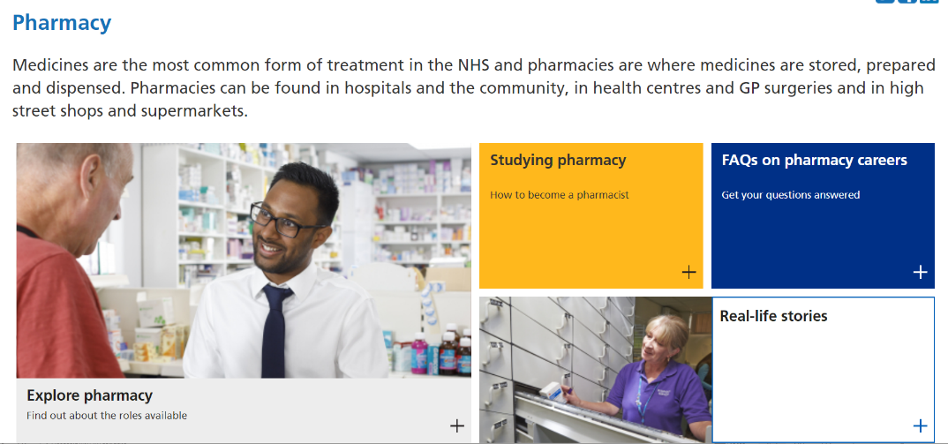
Further help & support
If you are keen to help others, enjoy science and want a career in healthcare, Pharmacy could be for you. Check out the animation below for a quick recap.
0:00- 3:47
The animation contains a summary of the key roles and responsibilities of Pharmacy Professionals and how you can help others in this fantastic career.
The NHS Careers website has been developed to support students looking at careers in Pharmacy. It contains everything you need to know.
©VotesforSchools The WOW Show 2021
Notes:
You Tube Video Link: https://www.youtube.com/watch?v=ux3JW4PyBM8&list=PLnnppXZprOJcW878vJRHUiy0olgVrtmFA&index=40
SafeShare TV Video Link: https://safeshare.tv/x/ux3JW4PyBM8
References:
https://www.healthcareers.nhs.uk/explore-roles/pharmacy
https://www.healthcareers.nhs.uk/explore-roles/pharmacy/roles-pharmacy - The animation will be available on this website.

Slide 8
Further help & support
If you are keen to help others, enjoy science and want a career in healthcare, Pharmacy could be for you. Check out this website for everything you need to know.
The website has been developed to support students looking at careers in Pharmacy. It contains an interactive careers map to support your choices.
If you are inspired and want a career in Pharmacy check out the resources and the case studies about careers and how to get there.
©VotesforSchools The WOW Show 2021
Notes:
References:
1) HEE interactive Pharmacy Careers map – https://careersinpharmacy.uk/

