Slide 1
Pharmacy Module 1:
Pharmacy Improves People’s Lives
These resources have been developed by VotesforSchools and The WOW Show in association with Health Education England.

Slide 2
Today’s lesson
Subject Links
Learning Intentions
This resource may link to topics you study in PSHCE, Careers, Health & Social Care, Science, Critical Thinking and Self-Assessment.
To be able to explore interests, values, abilities and attitudes in relation to options in learning, work and future careers.
Skills
This resource helps with skills such as evaluation, teamwork, communication, empathy, organisation and problem solving.
©VotesforSchools The WOW Show 2021
Notes:
Images:
1) HEE

Slide 3
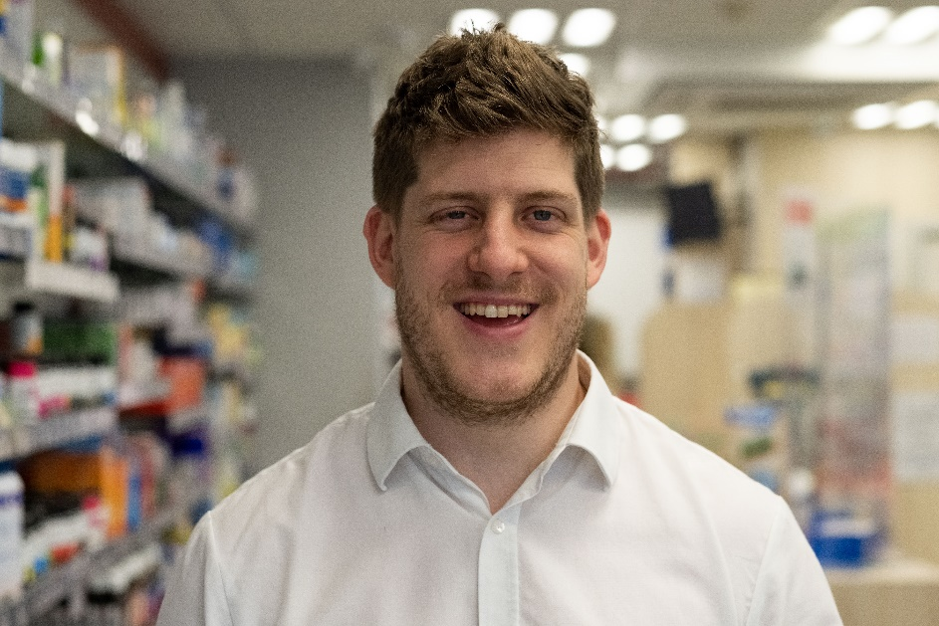
1
What is Pharmacy?
Pair activity (2-3 mins)
Write down 5 key words that you associate with Pharmacy as a profession. Click to reveal some examples.
Medicines
Safety
Definition: Pharmacy
A place that prepares and sells medicines.
Prescribing
Records
Research
Budgets
Professional
Advice
Challenge:
Compare your words with another pair. Is there any overlap?
©VotesforSchools The WOW Show 2021
Notes:
Images:
HEE
Icons8
References:
https://www.healthcareers.nhs.uk/explore-roles/pharmacy/roles-pharmacy/pharmacist
https://dictionary.cambridge.org/dictionary/learner-english/pharmacy

Slide 4
1
What is Pharmacy?
Class activity (2-3 mins)
Now, take a look at the key responsibilities in Pharmacy listed below. How do these compare to the words you came up with?
Making sure medicines are used safely
Researching new drug therapies
Helping patients understand their medicines
Managing budgets and Pharmacy staff
Prescribing medication for patients
Working alongside other professionals
Noting patients’ histories and updating records
Providing advice on quitting smoking
Definition: Pharmacist
Someone who is trained as an expert in medicines.
©VotesforSchools The WOW Show 2021
Notes:
Images:
HEE
Icons8
References:
https://www.healthcareers.nhs.uk/explore-roles/pharmacy/roles-pharmacy/pharmacist
https://dictionary.cambridge.org/dictionary/learner-english/pharmacist
https://dictionary.cambridge.org/dictionary/english/prescribing

Slide 5
2
Who are Pharmacists?
Pair activity (2-3 mins)
Like many professions, stereotyping sometimes occurs in Pharmacy. For instance, did you make any assumptions in the previous task? Have a think about what they were.
Definition: Stereotype
A set idea that people have about what someone or something is like, especially an idea that is wrong.
When you heard the word Pharmacist, did you think about someone stood behind a counter putting medication into paper bags for patients? While this does happen, let’s understand a bit more about what it is they really do…
Definition: Pharmacy Technician
Someone who may supply medicines and medical devices to patients, whether on prescription or over the counter and also provides information on symptoms and products.
In addition to Pharmacists, Pharmacy Technicians work in Pharmacies and other environments to support patients.
When we hear certain words, stereotypical images may come to mind. What these images look like depends on our own experiences and often what we see in the media, too.
©VotesforSchools The WOW Show 2021
Notes:
References:
https://www.healthcareers.nhs.uk/explore-roles/pharmacy/roles-pharmacy/pharmacy-technician
https://dictionary.cambridge.org/dictionary/english/stereotype
https://dictionary.cambridge.org/dictionary/english/pharmacist
Images:
HEE
Icons8
References:
https://dictionary.cambridge.org/dictionary/learner-english/pharmacist

Slide 6
2
Who are Pharmacists?
0:00-1:30
The best way to understand who Pharmacists are and how they can help you is to hear from one!
Watch & discuss (5-6 mins)
Click the image to watch the video. Then, as a class, discuss the range of career opportunities in Pharmacy shown in the film. Click for a few questions to consider.
Where can Pharmacists work? Were any of the locations mentioned places you hadn’t thought of? Did you think about drug trials or changes made during the pandemic?
What are the benefits of being a Pharmacist or a Pharmacy Technician? And what are the benefits of seeing a Pharmacist if you are a patient?
Challenge:
Did this video change your view of Pharmacy? If so, how?
©VotesforSchools The WOW Show 2021
Notes:
Video Links:
YouTube Video Link: https://www.youtube.com/watch?v=XIzcBfK9U9Q
Safeshare TV Video Link: https://safeshare.tv/x/XIzcBfK9U9Q
Images:
1) Via video

Slide 7
2
Who are Pharmacists?
The term “Coronavirus” is used to describe a family of viruses with some similarities. They can range from common colds to more serious viruses such as Severe Acute Respiratory Syndrome (SARS).
Discuss (2-3 mins)
Have a look at the facts and figures below and then discuss how Pharmacists have supported the reduction in Covid-19 cases and the prevention of further deaths.
Providing medicines and vaccinations in the community.
Community Pharmacists talk to 700,000 people every week, giving health advice.
This saves approximately 500,000 GP visits and 70,000 A&E visits every week.
They have maintained their prescribing and dispensing services to patients.
Challenge:
Did you use a Pharmacy for services during the pandemic (for example, to get a vaccine)?
©VotesforSchools The WOW Show 2021
Notes:
References:
https://psnc.org.uk/psncs-work/about-community-pharmacy/the-value-of-community-pharmacy/
https://www.who.int/health-topics/coronavirus
Images:
1) Pixabay

Slide 8
3
Where do Pharmacists work?
Discuss (2-3 mins)
Where do you think Pharmacists can work?
Is it always directly with patients?
The first place that probably springs to mind is in a Pharmacy on the high street.
They also work in hospitals alongside doctors and nurses to ensure that patients receive the right medicines, and help with minimising any side effects of treatment for patients.
Pharmacists can also work in Pharmaceutical companies and in drug manufacture, testing and sales. This could involve clinical trials of new drugs and treatments.
Some Pharmacists also work in GP surgeries. You will find out more about these later. Pharmacists may recommend the right medicines alongside doctors and other healthcare professionals.
Challenge:
How do you think the pandemic has changed our view of health professionals?
©VotesforSchools The WOW Show 2021
Notes:
References:
1) https://www.nidirect.gov.uk/articles/careers-pharmacy
Images:
1) Via video

Slide 9
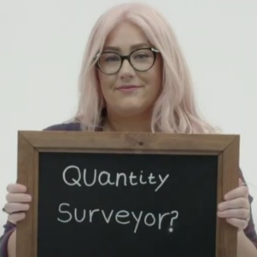
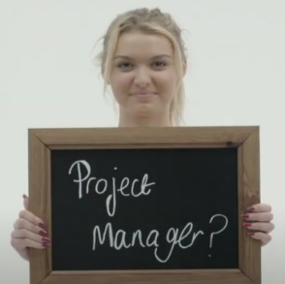
4
What is a stereotype?
Before the last activity, you might have had an image in mind of the kind of people who are likely to work in Pharmacy and what their role might entail. Now let’s take that idea a bit further…
Class discussion (4-5 mins)
Click the image on the right to watch a short film. When you’ve finished, discuss the following question: are there any roles that you think can only be carried out by a certain gender? Why?
0:00-3:00
We can sometimes assume that certain sectors and roles require a particular type of person. However, the opposite is true! Most careers are open to everyone when they receive the right training.
Individual reflection (1-2 mins)
What is it about certain roles that make us think that only one type of person can do them?
©VotesforSchools The WOW Show 2021
Notes:
Video Links:
YouTube Video Link: https://www.youtube.com/watch?v=9xCn-Kwy97U&feature=emb_logo
SafeShare Video Link: https://safeshare.tv/x/9xCn-Kwy97U
The WOW Show Link: https://www.thewowshow.org/mythbusters/
Images:
1) Via video

Slide 10
4
What is a stereotype?
Definition: Equality
The right of different groups of people to have a similar social position and receive the same treatment.
Definition: Diversity
The condition or fact of being different or varied; variety.
Equality, diversity and inclusion for patients ensures patients access the services they need. It also makes sure they receive the best care, no matter their background.
Equality means making sure individuals or groups are not treated differently based on a specific “protected characteristic”. These include race, gender, disability, religion or belief, sex, sexual orientation, and age.
Understanding this will help improve the access, experiences and health outcomes for all patients and communities, and to support the NHS to become a more inclusive employer by making full use of the talents of its diverse staff and the communities it serves.
©VotesforSchools The WOW Show 2021
Notes:
Images:
iStock
References:
https://www.england.nhs.uk/about/equality/equality-hub/edc/
https://www.christie.nhs.uk/work-with-us/why-work-with-us/equality-diversity-and-inclusion
https://dictionary.cambridge.org/dictionary/english/equality
https://dictionary.cambridge.org/dictionary/english/diversity

Slide 11
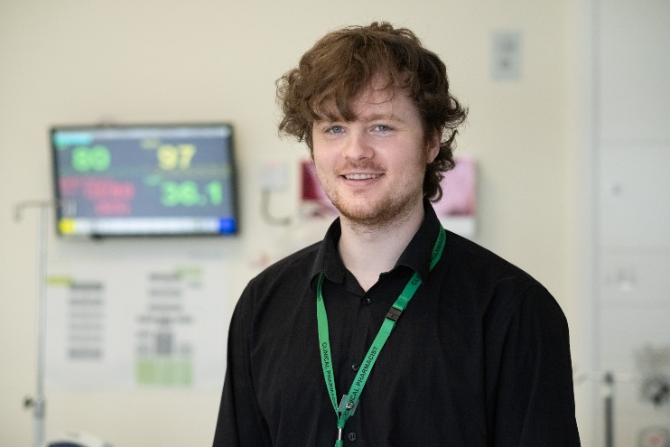
5
What is discrimination?
Stereotyping can lead to discrimination without realising it, so it is important to always treat people equally.
Definition: Discrimination
Treating a person or group of people differently, especially in a worse way from the way in which you treat other people.
Pair discussion (2-3 mins)
Talk to a partner about the following question: have you ever felt discriminated against? When? What did you do about it?
As you have seen today, discrimination can affect what we choose to do as a future career. This can then lead to industries or companies missing out on having a more diverse group of people working for them (also known as a workforce).
©VotesforSchools The WOW Show 2021
Notes:
References:
https://dictionary.cambridge.org/dictionary/english/discrimination
https://www.oxfordshirelep.com/sites/default/files/uploads/Equality%20and%20Diversity%20Statement%20v2%20230519.pdf
Images:
Icons8
iStock

Slide 12
6
The future of Pharmacy
Small group activity (1-2 mins)
Discuss what role you think Pharmacists and Pharmacy have played in life in the UK in the last few years, based on what you have discussed. Click to see a selection of questions to help you get started.
How might Pharmacy contribute to supporting the NHS?
What roles do you think Pharmacists took during the pandemic?
How and why might their current roles have changed in recent years?
What do you think the future holds for Pharmacies and Pharmacists?
Challenge:
Consider: how rewarding do you think the role of a Pharmacist would be?
How could you improve people’s lives and futures?
©VotesforSchools The WOW Show 2021
Notes:
Teacher notes: The answers to this will be covered in Lesson 3 by the Pharmacists, as part of the question and answers session.
Images:
HEE
Icons8

Slide 13
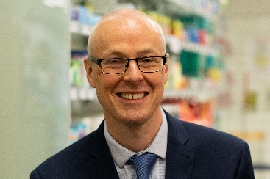
7
What skills are needed in Pharmacy?
Individual reflection (3-5 mins)
Consider which traits you think are most important to be a Pharmacist - click to see some suggestions. Why do you think these are so important?
Challenge:
Do you think this career could be for you? Make sure to check out the final slides for more information.
Understanding
Resilience
Empathy
Co-operation
Teamwork
Communication
Problem Solving
Interpersonal Skills
©VotesforSchools The WOW Show 2021
Notes:
Images:
HEE

Slide 14
8
Pharmacy & me
Small group activity (3-5 mins)
Have a read of the following core values that Pharmacists are trained to deliver. Did any of these ideas come up in your previous discussion?
Working together for patients: patients come first in everything Pharmacists do.
Improving lives: Pharmacists strive to improve health & wellbeing, and people’s experiences of the NHS.
Respect and dignity: every person – whether a patient, their families/carers, or staff – is valued as an individual, and Pharmacists respect their aspirations and commitments in life, and seek to understand their priorities, needs, abilities and limits.
Compassion: Pharmacists ensure that compassion is central to the care they provide, and that they respond with humanity and kindness to each person’s pain, distress, anxiety or need.
Commitment to quality of care: Pharmacists earn the trust placed in them by insisting on quality and striving to get the basics of quality of care, such as safety, effectiveness and patient experience, right every time.
Everyone counts: Pharmacists maximise their resources for the benefit of the whole community, and make sure nobody is excluded, discriminated against or left behind.
©VotesforSchools The WOW Show 2021
Notes:
Images:
Icons8

Slide 15
Further help & support
If you are interested in a career as a Pharmacist or in Pharmacy, then Module 4 has all of the links to further information and support to help you consider if this profession is for you.
©VotesforSchools The WOW Show 2021
Notes:
References:
Royal Pharmaceutical society: https://www.rpharms.com/pharmacycareers
General Pharmaceutical Council - https://www.pharmacyregulation.org/education-and-training-requirements-pharmacy-team
Association of Pharmacy Technicians UK (APTUK) - https://www.aptuk.org/site/how-do-you-become-a-pharmacy-technician
https://www.ucas.com/explore/subjects/pharmacology-toxicology-and-pharmacy
https://www.pharmacyschoolscouncil.ac.uk/study/
https://www.prospects.ac.uk/jobs-and-work-experience/job-sectors/science-and-pharmaceuticals/pharmacy-courses
https://studyinghealthcare.ac.uk/applications/pharmacy/careers-in-pharmacy/
Images:
See below
Icons8
References:
https://www.healthcareers.nhs.uk/explore-roles/pharmacy
https://www.rpharms.com/pharmacycareers
https://www.prospects.ac.uk/careers-advice/what-can-i-do-with-my-degree/pharmacy
https://nationalcareers.service.gov.uk/job-profiles/pharmacist
https://targetcareers.co.uk/career-sectors/healthcare-and-veterinary-medicine/1014243-careers-in-pharmacy
https://www.nidirect.gov.uk/articles/careers-pharmacy
https://www.boots.jobs/pharmacy/

Slide 16
Further help & support
If you are keen to help others, enjoy science and want a career in healthcare, Pharmacy could be for you. Check out this website for everything you need to know.
The website has been developed to support students looking at careers in Pharmacy. It contains an interactive careers map to support your choices.
If you are inspired and want a career in Pharmacy check out the resources and the case studies about careers and how to get there.
©VotesforSchools The WOW Show 2021
Notes:
References:
1) HEE interactive Pharmacy Careers map – https://careersinpharmacy.uk/

Slide 17
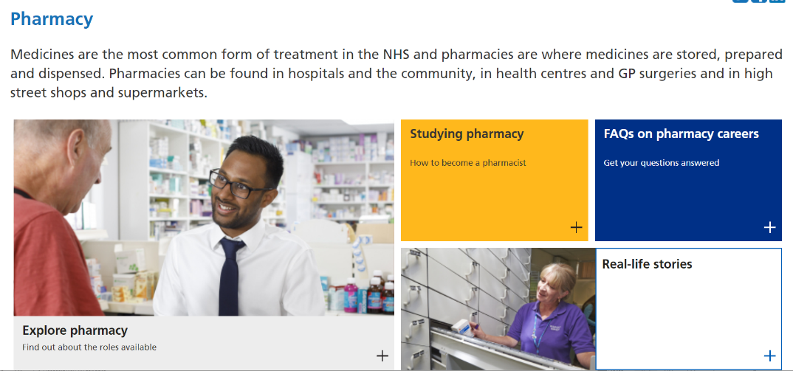
Further help & support
If you are keen to help others, enjoy science and want a career in healthcare, Pharmacy could be for you. Check out the animation below for a quick recap.
0:00- 3:47
The animation contains a summary of the key roles and responsibilities of Pharmacy Professionals and how you can help others in this fantastic career.
The NHS Careers website has been developed to support students looking at careers in Pharmacy. It contains everything you need to know.
©VotesforSchools The WOW Show 2021
Notes:
You Tube Video Link: https://www.youtube.com/watch?v=ux3JW4PyBM8&list=PLnnppXZprOJcW878vJRHUiy0olgVrtmFA&index=40
SafeShare TV Video Link: https://safeshare.tv/x/ux3JW4PyBM8
References:
https://www.healthcareers.nhs.uk/explore-roles/pharmacy
https://www.healthcareers.nhs.uk/explore-roles/pharmacy/roles-pharmacy - The animation will be available on this website.

