Slide 1



KS5 Lesson
Supporting
Sponsored by

Slide 2
Learning objectives for today
1. Assess how you are changing and be able to match your skills, interests and values to requirements and opportunities in learning and work.
2. Reflect on changing career processes and structures and their possible effects on your experience and management of your own career development.
3. Explain how you are developing your employability qualities and skills to satisfy your own expectations and the future expectations of your employers and co-workers.
4. Be able to research and evaluate progression pathways and return on investment for the higher and further education, training, apprenticeship, employment and volunteering options open to you.
Keywords
Oncology - The study and treatment of tumours (= masses of cells) in the body.
Proton beam therapy – Proton therapy is an invisible and highly controlled beam that works by using pencil point precision to target a tumour.
Resilience - the ability to be happy, successful, etc. again after something difficult or bad has happened.
Soft skills – Including people's abilities to communicate with each other and work well together.
©VotesForSchools2019
Notes:
References:
1) https://dictionary.cambridge.org/dictionary/english/resilience
2) https://dictionary.cambridge.org/dictionary/english/soft-skills
3) https://dictionary.cambridge.org/dictionary/english/oncology
4) https://www.thecdi.net/Careers-Framework

Slide 3




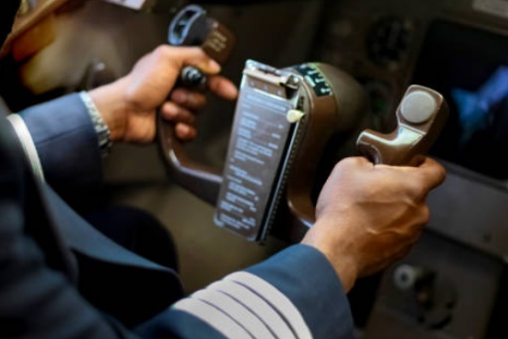


1
Have you thought about a career?
Paired discussion (3 mins)
Talk to a partner about a job or career you are interested in.
Teacher
App creator
Doctor
Builder
Author
Pilot
There are 1000s of careers to think about and some that we don’t even know about yet!
Architect
Designer
Paired talk (3 mins)
Have you researched how to get there? What will it take?
Career:
An occupation undertaken for a significant period of a person's life.
©VotesForSchools2019
Notes:
References:
https://www.lexico.com/en/definition/career
Images:
Istock

Slide 4







2
What comes to mind when think about a career?
Salary
Hours
Class discussion (2 mins)
What do you think about when you consider a career for your future?
Qualifications
Position
Environment
Job Satisfaction
Individual Activity (3 mins)
Rank these values in order of importance for you.
Achievement
Compassion
Helping others
Adventure
Structure
Routine
Success
Money
Risk
Excitement
Colleagues
Think about your values.
Think about your skills.
Break down roles and sectors.
Meet people.
Don’t be afraid to experiment.
Choosing a career and knowing where to start can seem downright impossible. There are so many options. It’s daunting, confusing and often anxiety-riddled. Add to that advice that tells you to ‘follow your passion’ and ‘do what you love’ – you might like things, but do you really love them?
©VotesForSchools2019
Notes:
References:
https://www.lexico.com/en/definition/salary
https://dictionary.cambridge.org/dictionary/english/cv?q=CV
https://www.brightnetwork.co.uk/no-idea-what-do/why-its-ok-have-no-idea-what-do/
Images:
Istock

Slide 5
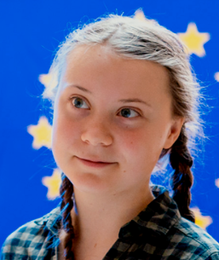
3
Can your career save the environment?
Questions (3 mins)
1) Which careers do you think could save the environment?
2) What do you think of environmental activist Greta Thunberg?
The environment:
The air, water, and land in or on which people, animals, and plants live. :
Greta Thunberg has spoken at climate rallies in Stockholm, Helsinki, Brussels and London. In December 2018 she attended the United Nations COP24 in Katowice, Poland, where she addressed the Secretary-General and made a plenary speech that went viral and was shared many million times around the globe. In January 2019, she was invited to the World Economic Forum in Davos where her speeches again made a worldwide impact.
Environmentalist
Scientist
Politician
Engineer
Designer
Which other careers?
Notes:
References:
https://dictionary.cambridge.org/dictionary/english/environment
https://www.ted.com/speakers/greta_Thunberg
Images:
https://www.ted.com/speakers/greta_Thunberg

Slide 6
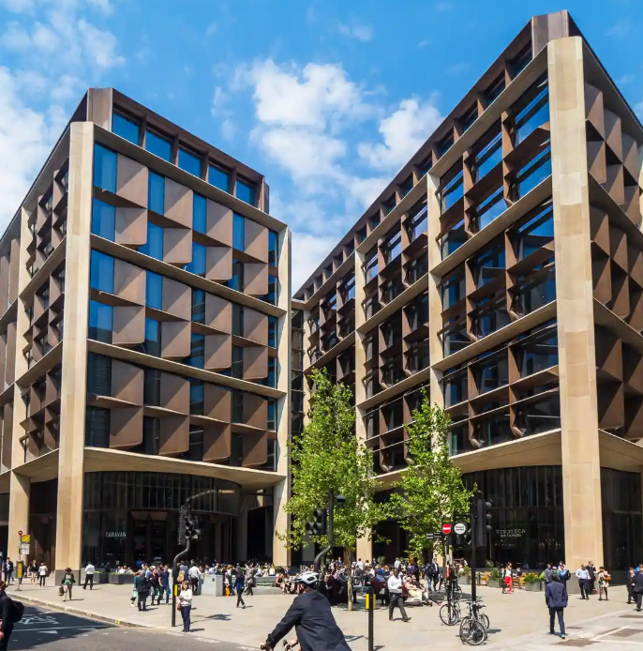
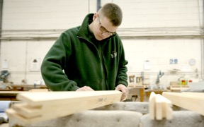
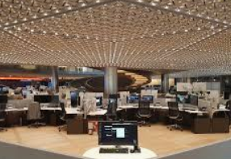
3
Can your career save the environment?
Questions (3 mins)
1) How can we create an environmentally friendly infrastructure?
(Roads, towns and buildings)
2) Would you be interested in an apprenticeship like Bailey’s?
The Bloomberg building in London
The 1 million sq ft complex has vacuum-flush toilets, breathing “gills” in the facade, a “petal”-studded ceiling that provides lighting, cooling and acoustic attenuation, and a host of other features that mean it should use 70% less water and 40% less energy than a typical office block.
Engineer:
A person whose job is to design or build
machines, engines, or electrical equipment,
or things such as roads, railways,
or bridges, using scientific principles.
Latest figures show that the construction industry contributed £117 billion to the UK economy, 6% of the total. There are 2.4 million construction industry jobs in the UK - that’s 6.6% of all jobs. In the next five years it is expected that 232,000 jobs will be created in the industry.
Notes:
References:
https://www.theguardian.com/artanddesign/2018/oct/10/norman-fosters-bloomberg-office-in-london-wins-stirling-prize
https://constructionclimatechallenge.com/2019/05/22/3-ways-the-construction-industry-can-help-the-environment/
https://www.theguardian.com/environment/2007/nov/22/ethicalliving.renewableenergy
Images:
Istock

Slide 7



3
Can your career save the environment?
0:00-
1:02
Class reflection (3 mins)
Watch the Blue Planet 2 trailer.
What impact do you think the series had on people’s views on saving the environment?
Will your generation be the ones to save it?
How can a career save the environment?
Fact file:
Latest figures show that the construction industry contributed £117 billion to the UK economy, 6% of the total. There are 2.4 million construction industry jobs in the UK - that’s 6.6% of all jobs.
In the next five years it is expected that 232,000 jobs will be created in the industry.
https://safeshare.tv/x/ss5e49729325fd4#
Notes:
Alternative video link:
https://www.youtube.com/watch?v=kAphgHhlteM You tube Blue Planet 2 trailer
References:
https://dictionary.cambridge.org/dictionary/english/engineer
Images:
Istock
Blue planet 2 trailer

Slide 8
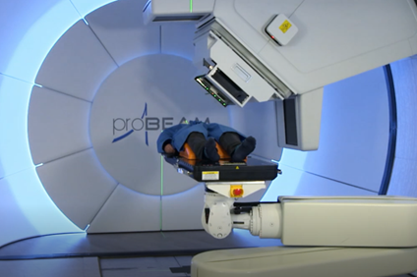
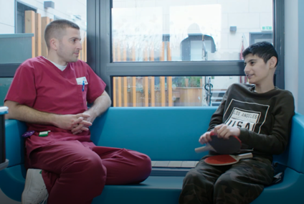
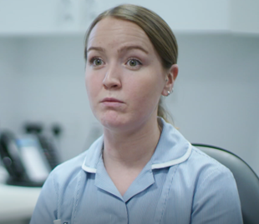
4
Can your career save a life?
Class reflection (3 mins)
1) What careers can you think of that can save a life?
2) Have you considered one?
3) What would it feel like to save a life?
In the film we met Georgia, the paediatric nurse who looks after children throughout their cancer treatment.
In the film we met David, the Superintendent Proton Radiographer who oversees people’s treatment for cancer with proton therapy.
Careers helping people come in all shapes and sizes. You can get hands-on in a healthcare or emergency services job, think your way around problems as a social worker or lawyer, or create broader benefits for society in a career such as science or engineering.
Class reflection (3 mins)
1) What qualities would you need to work in a caring career?
2) How important is communication?
3) What qualities would be essential in these roles?
Notes:
References:
https://targetcareers.co.uk/careers-advice/choosing-your-career/385829-i-want-a-career-helping-people-what-are-my-options
Images:
Istock
Screenshots from the film.

Slide 9

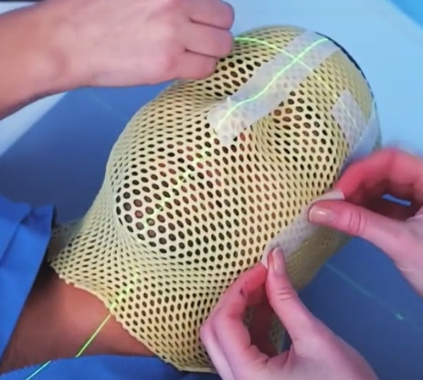
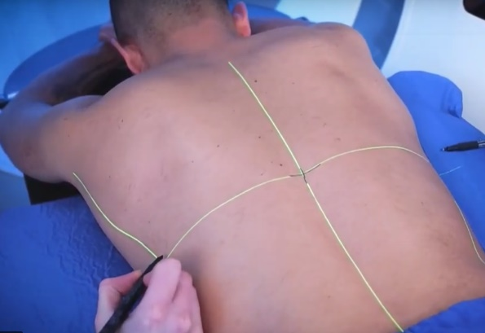
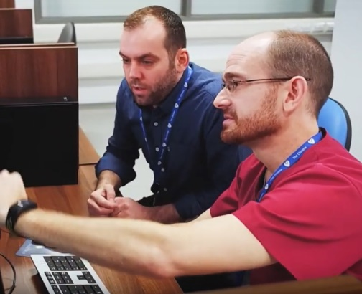
4
Can your career save a life?
Proton therapy, also called proton beam therapy, is a type of radiation therapy. It uses protons rather than x-rays to treat cancer.
A proton is a positively charged particle. At high energy, protons can destroy cancer cells. Doctors may use proton therapy alone. Like x-ray radiation, proton therapy is a type of external-beam radiation therapy. It painlessly delivers radiation through the skin from a machine outside the body.
Proton:
The definition of a proton is a particle with a positive charge that is in the nucleus of an atom.
Fact file:
The NHS is the biggest employer in Europe with 1.5 million employees. There are 360 different job roles, taking in a huge array of different skills and qualifications. It means that there’s probably a career opportunity in every town and city in the country at your local hospital or health authority.
Class discussion (4 mins)
1) Could you work with cancer patients?
2) What would be the challenges?
3) What are the advantages of proton therapy for patients?
Notes:
References:
https://www.youtube.com/watch?time_continue=142&v=PSrpfLmxwu0&feature=emb_logo Christie hospital proton therapy
https://www.cancer.net/navigating-cancer-care/how-cancer-treated/radiation-therapy/proton-therapy Proton therapy information
https://www.yourdictionary.com/proton
Images:
1) Screenshot from the film.

Slide 10

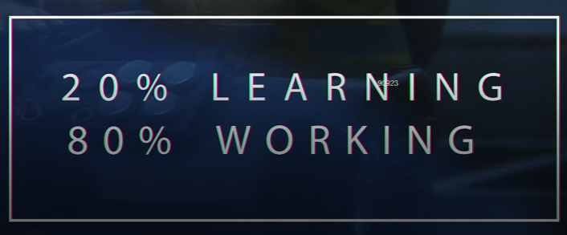
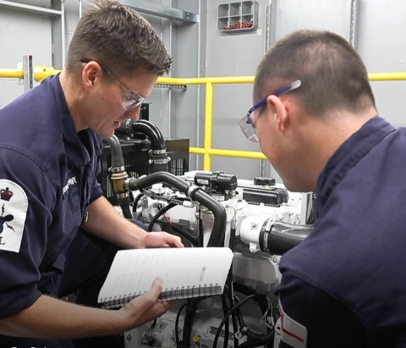

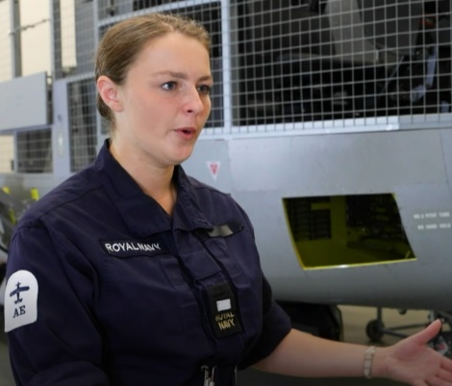
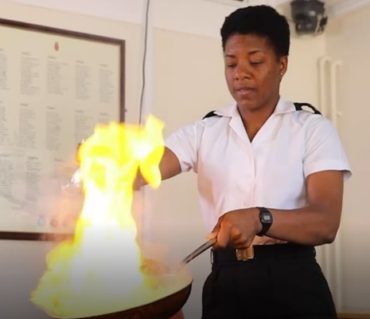
5
Can your career keep us safe?
Class reflection (4 mins)
In the film we saw all of the careers open to you in the navy.
1) Were you surprised at all of the different opportunities?
2) What did you think of their training and apprenticeships?
Chef
The navy is an excellent place to learn skills for a career whilst earning a salary. A job is guaranteed after you complete your training.
Logistics
Diver
Firefighter
Aircraft Controller
Engineer
©VotesForSchools2019
Notes:
Images:
1) iStock
2) Screenshots from the film

Slide 11
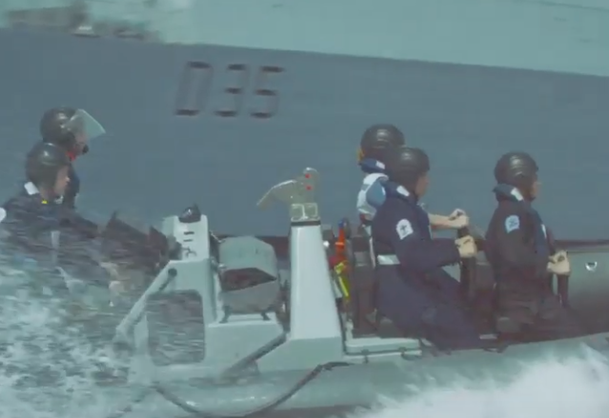
5
Can your career keep us safe?
0:00-
1:02
Paired talk (2 mins)
Watch the Royal Navy recruitment video. 1) What do you think are its messages?
2) How important are interpersonal skills in the roles?
Fact file:
Making sure the force of 30,000 men and women can protect our nation’s interests all over the world, is no small task. The Naval service has nine branches, each performing a vital role. They keep the ships, submarines, aircraft – and people – operationally effective on every mission, 365 days a year. Depending on skills and experience, recruits can join a branch at either rating or officer level.
Joining the Royal Navy makes you part of something special. Part of a team. Protecting our nation’s interests, all over the world. It’s the kind of career you can be proud of, and your family can be proud of you for. A way to use your natural skills and develop new ones that stay with you for life. It’s not for everyone, but it could be for you.
https://safeshare.tv/x/KXTCzzden2o#
©VotesForSchools2019
Notes:
Alternative video link:
1) https://www.youtube.com/watch?v=KXTCzzden2o#action=share Navy recruitment
Images:
1) iStock
2) Video screenshot

Slide 12

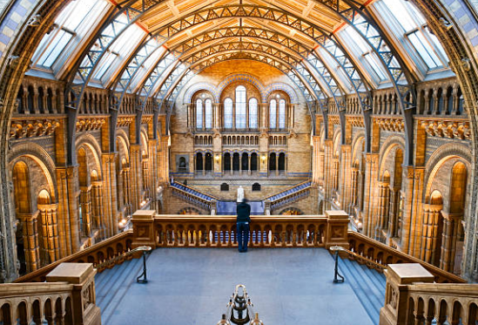
5
Can your career be creative?
Creative:
Producing or using original and unusual ideas.
Class discussion (2 mins)
1) What creative careers can you think of?
2) Are the skills needed for creative careers different than the other careers we have looked at?
3) If so, why?
Designer
There are many different jobs in the creative industries for those with artistic talent, a flair for design or a desire to perform.
Gamer
Artist
Creative & Cultural Skills gives young people opportunities to work and learn in the creative industries. They are an independent charity that provides careers advice and guidance, promotes apprenticeships, and delivers activities for young people through our National Skills Academy network of industry and education supporters.
https://ccskills.org.uk/about
Film maker
Actor
Curator
©VotesForSchools2019
Notes:
References:
https://ccskills.org.uk/about
Images:
1- iStock

Slide 13

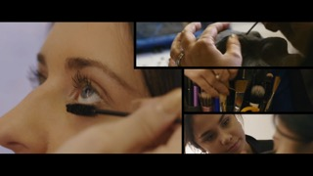



5
Can your career be creative?
Class discussion (2 mins)
1)How many people do you think are needed to have a successful television show?
2) How do the roles vary?
Theatre Technician
Make-up Artist
Fashion Photographer
Music Producer
Music Producer
©VotesForSchools2019
Notes:
Images:
1- iStock

Slide 14





6
Do you have the skills?
Individual activity (2 mins)
What skills do you need to be successful in your career?
Write them down and then discuss them with a partner.
Communication
Resilient
Creativity
‘Soft skills’ are so important to employers. They are things you can work on yourself to make you more successful.
Manners
Time keeping
…
Qualities:
A characteristic or feature of someone or something.
…
…
©VotesForSchools2019
Notes:
Images:
1) Istock

Slide 15
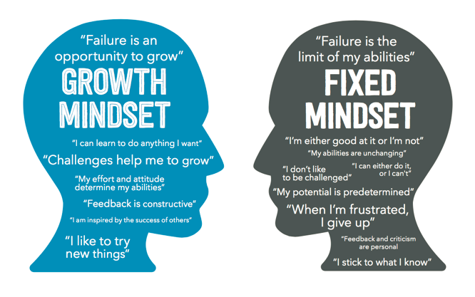
6
Do you have the skills? Growth mindset
Growth mindset occurs when we believe our intelligence and abilities can be improved upon with effort and the right strategies.
Paired talk (3 mins)
How is a growth mindset important to an employer?
What sort of mindset do you have?
There are lots of quizzes you can take to find out if you’re not sure.
Fixed mindset occurs when we believe our intelligence and abilities cannot be altered in a meaningful way.
Fact file:
The top ten attributes that employers say they look for in young employees are: Commercial awareness, communication, teamwork, negotiation and persuasion, problem solving, leadership, organisation, resilience, ability to work under pressure, and confidence.
©VotesForSchools2019
Notes:
Reference:
https://biglifejournal.com/blogs/blog/teach-growth-mindset-kids-activities
https://www.excelsior.edu/article/growth-mindset/
https://www.wabisabilearning.com/blog/growth-mindset-quiz Growth mindset quiz
Images:
1

Slide 16
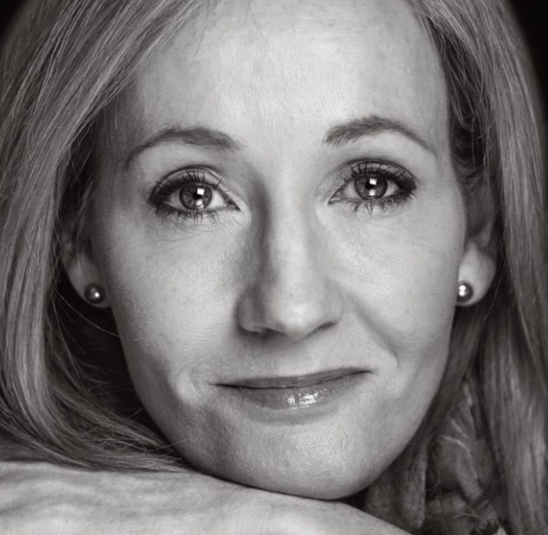
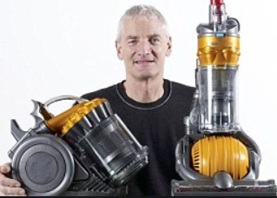
6
Do you have the skills? Resilience
Individual task (3 mins)
1) Write down 3 goals you have for your life.
2) Have you thought about how to get there?
J K Rowling had her Harry Potter book turned down 12 times before it was eventually published.
Sometimes reaching our goals takes huge amounts of resilience. It doesn’t always happen the first time we try.
When Dyson invented his first Dual Cyclone vacuum cleaner, which hit stores in 1993, he spent 15 years creating 5,126 versions that failed before he made one that worked.
Resilience:
The ability to be happy,
successful, etc. again after something difficult or bad
has happened.
Resilience encourages you to believe that anything can be achieved when they put their mind to it.
©VotesForSchools2019
Notes:
References:
https://www.today.com/popculture/j-k-rowling-s-original-harry-potter-pitch-was-rejected-t117763
https://en.wikipedia.org/wiki/James_Dyson
Images:
1) https://www.today.com/popculture/j-k-rowling-s-original-harry-potter-pitch-was-rejected-t117763

Slide 17



6
Do you have the skills? Oracy
Paired task (7 mins)
In pairs, interview each other for a career you are interested in. What do you think will be the first 2 questions asked?
With employers now rating communication skills as their highest priority, above even qualifications, the ability to express ideas is more important than ever before. Indeed, a recent study estimated pupils contributed on average just four words per lesson, while another revealed that children with good communication skills are four times more likely to get five A*-Cs at GCSE.
Debating helps students develop their oracy skills
Oracy:
The ability to speak clearly and grammatically correctly.
©VotesForSchools2019
Notes:
References:
https://dictionary.cambridge.org/dictionary/english/oracy
Images:
1) Istock

Slide 18
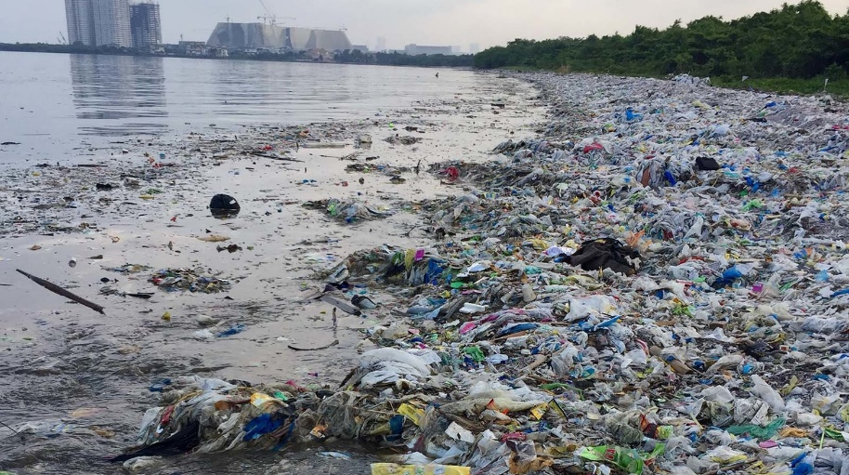
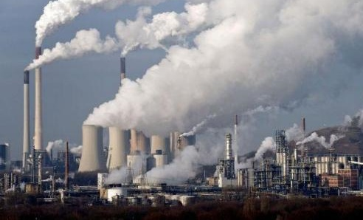
6
Do you have the skills? Critical thinking
Group discussion (4-5 mins)
Why do you think all newspapers agree that plastic pollution in the ocean is a big issue, but disagree on man-made climate change?
As a group decide on one of the below reasons. Then defend it to the class.
Reducing plastic pollution wouldn’t affect newspapers, but stopping climate change could cost.
Man-made climate change is a more complicated issue. It is acceptable to believe that it doesn’t exist.
It is easier for newspapers to show they are reducing plastic pollution than climate change.
Pollution of the oceans with plastic is a bigger issue than climate change.
Blue Planet 2 showed us the problem with plastic waste in the environment. Did it convince people to use less plastic?
Critical thinking:
The process of thinking carefully about a subject or idea, without allowing
feelings or opinions to affect you.
©VotesForSchools2019
Notes:
References:
https://dictionary.cambridge.org/dictionary/english/critical-thinking
BBC Blue Planet 2 programme
Images:
Istock
Blue Planet 2

Slide 19



What to do after A levels:
Get a job. Once you've completed your A-levels (or an equivalent qualification like a BTEC) you can leave school and find a job.
Become a Young Entrepreneur.
Have you got a great idea for a business or a product?
Higher Apprenticeships.
A Higher Apprenticeship could be a good next step for you if you don’t want to choose between a job or a degree. You’ll get training (resulting in an industry-recognised qualification) while earning a salary and getting real-life work experience on your CV at the same time.
Sponsored Degrees.
A sponsored degree is an opportunity to gain work skills AND a degree that is associated with one particular employer. Your resulting skills, knowledge and qualification will be recognised by everyone in the industry.
https://safeshare.tv/x/48TE3mqUXow#
©VotesForSchools2019
Notes:
References:
https://www.youthemployment.org.uk/yp-article/what-to-do-after-a-levels-apprenticeships-degree-job/
Images:
Istock

Slide 20
What to do after A levels:
Degree Apprenticeships.
Degree apprenticeships are a Government-backed scheme that’s similar to sponsored degrees. With a degree apprenticeship, you’re mixing traditional university study and paid work, but the degree apprenticeship is designed by a group of businesses along with the participating universities and colleges.
School Leaver Programmes.
Essentially school leaver programmes are a paid training scheme. You’ll work with an employer for a salary, building life and work skills (and the contents of your bank account). You’ll also train towards a qualification, usually a professional vocational qualification that is relevant to your career.
Further Education and College.
You can study for vocational and competency-based qualifications including awards, certificates and diplomas. These are all industry-recognised qualifications and they are awarded by organisations like City and Guilds, Edexcel (BTEC) and OCR. You can also do higher education (HE) qualifications like HNCs, HNDs, foundation degrees or PGCEs.
University.
You may decide that university is the best next step for you. You can apply for a range of degrees that best suit your interests and level of learning. For example, you can apply for foundation degrees to give you a strong grounding in a particular academic or professional area.
https://www.ucas.com/undergraduate/what-and-where-study/ucas-undergraduate-entry-requirements
https://safeshare.tv/x/48TE3mqUXow#
©VotesForSchools2019
Notes:
Alternative video link:
1) https://www.youtube.com/watch?time_continue=5&v=48TE3mqUXow&feature=emb_logo
2) https://www.ucas.com/further-education/ucas-progress/getting-started/what-are-my-options-after-gcses-or-national-5s
3) https://www.ucas.com/undergraduate/what-and-where-study/ucas-undergraduate-entry-requirements
Images:

Slide 21




We need your questions:
Why not use an Ipad to record your class question for our career's experts.
Upload your videos by clicking on this Dropbox link: https://www.dropbox.com/request/RNqdDJzDAj6Kcwom6Kql
Email:
You can email us a query or question at:
info@thewowshow.org
The CareersCast Q&A programme will include experts from each of the employment sectors in the Show who are able to give practical advice about pathways into the careers featured. Please read the guidelines for recording your questions.
©VotesforSchools2020
Notes:
Teachers: Please send us in your questions this week ready for our follow up show. Please make sure the students asking have permission for their photograph or recording to be shown. Thank you.
Images:
1) Istock

Slide 22






Need more information
Students | Useful links
There are lots of resources out there to help you choose the right career path. | Careers in construction can be found at: https://www.goconstruct.org/routes-into-construction/useful-qualifications-to-get-into-construction/
The Royal Navy advice on joining can be found at: https://www.royalnavy.mod.uk/careers/joining/get-in-contact | NHS careers telephone number: 0345 60 60 655
The NHS website supporting qualifications and training: https://www.healthcareers.nhs.uk/career-planning/study-and-training https://www.healthcareers.nhs.uk/explore-roles/allied-health-professionals | The City and Guilds qualifications and apprenticeships: https://www.cityandguilds.com/help/contact-us
Information on creative careers can be found at: https://ccskills.org.uk/careers | ScreenSkills is the industry-led skills body for the UK's screen-based creative industries - animation, film, games, television including children's TV and high-end drama, VFX and immersive technology. https://www.screenskills.com/careers/
BBC Bitesize is also a good source of information: https://www.bbc.co.uk/bitesize/careers | The National Careers Service: https://nationalcareers.service.gov.uk/
©VotesforSchools2020

Slide 23




Supporting
Sponsored by
Produced in association with
Notes:
End slide

