Slide 1



KS4 Lesson
Supporting
Sponsored by

Slide 2
Learning objectives for today
1. Review and reflect upon how you are benefitting as a learner from careers, employability and enterprise activities and experiences.
2. Discuss the skills involved in managing your own career.
3. Show how you are developing the qualities and skills which will help you to improve your employability.
4. Be able to research your education, training, apprenticeship, employment and volunteering options including information about the best progression pathways through to specific goals.
Keywords
Career – The job or series of jobs that you do during your working life,
especially if you continue to get better jobs and earn more money.
Oncology - The study and treatment of tumours (= masses of cells) in the body.
Proton beam therapy – Proton therapy is an invisible and highly controlled beam that works by using pencil point precision to target a tumour.
Soft skills – Including people's abilities to communicate with each other and work well together.
©VotesForSchools2019
Notes:
References:
1) https://dictionary.cambridge.org/dictionary/english/career
2) https://dictionary.cambridge.org/dictionary/english/aspiration?q=aspirations
3) https://dictionary.cambridge.org/dictionary/english/soft-skills
4) https://dictionary.cambridge.org/dictionary/english/oncology
5) https://www.thecdi.net/Careers-Framework

Slide 3







1
Have you thought about a career?
Pair discussion (2 mins)
Talk to a friend about a job or career you are interested in.
Teacher
App creator
Doctor
Builder
Author
Pilot
There are 1000s of careers to think about and some that we don’t even know about yet!
Architect
Designer
Reflect and share (1 min)
Has anyone thought about how they can make it happen?
Career:
An occupation undertaken for a significant period of a person's life.
©VotesForSchools2019
Notes:
References:
https://www.lexico.com/en/definition/career
Images:
Istock

Slide 4







2
What comes to mind when think about a career?
Salary
Hours
Discuss (2 mins)
What do you think about when you consider a career for your future?
What is important to you?
Qualifications
Position
Environment
Job Satisfaction
Curriculum Vitae (CV):
A short, written description of your education, qualifications, previous jobs, and sometimes also your personal interests, that you send to an employer when you are trying to get a job.
Colleagues
Salary:
A fixed regular payment, typically paid on a monthly basis but often expressed as an annual sum, made by an employer to an employee.
Fun fact!
The average time spent looking at a CV is 5-7 seconds. 1 spelling or grammar mistake and your CV will be thrown away. 76% of CVs are ignored if your email address is unprofessional.
©VotesForSchools2019
Notes:
References:
https://www.lexico.com/en/definition/salary
https://dictionary.cambridge.org/dictionary/english/cv?q=CV
Images:
Istock

Slide 5
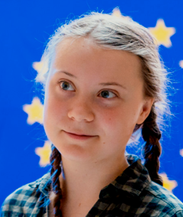
3
Can your career save the environment?
Discuss (4 mins)
Which careers do you think could save the environment?
What do you think of Environmental activist Greta Thunberg?
The environment:
The air, water, and land in or on which people, animals, and plants live. :
Greta Thunberg has spoken at climate rallies in Stockholm, Helsinki, Brussels and London. In December 2018 she attended the United Nations COP24 in Katowice, Poland, where she addressed the Secretary-General and made a plenary speech that went viral and was shared many million times around the globe. In January 2019, she was invited to the World Economic Forum in Davos where her speeches again made a worldwide impact.
Environmentalist
Scientist
Politician
Engineer
Designer
Which other careers?
Notes:
References:
https://dictionary.cambridge.org/dictionary/english/environment
https://www.ted.com/speakers/greta_Thunberg
Images:
https://www.ted.com/speakers/greta_Thunberg

Slide 6
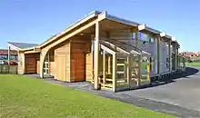
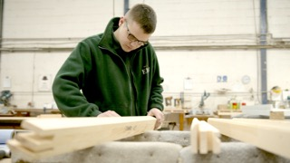
3
Can your career save the environment?
Latest figures show that the construction industry contributed £117 billion to the UK economy, 6% of the total. There are 2.4 million construction industry jobs in the UK - that’s 6.6% of all jobs. In the next five years it is expected that 232,000 jobs will be created in the industry.
Discuss (2 mins)
Which building materials do you think are best for the environment? Why?
In the film we met Bailey, the apprentice. Using timber as a construction material means trees need to be planted to provide the building materials. When they grow trees remove CO2 from the environment.
Kingsmead primary school is designed as a learning tool for pupils to understand more about the environment. They've got active voltage displays for the solar panels, as well as an electronic meter that shows how much rainwater is collected by the inverted roof. Renewable energy automatically opens and shuts the windows, skylights and blinds, allowing fresh air to flow through the building and shading pupils where necessary.
Engineer:
A person whose job is to design or build machines, engines, or electrical equipment, or things such as roads, railways, or bridges, using scientific principles.
Notes:
References:
https://constructionclimatechallenge.com/2019/05/22/3-ways-the-construction-industry-can-help-the-environment/
https://www.theguardian.com/environment/2007/nov/22/ethicalliving.renewableenergy
Images:
Istock

Slide 7


3
Can your career save the environment?
Discuss (4 mins)
Watch the Blue Planet 11 video. What impact do you think the series had on people’s views on saving the environment? Will your generation be the ones to save it?
0:00-
1:02
Fact file:
Latest figures show that the construction industry contributed £117 billion to the UK economy, 6% of the total. There are 2.4 million construction industry jobs in the UK - that’s 6.6% of all jobs.
In the next five years it is expected that 232,000 jobs will be created in the industry.
Engineer:
A person whose job is to design or build machines, engines, or electrical equipment, or things such as roads, railways, or bridges, using scientific principles.
https://safeshare.tv/x/ss5e49729325fd4#
Notes:
Alternative video link:
https://www.youtube.com/watch?v=kAphgHhlteM You tube Blue Planet 2 trailer
References:
https://dictionary.cambridge.org/dictionary/english/engineer
Images:
Istock
Blue planet 2 trailer

Slide 8
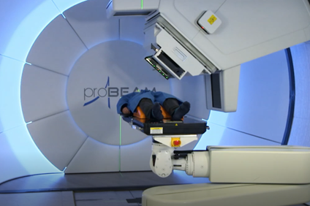
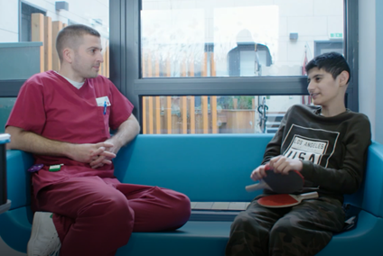
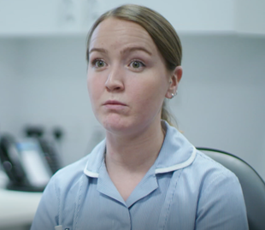

4
Can your career save a life?
Table Activity (2-3 mins)
What careers can you think of that could save a life? Have any of you considered one?
In the film we saw David, the Superintendent Proton Radiographer who oversees people’s treatment for cancer with proton therapy.
In the film we also saw Georgia, the paediatric nurse who looks after children throughout their cancer treatment.
Careers helping people come in all shapes and sizes. You can get hands-on in a healthcare or emergency services job, think your way around problems as a social worker or lawyer, or create broader benefits for society in a career such as science or engineering.
Paired discussion (3-4 mins)
What qualities would you need to work in a caring career?
How important is communication?
Notes:
References:
https://targetcareers.co.uk/careers-advice/choosing-your-career/385829-i-want-a-career-helping-people-what-are-my-options
Images:
Istock
Screenshots from the film.

Slide 9


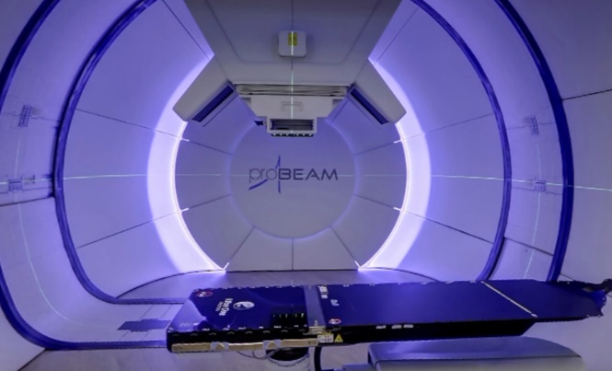
4
Can your career save a life?
Proton therapy, also called proton beam therapy, is a type of radiation therapy. It uses protons rather than x-rays to treat cancer.
A proton is a positively charged particle. At high energy, protons can destroy cancer cells. Like x-ray radiation, proton therapy is a type of external-beam radiation therapy. It painlessly delivers radiation through the skin from a machine outside the body.
Proton:
The definition of a proton is a particle with a positive charge that is in the nucleus of an atom.
Fact file:
The NHS is the biggest employer in Europe with 1.5 million employees. There are 360 different job roles, taking in a huge array of different skills and qualifications. It means that there’s probably a career opportunity in every town and city in the country at your local hospital or health authority.
Paired discussion (2-3 mins)
Could you work with cancer patients? What would be the challenges?
Notes:
References:
https://www.youtube.com/watch?time_continue=142&v=PSrpfLmxwu0&feature=emb_logo Christie hospital proton therapy
https://www.cancer.net/navigating-cancer-care/how-cancer-treated/radiation-therapy/proton-therapy Proton therapy information
https://www.yourdictionary.com/proton
4) https://www.christie.nhs.uk/patients-and-visitors/services/protons/proton-beam-therapy-at-the-Christie
Images:
1-

Slide 10

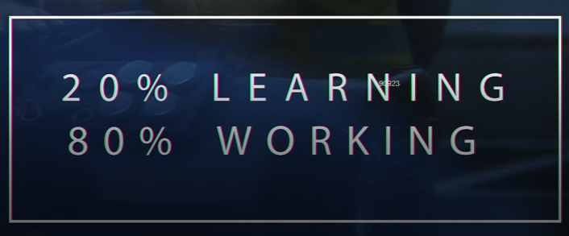
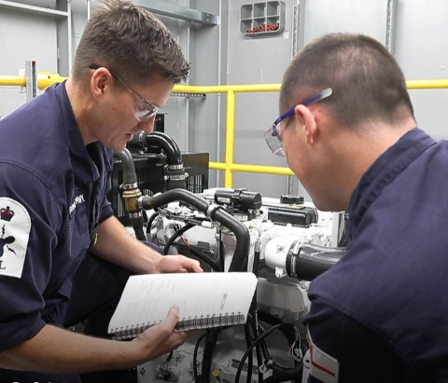

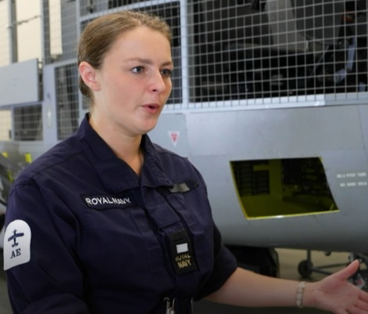
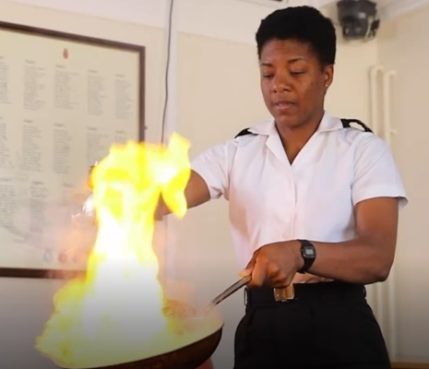
5
Can your career keep us safe?
Paired task (3 min)
In the film we saw all of the careers open to you in the navy.
Were you surprised at all of the different opportunities?
Chef
The Navy is an excellent place to learn skills for a career whilst earning a salary. A Job is guaranteed after you complete your training.
Logistics
Diver
Firefighter
Aircraft Controller
Engineer
©VotesForSchools2019
Notes:
Images:
1) iStock
2) Screenshots from the film

Slide 11

5
Can your career keep us safe?
0:00-
1:02
Paired talk (2 min)
Watch the Royal Navy recruitment video. What do you think are its messages?
Fact file:
Making sure the force of 30,000 men and women can protect our nation’s interests all over the world, is no small task. The Naval service has nine branches, each performing a vital role. They keep the ships, submarines, aircraft – and people – operationally effective on every mission, 365 days a year. Depending on skills and experience, recruits can join a branch at either rating or officer level.
Joining the Royal Navy makes you part of something special. Part of a team. Protecting our nation’s interests, all over the world. It’s the kind of career you can be proud of, and your family can be proud of you for. A way to use your natural skills and develop new ones that stay with you for life. It’s not for everyone, but it could be for you.
https://safeshare.tv/x/KXTCzzden2o#
©VotesForSchools2019
Notes:
Alternative video link:
1) https://www.youtube.com/watch?v=KXTCzzden2o#action=share Navy recruitment
Images:
1) iStock
2) Video screenshot

Slide 12




5
Can your career be creative?
Paired talk (3 min)
What creative careers can you think of?
Are you creative, would you like a creative career?
Creative:
Producing or using original and unusual ideas.
Designer
Gamer
Creative & Cultural Skills gives young people opportunities to work and learn in the creative industries. They are an independent charity that provides careers advice and guidance, promotes apprenticeships, and delivers activities for young people through our National Skills Academy network of industry and education supporters.
https://ccskills.org.uk/about
Artist
Film maker
Actor
Curator
©VotesForSchools2019
Notes:
References:
https://ccskills.org.uk/about
Images:
1- iStock

Slide 13





5
Can your career be creative?
Paired discussion task (2 mins)
What skills do you think you need for a creative career?
Theatre Technician
Make-up Artist
Fashion Photographer
Music Producer
Music Producer
©VotesForSchools2019
Notes:
Images:
1- iStock

Slide 14





6
Do you have the skills?
Individual task (2-4 mins)
What skills do you need to be successful in your career? Write them down. Then discuss why you would need these and whether you think you have what it takes.
Communication
Resilient
Creativity
Manners
‘Soft skills’ are so important to employers. They are things you can work on yourself to make you more successful.
Time keeping
…
Quality:
A characteristic or feature of someone or something.
…
…
©VotesForSchools2019
Notes:
Images:
1) Istock

Slide 15
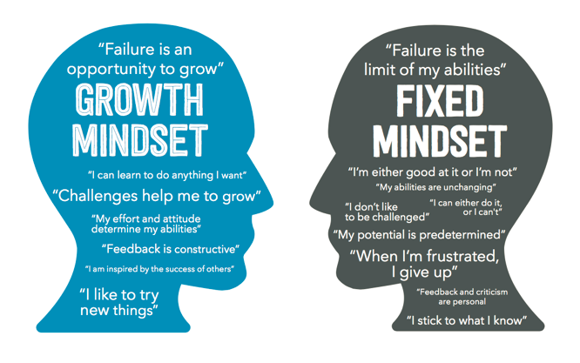
6
Do you have the skills? Growth mindset
Paired discussion
(2-4 mins)
How is a growth mindset important to an employer?
Growth mindset occurs when we believe our intelligence and abilities can be improved upon with effort and the right strategies.
Fixed mindset occurs when we believe our intelligence and abilities cannot be altered in a meaningful way.
Fact file:
The top ten attributes that employers say they look for in young employees are: Commercial awareness, communication, teamwork, negotiation and persuasion, problem solving, leadership, organisation, resilience, ability to work under pressure, and confidence.
©VotesForSchools2019
Notes:
Reference:
https://biglifejournal.com/blogs/blog/teach-growth-mindset-kids-activities
https://www.excelsior.edu/article/growth-mindset/
Images:
1

Slide 16

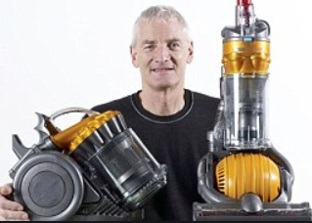
6
Do you have the skills? Resilience
Individual task
(3 mins)
Write down 3 goals you have for your life.
Have you thought about how to get there?
J K Rowling had her Harry Potter book turned down 12 times before it was eventually published.
Sometimes reaching our goals takes huge amounts of resilience. It doesn’t always happen the first time we try.
When Dyson invented his first Dual Cyclone vacuum cleaner, which hit stores in 1993, he spent 15 years creating 5,126 versions that failed before he made one that worked.
Resilience:
The ability to be happy,
successful, etc. again after something difficult or bad
has happened.
Resilience encourages you to believe that anything can be achieved when they put their mind to it.
©VotesForSchools2019
Notes:
References:
https://www.today.com/popculture/j-k-rowling-s-original-harry-potter-pitch-was-rejected-t117763
https://en.wikipedia.org/wiki/James_Dyson
Images:
1) https://www.today.com/popculture/j-k-rowling-s-original-harry-potter-pitch-was-rejected-t117763

Slide 17



6
Do you have the skills? Oracy
Paired task (10 mins)
In pairs, interview each other for a career you are interested in. What do you think will be the first two questions you will be asked?
With employers now rating communication skills as their highest priority, above even qualifications, the ability to express ideas is more important than ever before. Indeed, a recent study estimated pupils contributed on average just four words per lesson, while another revealed that children with good communication skills are four times more likely to get five A*-Cs at GCSE.
Debating helps students develop their oracy skills.
Oracy:
The ability to speak clearly and grammatically correctly.
©VotesForSchools2019
Notes:
References:
https://dictionary.cambridge.org/dictionary/english/oracy
Images:
1

Slide 18



6
Do you have the skills? Critical thinking
Paired discussion (5 min)
Can you explain how a mobile phone works with the internet to someone who has never seen it before?
Even just explaining what the internet is and where it is could prove difficult!
To be skilled at using critical thinking to solve problems, you will first need to overcome any bias you may have on a particular subject or problem. Depending on the problem, you may need to collect information in order to solve it
Critical thinking:
The process of thinking carefully about a subject or idea, without allowing
feelings or opinions to affect you.
©VotesForSchools2019
Notes:
References:
https://dictionary.cambridge.org/dictionary/english/critical-thinking
Images:
Istock

Slide 19



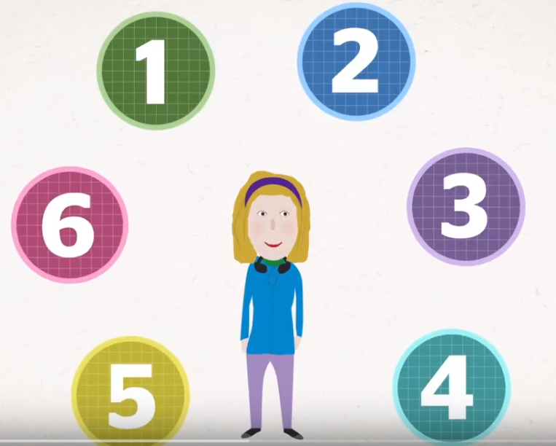

What to do after GCSEs:
Schools, colleges and training providers offer a range of subjects and courses that you can study full-time. You can study:
0:00-
1:59
Work and job-related courses:
NVQs, BTECs, TechBacs and Cambridge Technicals are good qualifications to take if you want to combine hands on, practical learning with studying subjects and technical skills. They are specialist courses which relate to particular jobs, sectors, or subject areas. Depending on what qualifications you take, you can go on to further education, training, or employment, or you can go to university.
A levels:
Watch the video and think about whether A levels are for you. You will need to think about what you want to do in the future as a career and if you want to get on a certain degree course or specific university.
https://safeshare.tv/x/48TE3mqUXow#
©VotesForSchools2019
Notes:
Alternative video link:
1) https://www.youtube.com/watch?time_continue=5&v=48TE3mqUXow&feature=emb_logo
2) https://www.ucas.com/further-education/ucas-progress/getting-started/what-are-my-options-after-gcses-or-national-5s
Images:
Istock
Screenshot from video clip

Slide 20

What to do after GCSEs:
You can also choose to train while you work by taking on an apprenticeship, traineeship or supported internship.
Traineeship: Gets you ready for work or for doing an apprenticeship. They last from six weeks to six months and provide essential work preparation training, literacy and numeracy skills and work experience to get an apprenticeship or other job.
Apprenticeships:
There are lots of apprenticeships available across many different careers. It’s a real job, with hands-on experience, a salary and the chance to train while you work. You’re treated just like all the other employees, with a contract of employment and holiday leave.
https://www.gov.uk/apply-apprenticeship
https://www.apprenticeships.gov.uk/apprentice/what-is-an-apprenticeship#
Supported internship: Just for students with learning difficulties or learning disabilities who want to get a job and need extra support to do this. They last for at least six months and are unpaid. You get work experience and an employer trains you to do a job role. You also get to study for qualifications or other courses to help you get ready to take up a job.
©VotesForSchools2019
Notes:
Alternative video link:
1) https://www.apprenticeships.gov.uk/apprentice/what-is-an-apprenticeship#
2) https://www.gov.uk/apply-apprenticeship
3) https://www.ucas.com/further-education/ucas-progress/getting-started/what-are-my-options-after-gcses-or-national-5s
Images:
Istock
Screenshot from video clip

Slide 21




We need your questions:
Why not use an Ipad to record your class question for our career's experts.
Upload your videos by clicking on this Dropbox link: https://www.dropbox.com/request/RNqdDJzDAj6Kcwom6Kql
Email:
You can email us a query or question at:
info@thewowshow.org
The CareersCast Q&A programme will include experts from each of the employment sectors in the Show who are able to give practical advice about pathways into the careers featured. Please read the guidelines for recording your questions.
©VotesforSchools2020
Notes:
Teachers: Please send us in your questions this week ready for our follow up show. Please make sure the students asking have permission for their photograph or recording to be shown. Thank you.
Images:
1) Istock

Slide 22






Need more information
Students | Useful links
There are lots of resources out there to help you choose the right career path. | Careers in construction can be found at: https://www.goconstruct.org/routes-into-construction/useful-qualifications-to-get-into-construction/
The Royal Navy advice on joining can be found at: https://www.royalnavy.mod.uk/careers/joining/get-in-contact | NHS careers telephone number: 0345 60 60 655
The NHS website supporting qualifications and training: https://www.healthcareers.nhs.uk/career-planning/study-and-training https://www.healthcareers.nhs.uk/explore-roles/allied-health-professionals | The City and Guilds qualifications and apprenticeships: https://www.cityandguilds.com/help/contact-us
Information on creative careers can be found at: https://ccskills.org.uk/careers | ScreenSkills is the industry-led skills body for the UK's screen-based creative industries - animation, film, games, television including children's TV and high-end drama, VFX and immersive technology. https://www.screenskills.com/careers/
BBC Bitesize is also a good source of information: https://www.bbc.co.uk/bitesize/careers | The National Careers Service: https://nationalcareers.service.gov.uk/
©VotesforSchools2020

Slide 23




Supporting
Sponsored by
Produced in association with
Notes:
End slide

