Slide 1



KS3 Lesson
Supporting
Sponsored by

Slide 2
Learning objectives for today
Describe yourself, your strengths and preferences.
Recognise the qualities and skills you have demonstrated both in and out of school that will help to make you employable.
Know how to make plans and decisions carefully including negotiating with those who can help you get the qualifications, skills and experience you need.
Show that you can be positive, flexible and well-prepared at transition points in your life.
Keywords
Career – the job or series of jobs that you do during your working life,
especially if you continue to get better jobs and earn more money.
Aspirations – something that you hope to achieve.
Soft skills – including people's abilities to communicate with each other and work well together.
©VotesForSchools2019
Notes:
References:
1) https://dictionary.cambridge.org/dictionary/english/career
2) https://dictionary.cambridge.org/dictionary/english/aspiration?q=aspirations
3) https://dictionary.cambridge.org/dictionary/english/soft-skills
4) https://www.thecdi.net/Careers-Framework

Slide 3




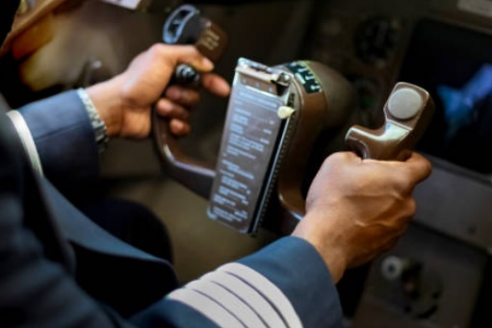


1
Have you thought about a career?
Pair discussion (2 mins)
Talk to a friend about a job or career you are interested in.
Teacher
App creator
Doctor
Builder
Author
Pilot
There are 1000s of careers to think about and some that we don’t even know about yet!
Architect
Designer
Reflect and share (2 mins)
Has anyone thought about how they can make it happen?
Career:
An occupation undertaken for a significant period of a person's life.
©VotesForSchools2019
Notes:
References:
https://www.lexico.com/en/definition/career
Images:
Istock

Slide 4







2
What comes to mind when think about a career?
Salary
Hours
Discuss (2 mins)
What do you think about when you consider your future career?
Qualifications
Position
Environment
Job Satisfaction
Curriculum Vitae (CV):
A short, written description of your education, qualifications, previous jobs, and sometimes also your personal interests, that you send to an employer when you are trying to get a job.
Colleagues
Salary:
A fixed regular payment, typically paid on a monthly basis but often expressed as an annual sum, made by an employer to an employee.
Fun fact!
The average time spent looking at a CV is 5-7 seconds. 1 spelling or grammar mistake and your CV will be thrown away. 76% of CVs are ignored if your email address is unprofessional.
©VotesForSchools2019
Notes:
References:
https://www.lexico.com/en/definition/salary
https://dictionary.cambridge.org/dictionary/english/cv?q=CV
Images:
Istock

Slide 5
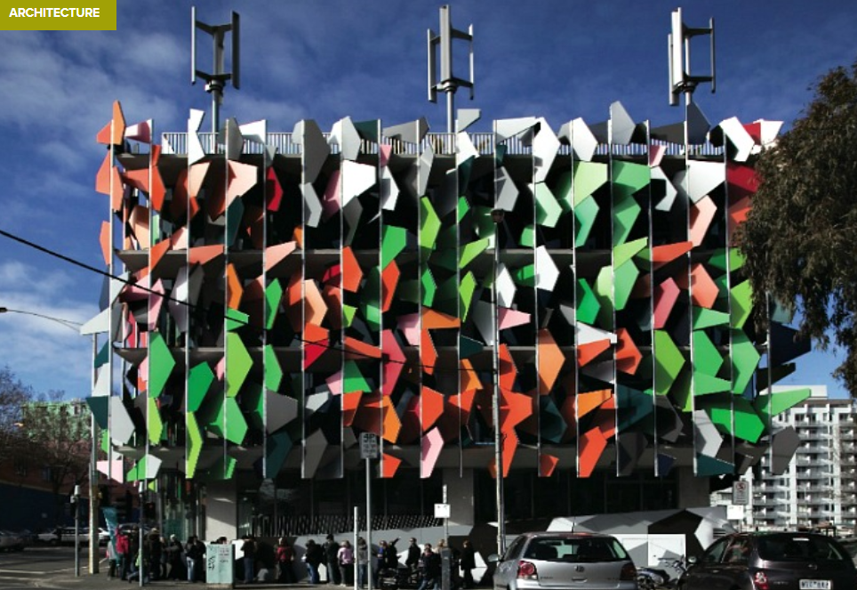
3
Can your career save the environment?
Discuss (4 mins)
Which careers do you think could save the environment?
The environment:
The air, water, and land in or on which people, animals, and plants live. :
This crazy building is Australia's very first carbon neutral building. The Pixel Building was designed by Studio505 is an amazing example of what is possible in terms of energy efficiency, renewable energy, water collection, waste reduction and a green roof. It is capable of collecting all of its own water and generating all of its own energy.
Environmentalist
Scientist
Politician
Engineer
Designer
Which other careers?
Notes:
References:
https://dictionary.cambridge.org/dictionary/english/environment
https://inhabitat.com/pixel-building-australias-first-carbon-neutral-building-is-now-complete/
Images:
1)

Slide 6




3
Can your career save the environment?
The UK is at the forefront of wind energy. That’s not really surprising since it has about the best wind resource in the world, in Scotland especially.
The UK is aiming to get at least 15% of its energy from renewable sources by 2020. This means that we’ll all start to use more wind, solar, hydro, biomass, tidal and wave energy in the near future.
Do you have any great ideas for future energy sources, could you save the world?
Renewable energy:
Energy that is produced using the sun, wind, or from crops, rather than using fuels such as oil or coal.
Notes:
References:
https://dictionary.cambridge.org/dictionary/english/renewable-energy
https://physicsworld.com/a/wind-power-in-the-uk/
https://www.britishgas.co.uk/energy/guides/renewable-energy-types.html
Images:
Istock

Slide 7
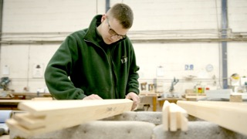

3
Can your career save the environment?
Discuss (2 mins)
In the film we met Bailey, an apprentice. How can working with wood be good for the environment?
Fact file:
Latest figures show that the construction industry contributed £117 billion to the UK economy, 6% of the total. There are 2.4 million construction industry jobs in the UK - that’s 6.6% of all jobs.
In the next five years it is expected that 232,000 jobs will be created in the industry.
Engineer:
A person whose job is to design or build machines, engines, or electrical equipment, or things such as roads, railways, or bridges, using scientific principles.
Notes:
References:
https://dictionary.cambridge.org/dictionary/english/engineer
Images:
Istock

Slide 8



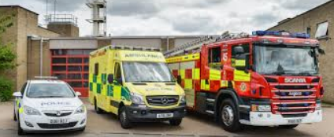
4
Can your career save a life?
Table Activity (3-5 mins)
What careers can you think of that could save a life? Have any of you considered one?
Police Officer
Nurse
Surgeon
Paramedic
Fire Fighter
Doctor
Careers helping people come in all shapes and sizes. You can get hands-on in a healthcare or emergency services job, think your way around problems as a social worker or lawyer, or create broader benefits for society in a career such as science or engineering.
Counsellor
Who else?
Notes:
References:
https://targetcareers.co.uk/careers-advice/choosing-your-career/385829-i-want-a-career-helping-people-what-are-my-options
Images:
1- Istock

Slide 9
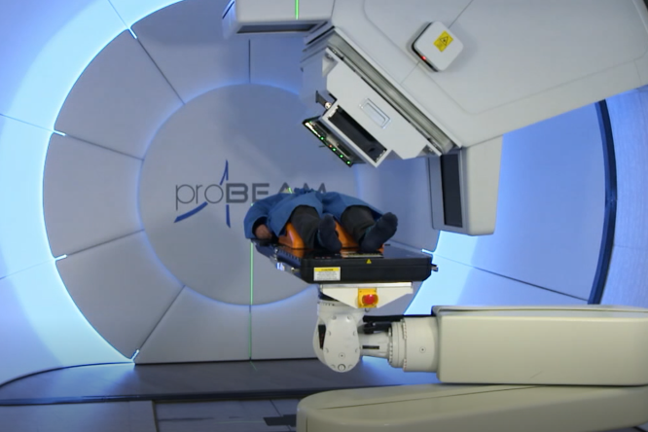
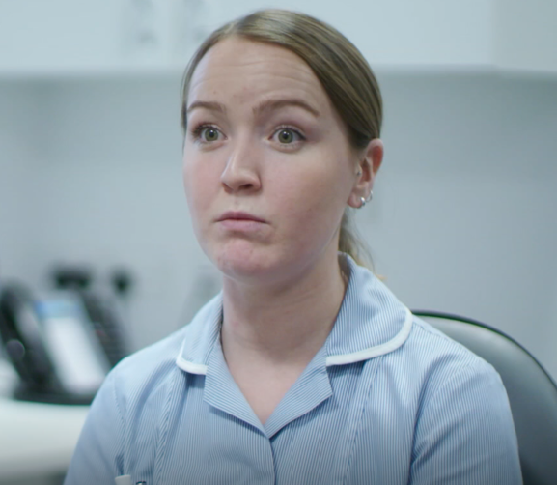
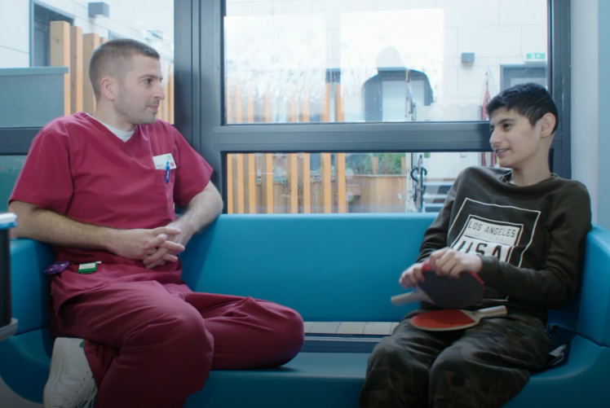
4
Can your career save a life?
In the film we saw David, the Superintendent Proton Radiographer who oversees people’s treatment for cancer with proton therapy.
In the film we also saw Georgia, the paediatric nurse who looks after children throughout their cancer treatment.
Fact file:
The NHS is the biggest employer in Europe with 1.5 million employees. There are 360 different job roles, taking in a huge array of different skills and qualifications. It means that there’s probably a career opportunity in every town and city in the country at your local hospital or health authority.
Paired discussion (3-5 mins)
What qualities would you need to work in a caring career?
How important is communication?
Notes:
References:
1) https://www.youtube.com/watch?time_continue=142&v=PSrpfLmxwu0&feature=emb_logo Christie hospital proton therapy
Images:
1) Screenshots from the film.

Slide 10

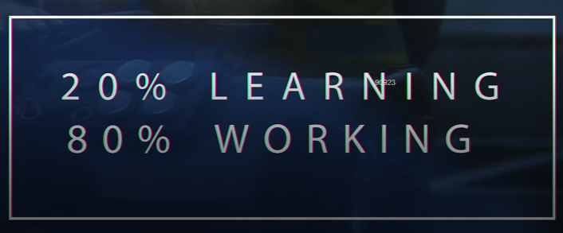
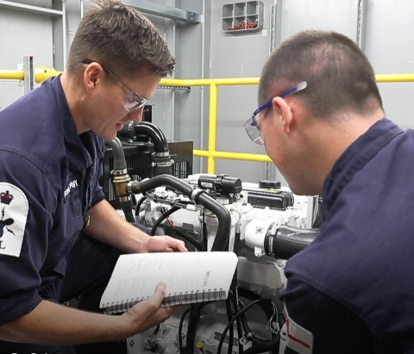

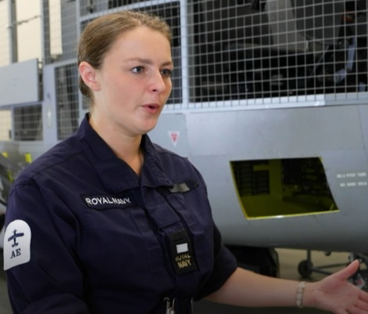
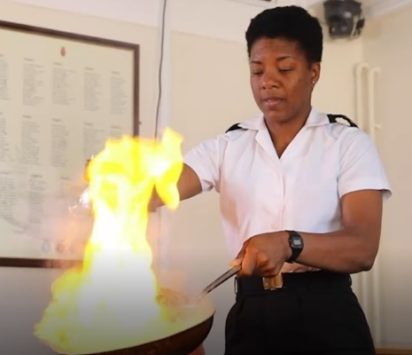
5
Can your career keep us safe?
Paired task (1 min)
In the film we saw all of the careers open to you in the navy. How many can you name?
Chef
The Navy is an excellent place to learn skills for a career whilst earning a salary. A Job is guaranteed after you complete your training.
Logistics
Diver
Firefighter
Aircraft Controller
Engineer
©VotesForSchools2019
Notes:
Images:
1) iStock
2) Screenshots from the film

Slide 11
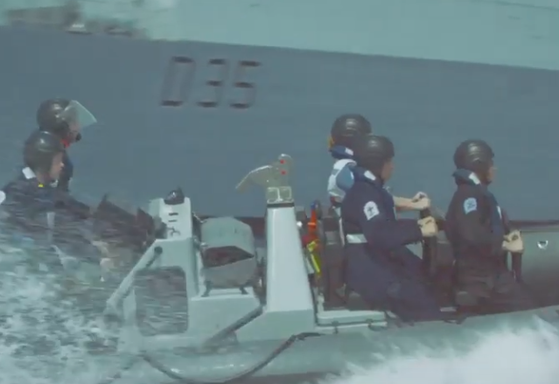
5
Can your career keep us safe?
0:00-
1:02
Paired talk (2 min)
Watch the Royal Navy recruitment video. What do you think are its messages?
Fact file:
Making sure the force of 30,000 men and women can protect our nation’s interests all over the world, is no small task. The Naval service has nine branches, each performing a vital role. They keep the ships, submarines, aircraft – and people – operationally effective on every mission, 365 days a year. Depending on skills and experience, recruits can join a branch at either rating or officer level.
There are many careers in services that help keep us safe. Police officers, firefighters, soldiers, doctors, solicitors and many more all keeping us safe in different ways.
These roles come with various entry qualifications and requirements.
https://safeshare.tv/x/KXTCzzden2o#
©VotesForSchools2019
Notes:
Alternative video link:
1) https://www.youtube.com/watch?v=KXTCzzden2o#action=share Navy recruitment
Images:
1) iStock
2) Video screenshot

Slide 12




5
Can your career be creative?
Paired talk (1 min)
What creative careers can you think of?
Are you creative, would you like a creative career?
Designer
Gamer
Artist
Film maker
Actor
Curator
©VotesForSchools2019
Notes:
Images:
1- iStock

Slide 13

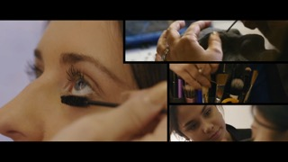



5
Can your career be creative?
Paired discussion task (1 min)
Are you creative, would you like a creative career?
Theatre Technician
Make-up Artist
Fashion Photographer
Music Producer
Music Producer
©VotesForSchools2019
Notes:
Images:
1- iStock

Slide 14





6
Do you have the skills?
Individual task (2-4 mins)
What qualities do you need to be successful in your career? Write them down. Then discuss why you would need these and whether you think you have what it takes.
Good listener
Resilient
Creative
…
‘Soft skills’ are so important to employers. They are things you can work on yourself to make you more successful.
…
…
Qualities:
A characteristic or feature of someone or something.
…
…
©VotesForSchools2019
Notes:
Images:
1) Istock

Slide 15
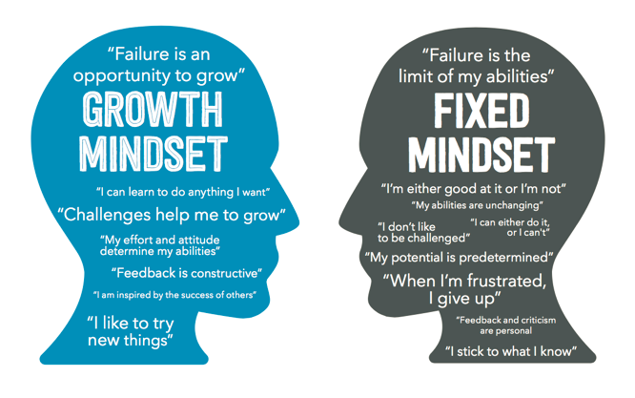
6
Do you have the skills? Growth mindset
Paired discussion
(2-4 mins)
Do you know what a growth mindset is?
Do you have a growth mindset?
Growth mindset occurs when we believe our intelligence and abilities can be improved upon with effort and the right strategies.
Fixed mindset occurs when we believe our intelligence and abilities cannot be altered in a meaningful way.
Fact file:
The top ten attributes that employers say they look for in young employees are: Commercial awareness, communication, teamwork, negotiation and persuasion, problem solving, leadership, organisation, resilience, ability to work under pressure, and confidence.
©VotesForSchools2019
Notes:
Reference:
https://biglifejournal.com/blogs/blog/teach-growth-mindset-kids-activities
https://www.excelsior.edu/article/growth-mindset/
Images:
1

Slide 16
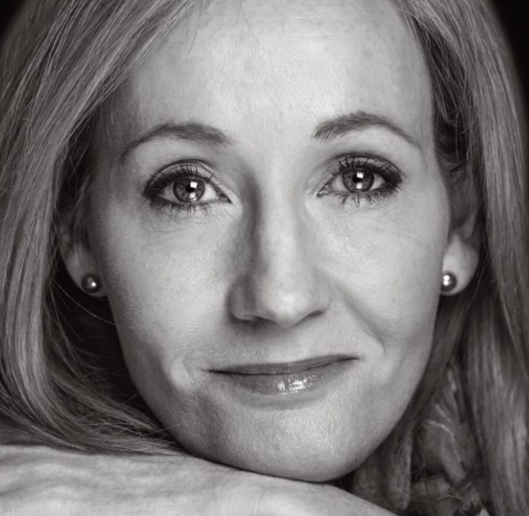
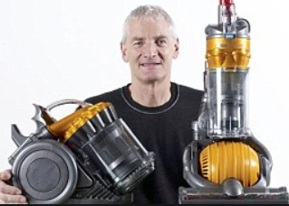
6
Do you have the skills? Resilience
Individual task
(3 mins)
Write down 3 goals you have for your life.
Have you thought about how to get there?
J K Rowling had her Harry Potter book turned down 12 times before it was eventually published.
Sometimes reaching our goals takes huge amounts of resilience. It doesn’t always happen the first time we try.
When Dyson invented his first Dual Cyclone vacuum cleaner, which hit stores in 1993, he spent 15 years creating 5,126 versions that failed before he made one that worked.
Resilience:
The ability to be happy,
successful, etc. again after something difficult or bad
has happened.
Resilience encourages you to believe that anything can be achieved when they put their mind to it.
©VotesForSchools2019
Notes:
References:
https://www.today.com/popculture/j-k-rowling-s-original-harry-potter-pitch-was-rejected-t117763
https://en.wikipedia.org/wiki/James_Dyson
Images:
1) https://www.today.com/popculture/j-k-rowling-s-original-harry-potter-pitch-was-rejected-t117763

Slide 17


6
Do you have the skills? Oracy
Paired discussion task (1 min)
With employers now rating communication skills as their highest priority, above even qualifications, the ability to express ideas is more important than ever before. Indeed, a recent study estimated pupils contributed on average just four words per lesson, while another revealed that children with good communication skills are four times more likely to get five A*-Cs at GCSE.
Debating helps students
develop their oracy skills
Oracy:
The ability to speak clearly and grammatically correctly.
©VotesForSchools2019
Notes:
References:
https://dictionary.cambridge.org/dictionary/english/oracy
Images:
1

Slide 18
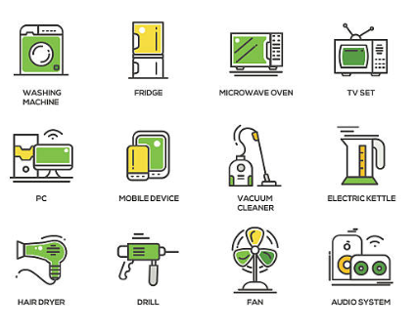
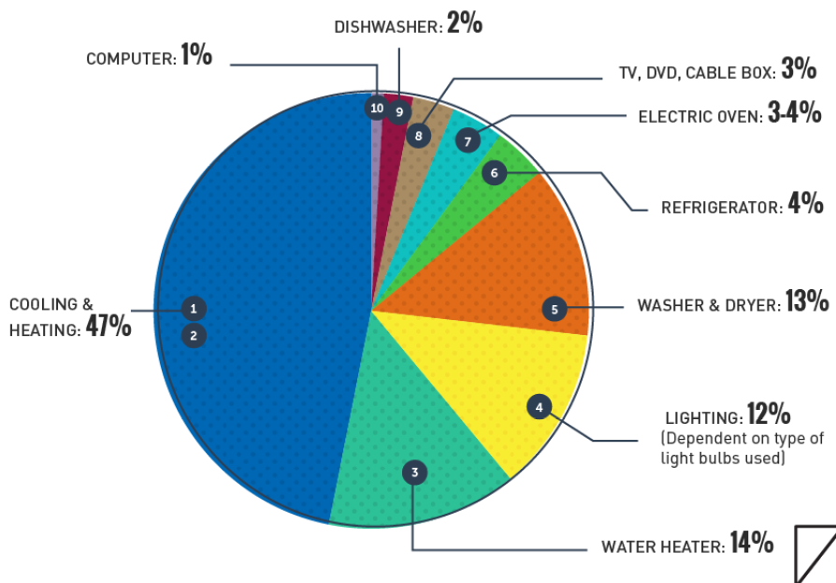
6
Do you have the skills? Critical thinking
Paired discussion (5 min)
What would happen if we had to live in a world without electricity? What could we use instead?
Even just thinking about the home shows us how important it is in our lives.
Energy use
To be skilled at using critical thinking to solve problems, you will first need to overcome any bias you may have on a particular subject or problem. Depending on the problem, you may need to collect information in order to solve it.
Critical thinking:
The process of thinking carefully about a subject or idea, without allowing
feelings or opinions to affect you.
©VotesForSchools2019
Notes:
References:
https://dictionary.cambridge.org/dictionary/english/critical-thinking
Images:
Istock

Slide 19


7
Find out more:
0:00-
1:58
What about vocational qualifications?
Vocational education is education that prepares students for work in a specific trade, a craft, as a technician, or in professional vocations such as engineering, accountancy, nursing, medicine, architecture, or law. Craft vocations – such as jewellery making, or metalwork such as those training to become silversmiths – are usually based on manual or practical activities and are traditionally related to a specific trade or occupation.
Watch the video about GCSEs
Which GCSEs should I take?
This is really down to a combination of things, including your own interests, which optional subjects your school allows you to choose, and your future plans.
You’re in the driving seat now, and you’re beginning to shape your own education! This is the first time you can focus on the subjects you like the most and feel you will do well at.
https://www.bbc.co.uk/bitesize/articles/zrjh92p
©VotesForSchools2019
Notes:
Alternative video link:
https://www.bbc.co.uk/bitesize/articles/zrjh92p Which GCSEs to take
https://www.allaboutschoolleavers.co.uk/school-leaver-options/college/what-is-vocational-education
Images:
1) Istock

Slide 20




8
We need your questions:
Why not use an iPad to record your class question for our career's experts.
Upload your videos by clicking on this Dropbox link: https://www.dropbox.com/request/RNqdDJzDAj6Kcwom6Kql
Email:
You can email us a query or question at:
info@thewowshow.org
The CareersCast Q&A programme will include experts from each of the employment sectors in the Show who are able to give practical advice about pathways into the careers featured. Please read the guidelines for recording your questions.
©VotesforSchools2020
Notes:
Teachers: Please send us in your questions this week ready for our follow up show. Please make sure the students asking have permission for their photograph or recording to be shown. Thank you. Please use the guidelines provided for recording questions.
Images:
1) Istock

Slide 21






Need more information
Students | Useful links
There are lots of resources out there to help you choose the right career path. | Careers in construction can be found at: https://www.goconstruct.org/routes-into-construction/useful-qualifications-to-get-into-construction/
The Royal Navy advice on joining can be found at: https://www.royalnavy.mod.uk/careers/joining/get-in-contact | NHS careers telephone number: 0345 60 60 655
The NHS website supporting qualifications and training: https://www.healthcareers.nhs.uk/career-planning/study-and-training https://www.healthcareers.nhs.uk/explore-roles/allied-health-professionals | The City and Guilds qualifications and apprenticeships: https://www.cityandguilds.com/help/contact-us
Information on creative careers can be found at: https://ccskills.org.uk/careers | ScreenSkills is the industry-led skills body for the UK's screen-based creative industries - animation, film, games, television including children's TV and high-end drama, VFX and immersive technology. https://www.screenskills.com/careers/
BBC Bitesize is also a good source of information: https://www.bbc.co.uk/bitesize/careers | The National Careers Service: https://nationalcareers.service.gov.uk/
©VotesforSchools2020

Slide 22




Supporting
Sponsored by
Produced in association with
Notes:
End slide

